Slide 1
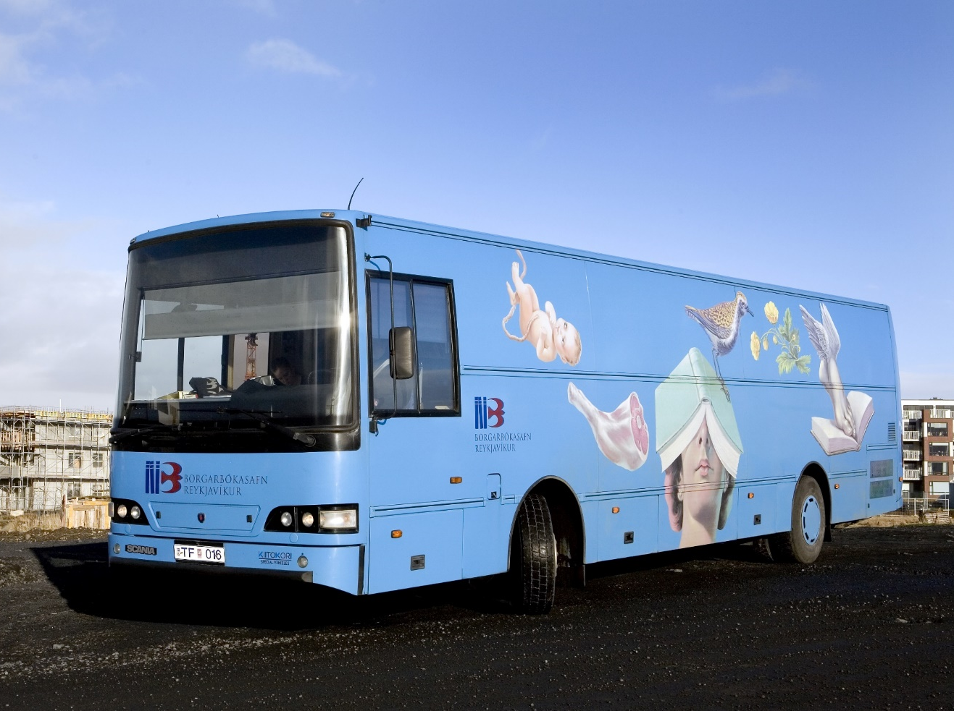
On the Move for 50 Years
Notes:
Hello. My name is Guðríður Sigurbjörnsdóttir and come from Reykjavík City Library. Thank you so much for inviting me to this conference.

Slide 2
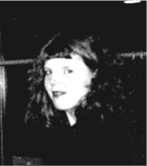
23 years at Reykjavík City Library
BA in Spanish 1997
MA in Human Resource Management 2005
Branch manager since 2015
One neighbourhood branch
One mall branch
One mobile library
Notes:
I have been with the Reykjavik City Library since 1996 and have played many roles there, small and big.
I started out as a library assistant. When I finished my bachelor in Spanish in 1997, I was promoted to a librarian, regardless of my lack of a library-related-degree. I got a Masters degree in HRM in 2005 and in 2008 I became Project manager until 2015, when I took on my current role as branch manager and I am in charge of 2 branches, one small neighbourhood branch and another one in a big shopping mall and the bookmobile.

Slide 3
The Early Years
The service was launched 1969
Served the outskirts of Reykjavík
Joined by Shorty from 1971-2000
Together they contained:
12.000 items
40 stops
1000 loans a day
Notes:
Inspired by our Swedish counterparts, our city librarian in the late 50s pushed for the bookmobile to become reality, but it would take many years of pushing for that birth to be realized. It wasn’t until right-hand traffic was adapted in Iceland in 1969, and the public transport system had to be modified accordingly, that the bookmobile finally arrived. One of the retired busses, originally from 1955, got a make-over and became Iceland’s first Bookmobile in 1969. It got the name Höfðingi, or Chief in English.
In the early years the bookmobile provided library services for booming new neighborhoods in Reykjavík, where there weren’t many other services or avenues for recreation. The bookmobile was an instant success, which showed that its service was wanted. Back then there were two desks in the bus, one in the front for lending and another one at the back for returns. There were up to four people working in the bus at the same time.
Its popularity warranted a second, though smaller, bookmobile, Stubbur (or Shorty) which was Finnish-built and joined the force in 1971.
Circulation was rapid in the early years of the bookmobiles and by the 10 year anniversary of the program in 1979, 2.4 million items had been lent out to the inhabitants of Reykjavík, nearly a thousand copies a day on average.
At the time the bookmobiles had their own private collections, which counted 12.000 items and the numbers of stops increased to a maximum of 40.

Slide 4
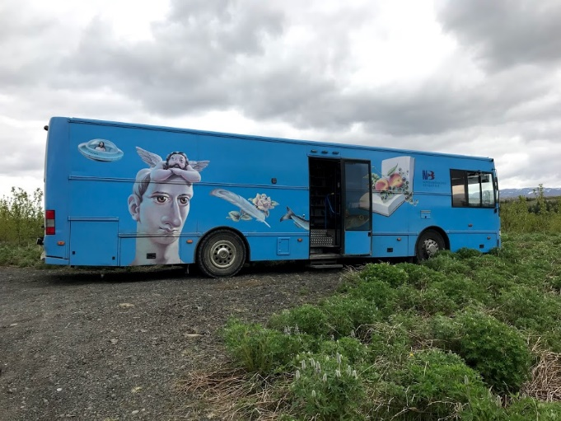
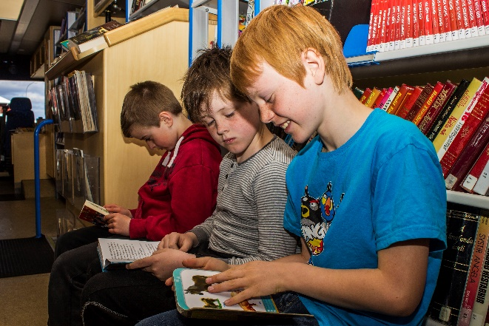
The bookmobile today
Current vehicle from 2000
3 full time jobs
4000 items
800-1000 loans a month
30 stops
Runs from September to June
Notes:
In the year 2000 a new bookmobile took over the title of Chief, and replaced both of the old ones. The new one was a Scania model, with the body built by the same Finnish company that had built Stubbur or Shorty.
The new Chief had an artistic outside, illustrated by artist Gunnar Karlsson.
As of now there are 3 full time jobs in the bookmobile, split between 5 employees, i.e. 2 drivers and 3 assistants.
The size of the collection has decreased a little and consists now of 4000 items, books, magazines, DVDs, CDs audiobooks and so on.
The loans have also decreased a lot and are now between 800 -1000 in the average month.
The bookmobile runs 4 days a week from September to June. The stops are 30, among them are schools, kindergartens, retirement homes, residents and most neighborhoods in Reykjavík.

Slide 5
We are on crossroads
Notes:
In the 50 years of the bookmobile service, Reykjavík has seen a lot of changes to its structure and population. We have taken that in to consideration in our libraries and a lot has changed there, but the services of the bookmobile have perhaps not been adapted in the same way. The service that we now provide there is more or less the same as it was in it‘s heydays. The need for this kind of „traditional” service has diminished through the years, which can be clearly been seen from the lending and guest data.
And right now we’re standing on crossroads.
The current bookmobile has been running for nearly 20 years and is due for replacement. We have asked for the funding for a new one, but these things take time and we have not got any answer yet. We don‘t even know if we‘ll take it, if we get the funding. Running a bookmobile is costly, so we really have to think carefully before taking our next steps.
(The cost of the bookmobile is around 28.000.000 ISK which is about 2.8% of our annual costs. We could use this money to strengthen the service in our libraries, which are chronically underfunded. )

Slide 6
Things to think about
Who will we serve?
What kind of service?
Where to stop and when?
What kind of employees?
Notes:
If we get the funding and decide to invest in a new bookmobile we will get the opportunity to completely rethink or redefine it’s role.
The first steps in this process can be summed up with these questions:
Who will we serve?
Which services will we provide
Where to stop and when
What kind of employees do we need?
It is essential to get the answer to these questions, at the least the first three ones, with the community, our users and non users, as we should design our services to their needs and longings. We have not done that yet, so I have tried to answer them on the next slides, but they are just my and the staff’s speculations and not based on any research or investigation. Just on our instinct and feeling.

Slide 7
Who will we serve?
underserved locations
elderly and homebound
schools and kindergartens
busy people
families
immigrants
Notes:
From the beginning the emphasis of our service has been on the elderly, the disabled, children and users in otherwise underserved locations.
But these groups use our services less and less, and we have some thoughts about why that is.
Firstly the number of underserved locations are disappearing as the library branches in Reykjavík has gone from three small ones to six relatively big ones and another one on the way. So there is a branch in almost every neighborhood in Reykjavík and thus much easier to seek the service at the library. Most children under the age of 17 now have access to school libraries (run by the municipality) so they and their teachers don’t need us like they used to. And for the elderly and disableb, we offer the service „Book to the door“, so they get books and other material sent home on a regular basis and thus do not visit the bookmobile as much as the they did before..
And then of course our users have easy access to all the information and entertainment they want or need without leaving their homes, in many cases even without standing up!
With this in mind I think it is necessary to turn our focus a little bit and ask ourselves if there is a group or groups that we should pay more attention to than we have done until now. As I mentioned before it is essential to work this out with the community but I have an idea that we could put more emphasis on busy people, families and immigrants. The beauty of mobile libraries is the fact that they are indeed mobile and thus able to bring the service to the people. In the modern society everybody is very busy and in lack of time so I think that everybody would be very thankful to get the service they need brought to them.
Small kids find the bookmobile very exciting and love to visit it so I think we should jump at this interest and offer them and their families some services and events they can enjoy together.
Immigrants is an expanding group in Reykjavík and it would be interesting to design the service with them in mind. I do not have any special ideas right now, put I think this is an opportunity for us.

Slide 8
What kind of service?
personal service
interesting collection
urban office; printing, scanning, small meeting room,
waste disposal for recycling
pop up events
participation in all kind of festivals and events
Notes:
What makes the bookmobile so special is the personal service our users get there. That is absolutely something we would want to keep. To serve the new groups and the old ones as well I think it is essential that the mobile library has it’s own collection and someone to oversee it. When the service of the bookmobile began it had its own collection but then it was changed and it shared the collection with one of the branches. In many cases the bookmobile got the material that did not get much attention in that branch. But we changed that again 2 years ago and now our focus is for the collection to be as interesting and new as in any other branch. And in regards to the immigrants I think it would be a good idea to have books in their language and thus bring them to them instead of collecting them in one branch as we do now.
Even though space is a limited resource in mobile libraries it’s possible to fit more things than have traditionally been in the bookmobiles.
With the latest technologies in mind it could even become an urban office with some basics, like a a printer and scanner, as we have seen that a lot of people come to the library just for that printing out or scanning.
Since in Reykjavík the recycling services, for lightbulbs and batteries, are few and far between, the bookmobile could expand into the recycling “market”.
The bookmobile could also be a venue for all kind of small events that do not require much space or much time, short meditation lessons, speed dates, outdoor yoga classes, story hours in different languages and so on, and so on. The ideas are out there, it just needs a creative mind to capture them.
And the bookmobile could take part in all kind of festivals and events in Reykjavík, alone or in cooperation with others.
While these ideas are probably old news to many of you, they are new to us as we have not done much of this kind for the last years.

Slide 9
Where and when?
located where the people are
opening hours
Notes:
Plotting the stops of the bookmobile is an art-form and should be an ongoing process. It is very important to stop where the people are, whether by their homes or where they gather, like in shopping malls, bus-stations, healthcare centers, markets and swimming pools to name a few. It would be very convenient to pop into the bookmobile at the same time as you do your groceries or go to the swimmingpool.
The opening hours should be suitable for the users. I think it would be convenient to stop in the daytime and in early afternoon in well sought places and in the late afternoon and in the evening in the residential areas, when the people have come home.

Slide 10
What kind of employees?
driver
library assistants
project manager
Notes:
We all know how important the staff is. We can have all kind of wonderful ideas but nothing happens without our people. The employees who are now working in the book mobile are absolutely fantastic. As I said before there are 2 drivers and 3 assistants. Most of them have been working in the bookmobile for many years by now and know all the users very well and provide them with excellent, personal service. Last year, for example, one of the drivers retired after 49 years, driving the bus from the beginning, and thus knew about all the secrets and needs of our users.
If we are going to expand our services, perhaps we need to take a look at our group of employees. A driver and library assistants are certainly essential but I think a project manager would be a good supplement to the group in order to carry our ideas out.

Slide 11
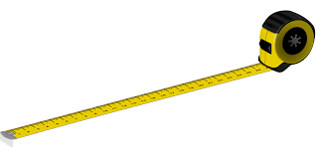
Other things
kind and size of the mobile library
technology
marketing
defining measures
Notes:
When we have defined our service there are few more things that we should bear in mind.
The most obvious thing to consider is the kind, size and shape of a bus or mobile library to buy. Then we have to decide on an eye-catching, self-explanatory design. This is usually the case with bookmobiles, I have, at least, only seen beautiful and colorful ones.
Technology is an important factor and it is vital to take a good look at all opportunities in order to not be lagging behind. Marketing is also something that we should take good care of. Brochures, posters and easily accessed information online are very important as the visibility of the designated stops.
I also think that we should think carefully about how we are going to define measures of the program. Now the outcome of our service depends on the number of guests and loans. Of course they say a lot about the use, but that is not all. The bookmobile is kind of an advertisement in itself and as such draws the attention to the service of the library as a whole. It also serves as a reminder that there are books to be read, which plays right into our hand as that’s just what we want everybody to remember. And the social benefits of the public libraries are well known and even though the bookmobile is much smaller I think it has the same effect. It could be a less barrier for someone to go to a bookmobile than a library as it is small and the service personal
And last but not least I know that the bookmobile brings happiness and joy wherever it goes.

Slide 12
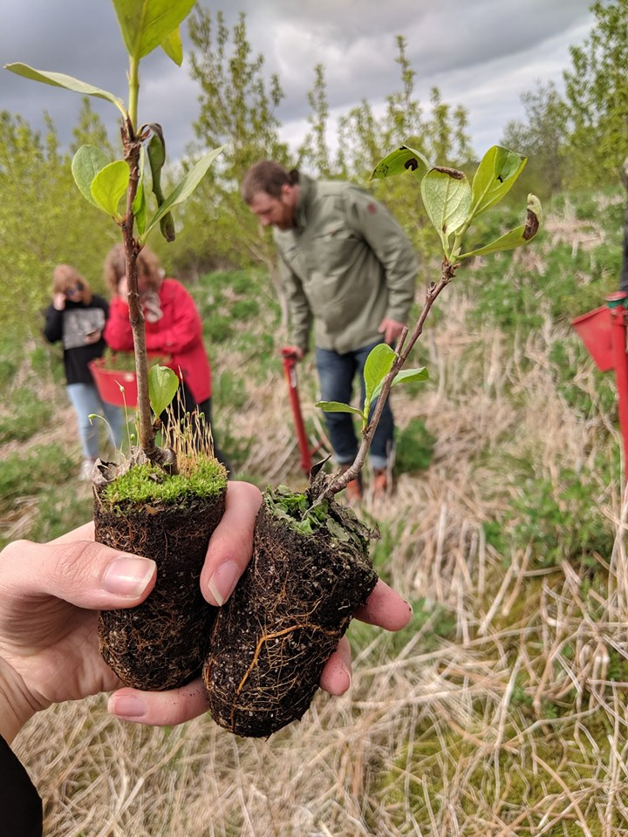
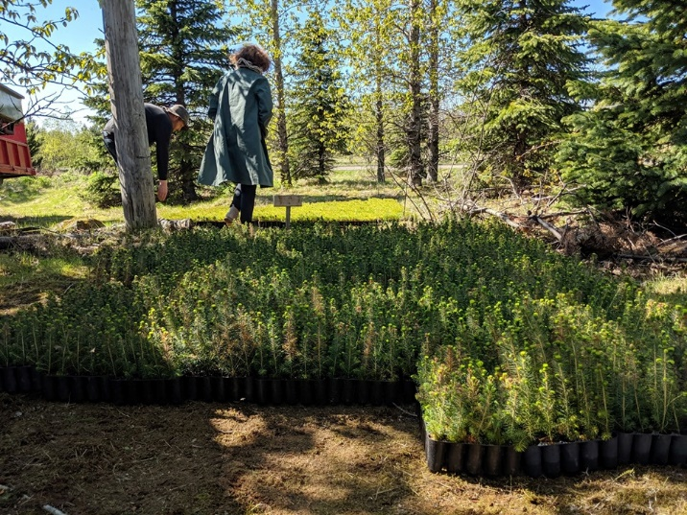
Offsetting the Carbon Footprint
Settlers in an afforestation
Planting 5000 trees
Notes:
To end this I am just going to tell you about few things that we have done this spring and summer. The Bookmobile turned 50 this year and to commemorate the anniversary we wanted to do something special. A colleague of mine came up with the idea of offsetting the bookmobile’s carbon footprint by planting some trees. So we became settlers in an afforestation close to Reykjavík and got a fairly big, stony and rough land that is now all “ours” to take care of. According to our calculations we have to plant 5000 trees in order to offset the carbon footprint. We’ve already planted 1800 trees and are planning to plant at least 700 more this year, then the rest in 2020.
The land is “ours” so we have a lot of work to do for the next years to come, to make the location an attractive place for the employees of Reykjavík City Library and the public in general. So if we chose to let go of the bookmobile we will a least have a living monument of it.

Slide 13
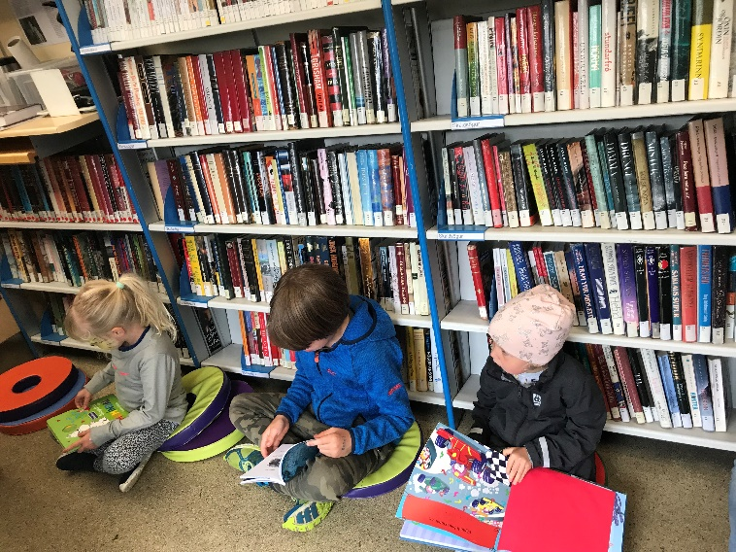
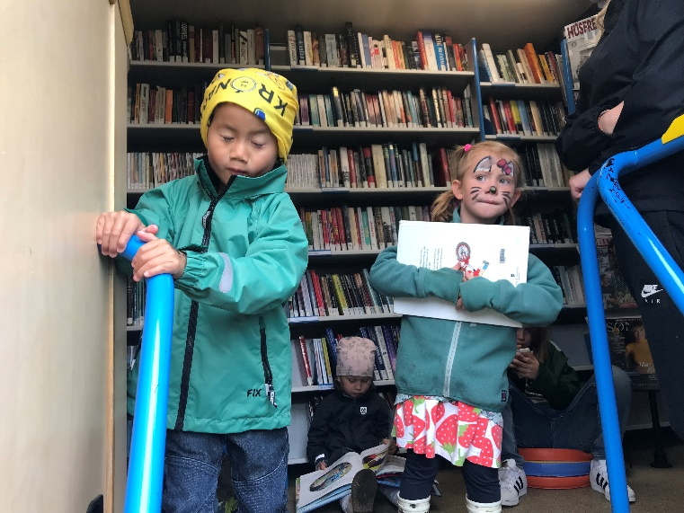
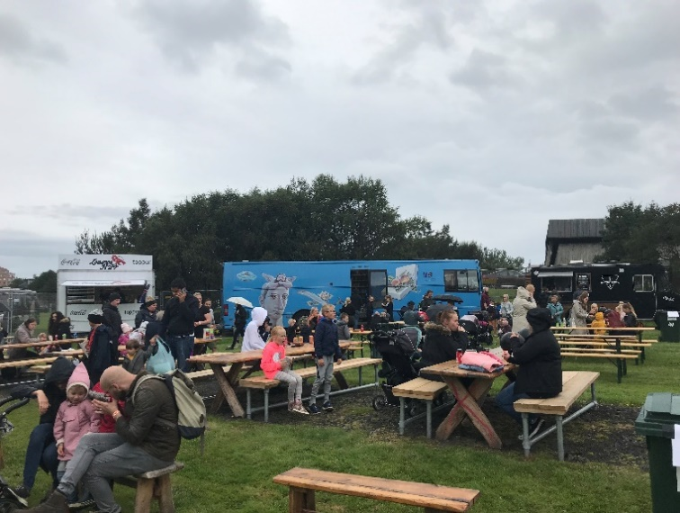
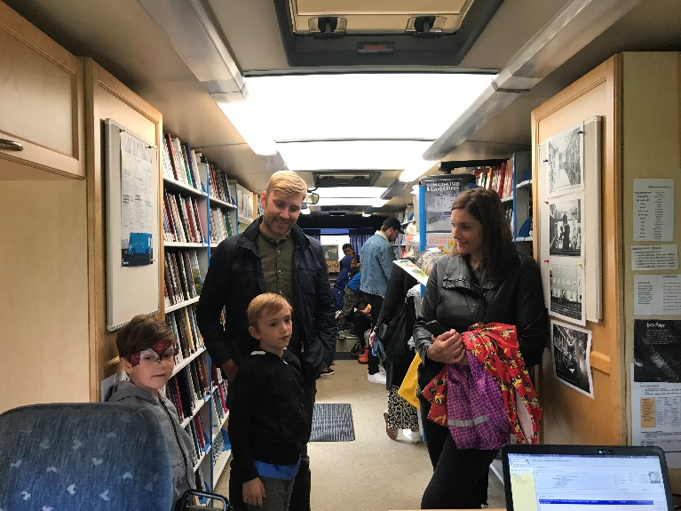
Children’s festival in July
Notes:
In the end of July we took part in a children’s festival in Reykjavík. The bookmobile got a lot of attention and was full of kids and parents the whole day, who found the bus very interesting. It was so nice to see how an event like this, that does not take much effort nor preparation, can be such a success. We had planned to have some story hours, but there was no need for that as the kids and the families just created them themselves.

Slide 14
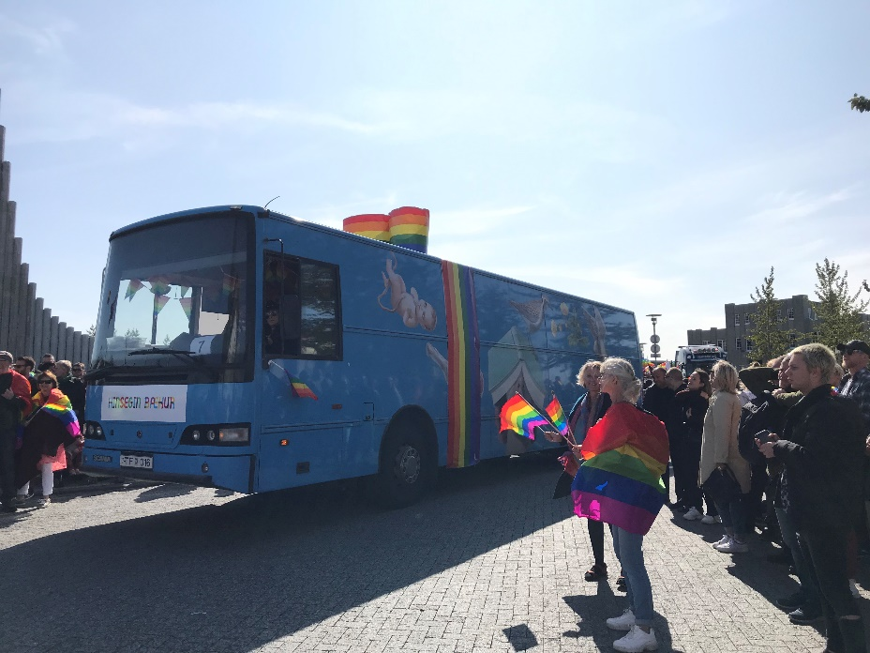
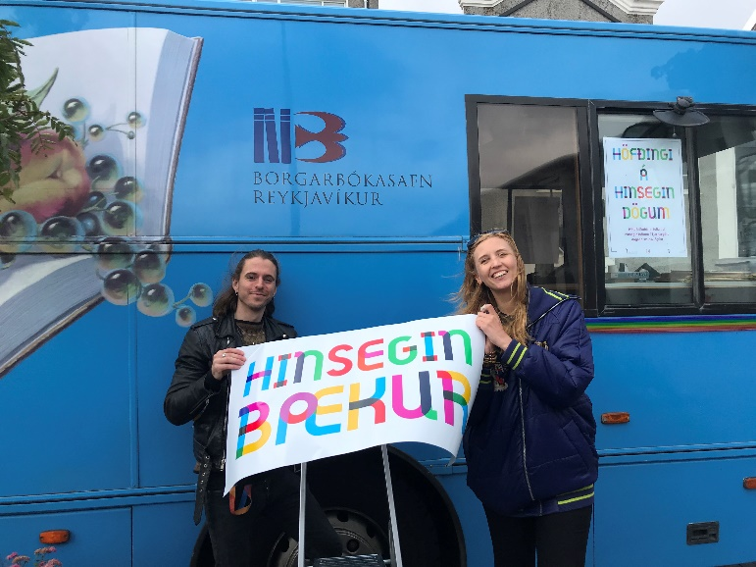
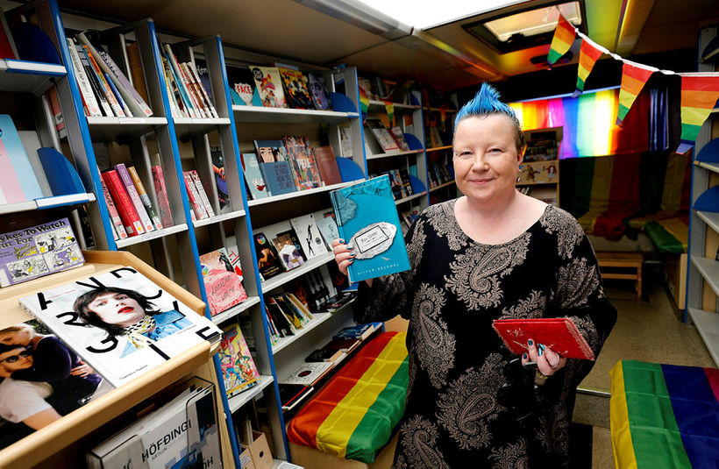
Reykjavík Pride
Notes:
Last but least did we take part in the annual Reykjavík Pride in August. This year was the 20 years anniversary of the Gay Pride festival so there was a program, full of queer events and happenings for more than a week. And our bookmobile was there. We removed the collection and replaced it with all sorts of queer books from our libraries. The bus was then located by the City Hall for a week, open daily to the public and we got much attention and many new visitors. We ended our participation with taking part in the Gay Pride parade itself. We contacted the Icelandic association of writers and invited them to walk with us in the parade. Which many of them did and so did many others. One could hear from everywhere, “look there is the bookmobile”, see the bookmobile is there. This was very much fun we were so proud of ourselves.

Slide 15
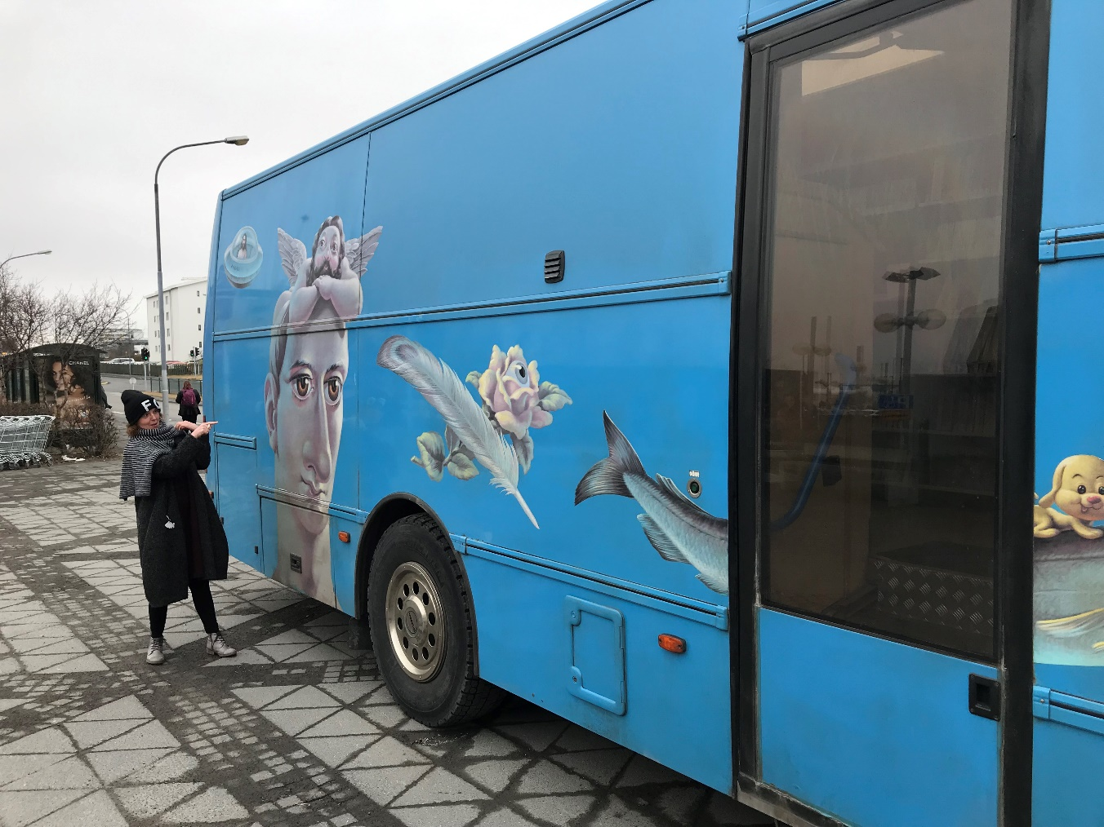
Thanks!

