Slide 1
New Full-Electric Mobile
Library Car to Turku Finland
Jyri Wuoristo, Teemu Hiltunen, Tiina Vesalainen
1

Slide 2
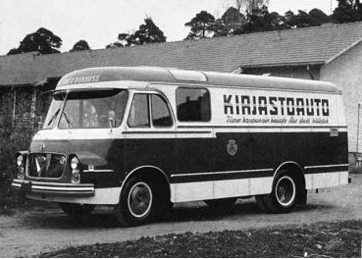
1961 - 1975
2

Slide 3
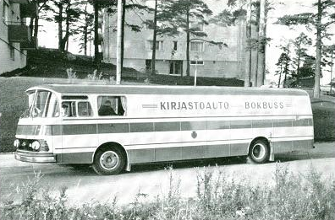
1964 - 1978
3

Slide 4
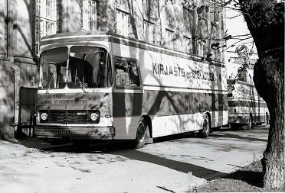
1970 - 1987
4

Slide 5
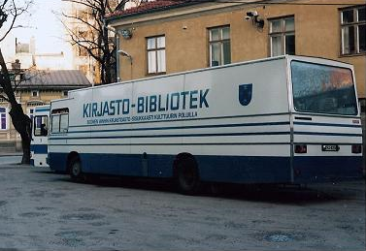
1975 - 1997
5

Slide 6
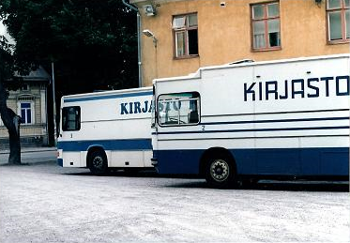
1978 - 1987
6

Slide 7
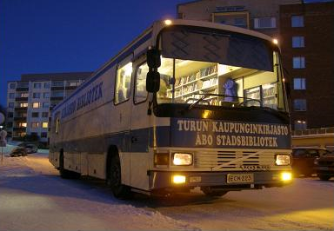
1987 - 2008
7

Slide 8
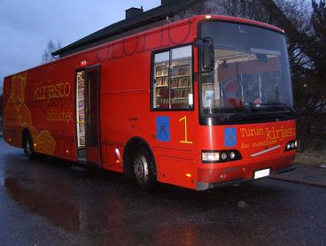
1997 -
8

Slide 9
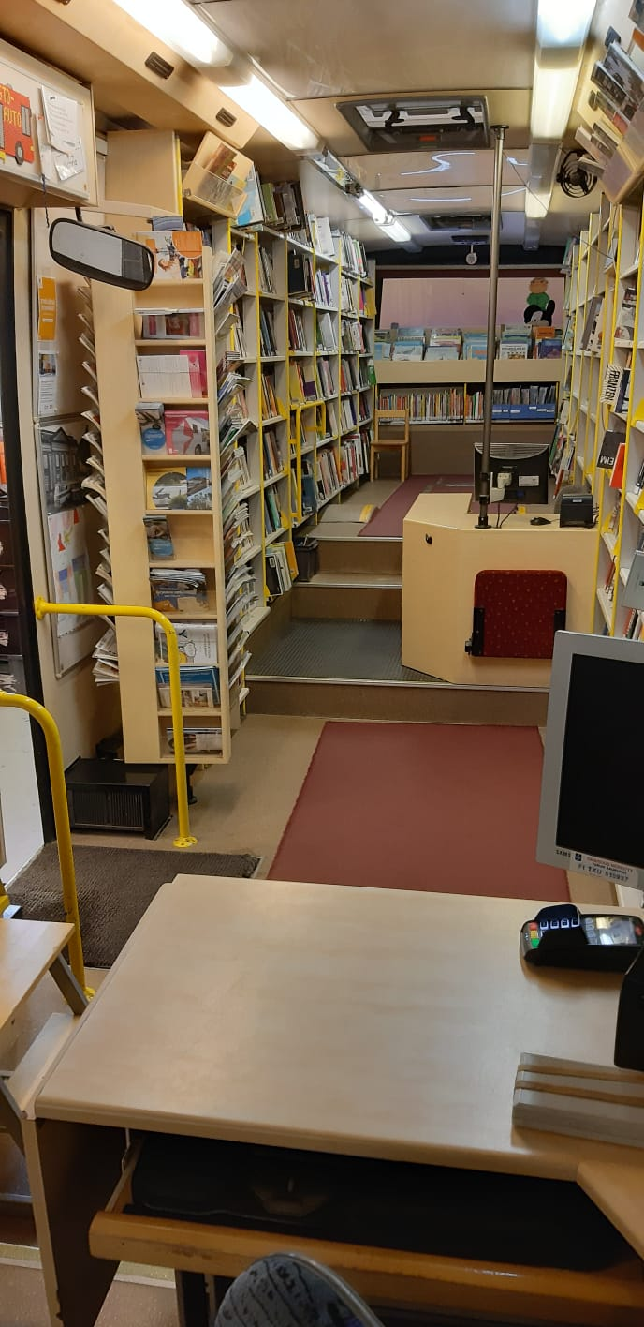
Picture from the inside of the 1997’s low entry mobile library
9

Slide 10
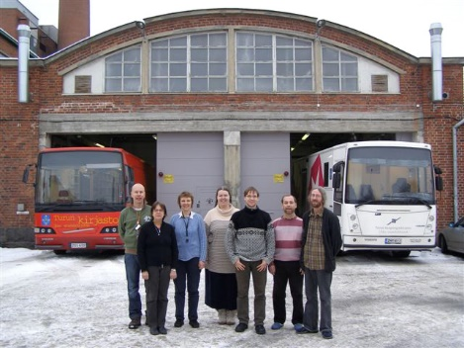
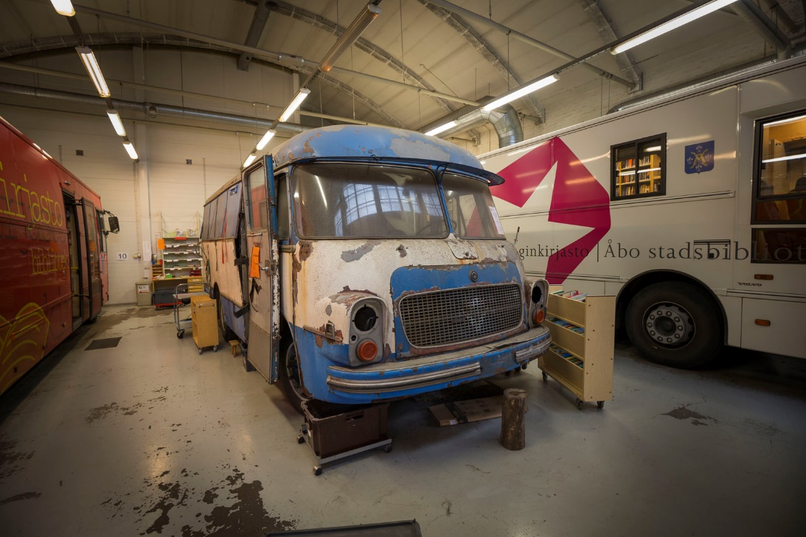
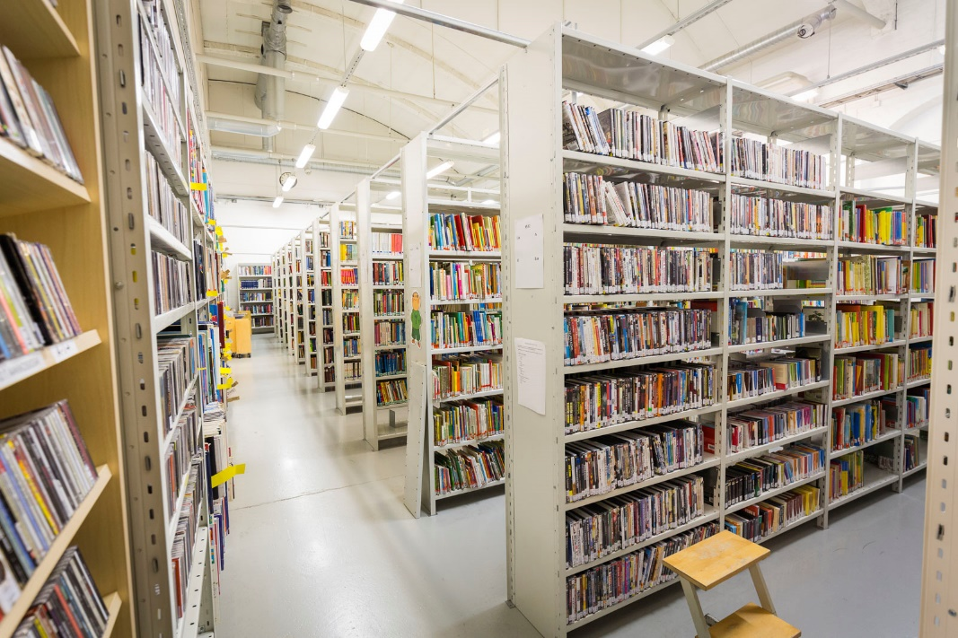
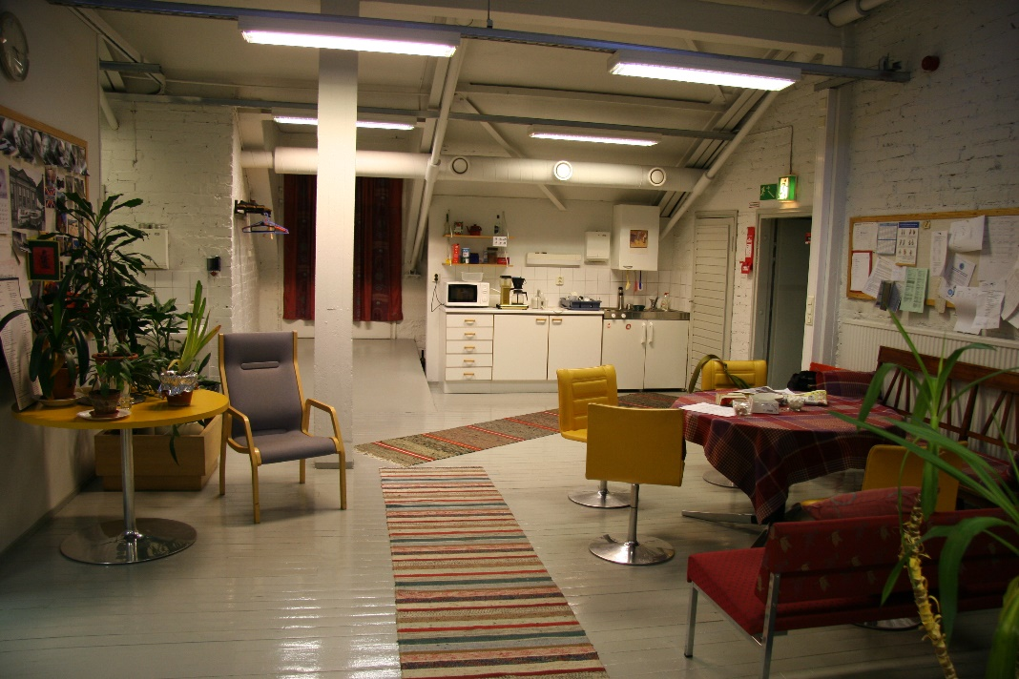
Home Base ”Talli”
10

Slide 11
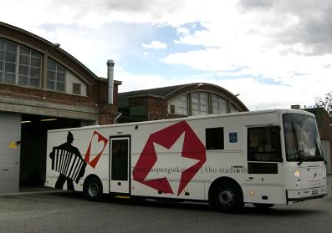
2008 -
11

Slide 12
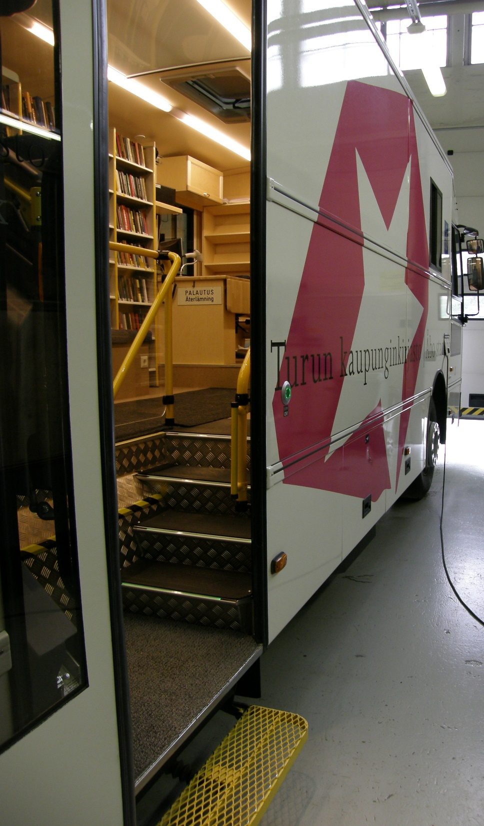
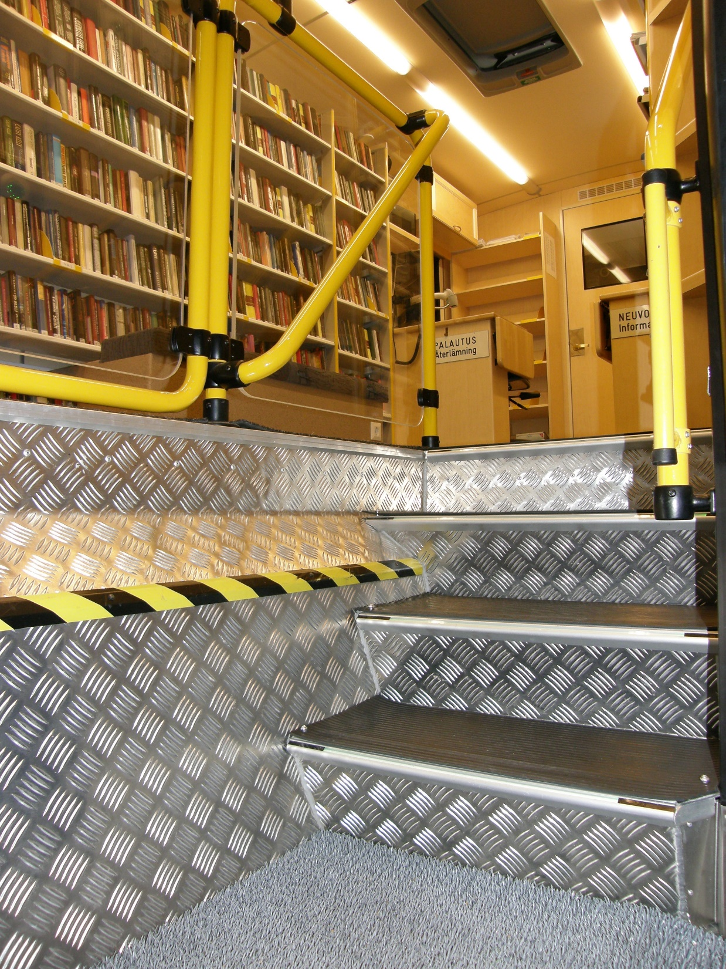
12

Slide 13
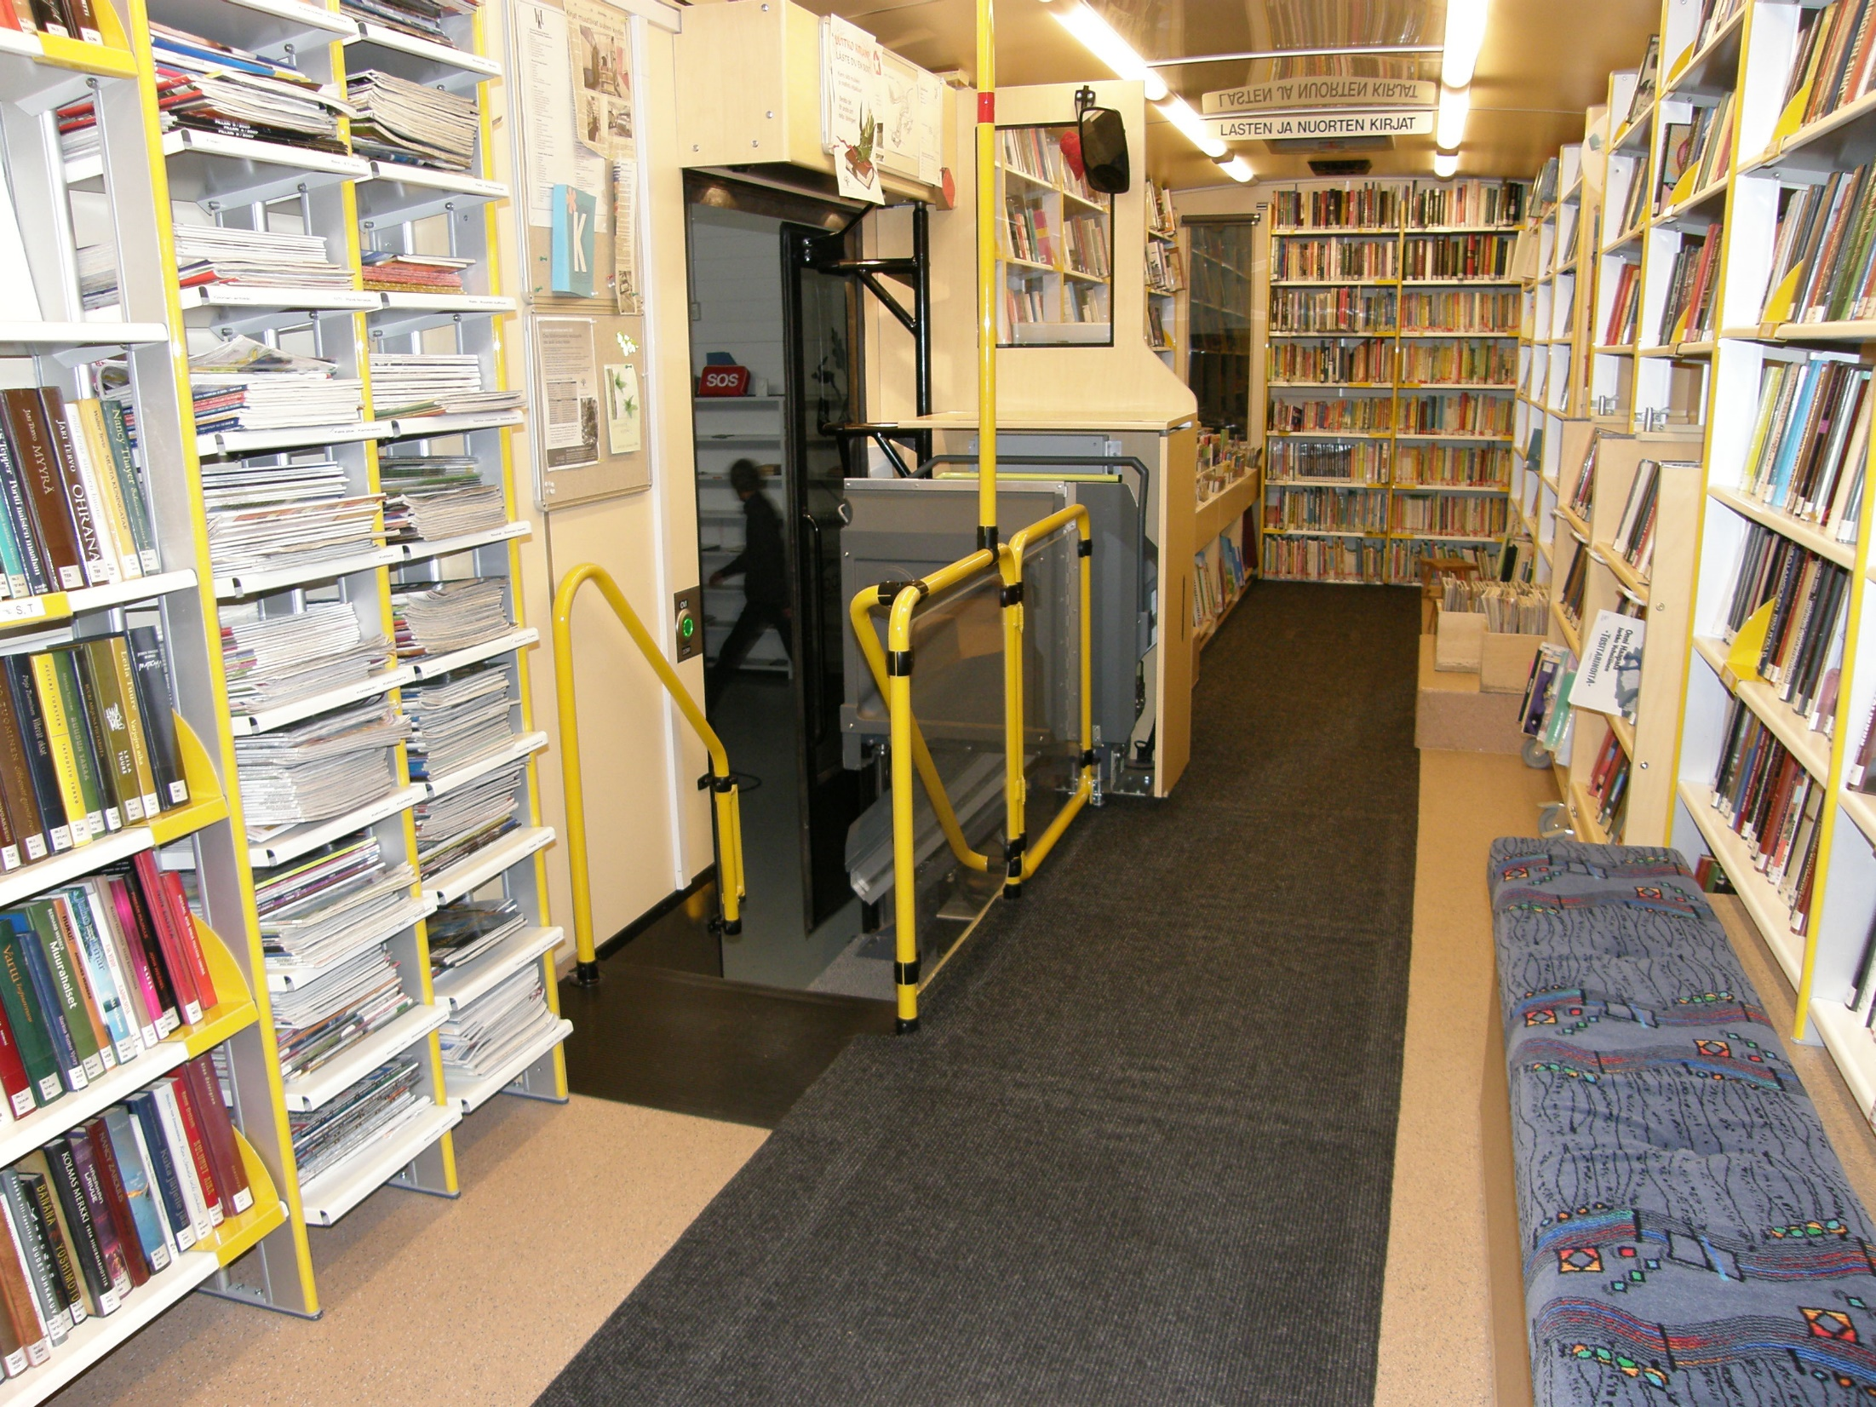
13

Slide 14
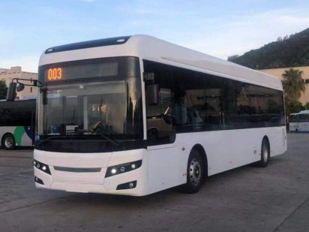
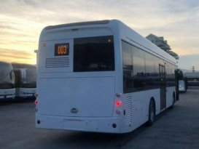
What the new full-electric
mobile library will look like
14

Slide 15
Turku`s Mobile libraries
The whole town comprehensive library service
15

Slide 16
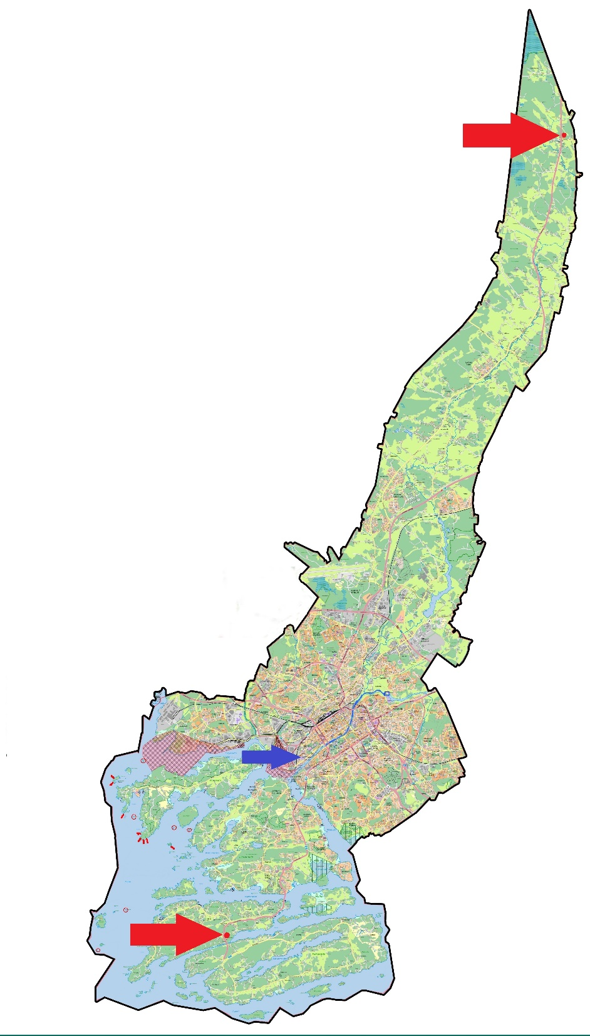
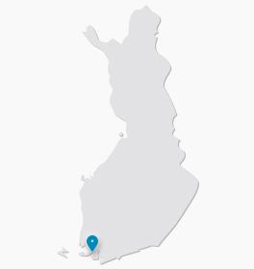
Finland
Turku
16

Slide 17
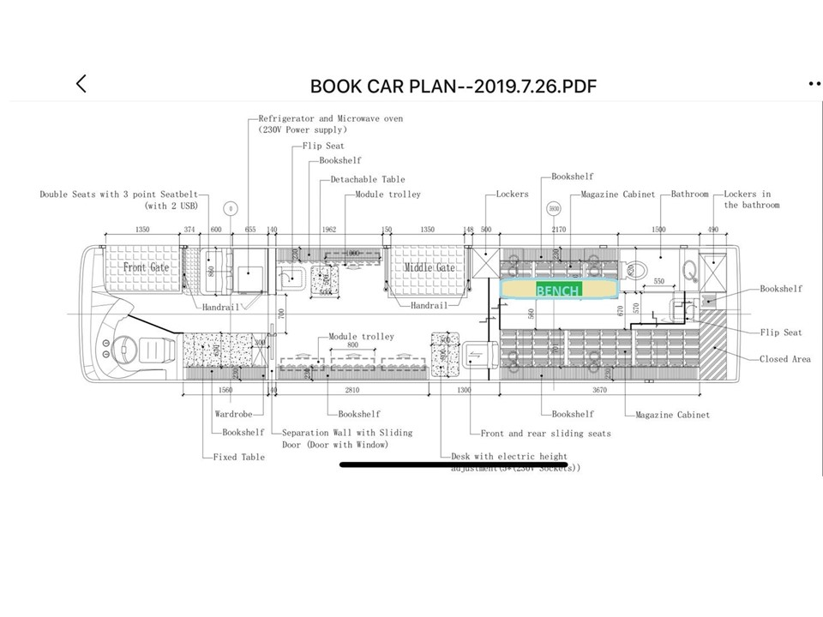
17

Slide 18
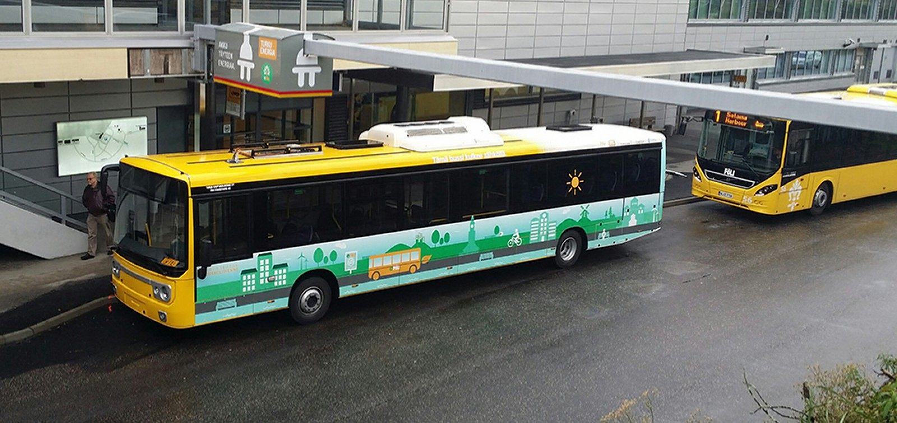
Turku’s full electric local bus

Slide 19
19

Slide 20
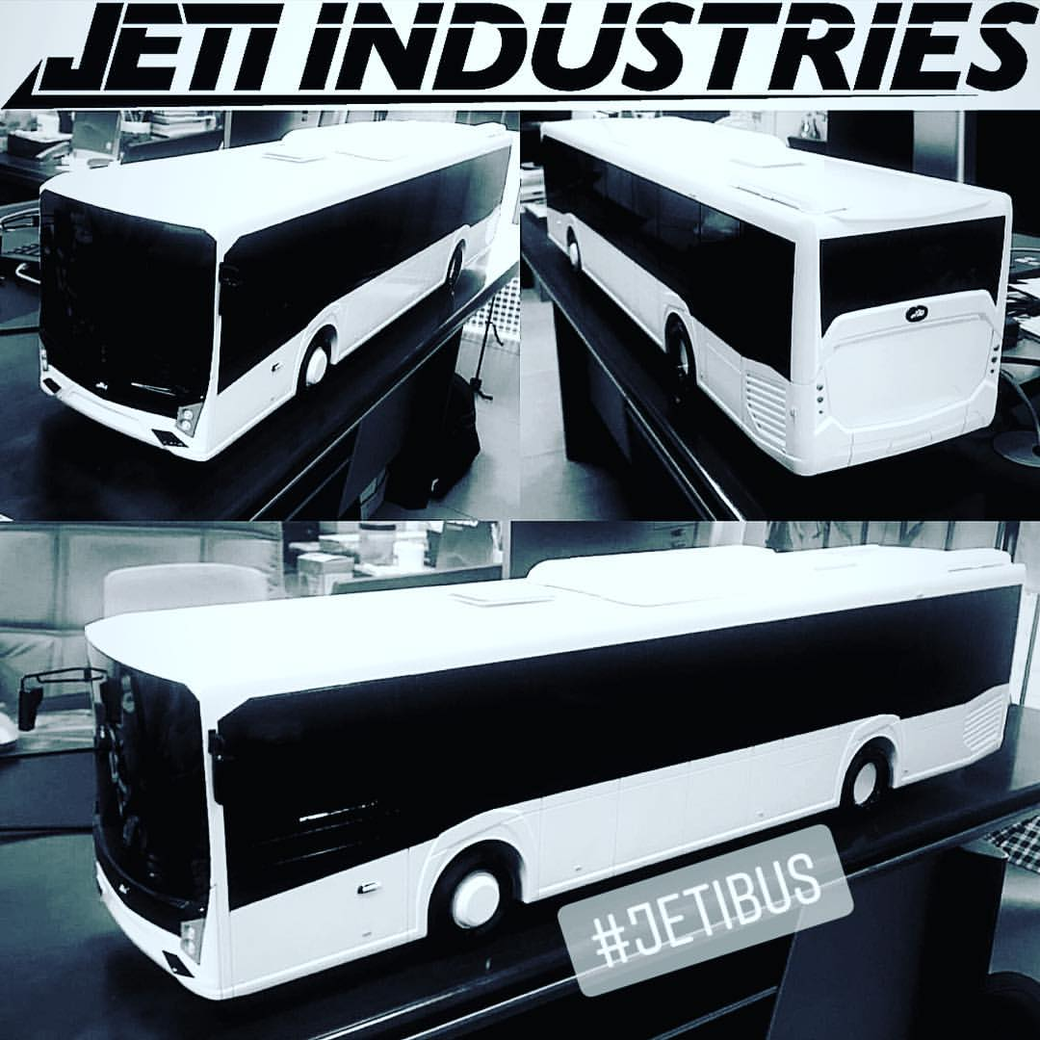
20

Slide 21
The project timetable:
26.7. Confirmation of technical specifications and changes
19.8. The start of the frame welding
15.9. The chassis is delivered to the interior decoration factory
31.10. The vehicle is finished
20.12. The vehicle arrives in Finland
At the end of December, vehicle inspection
The launch of the new mobile library during January
21

Slide 22
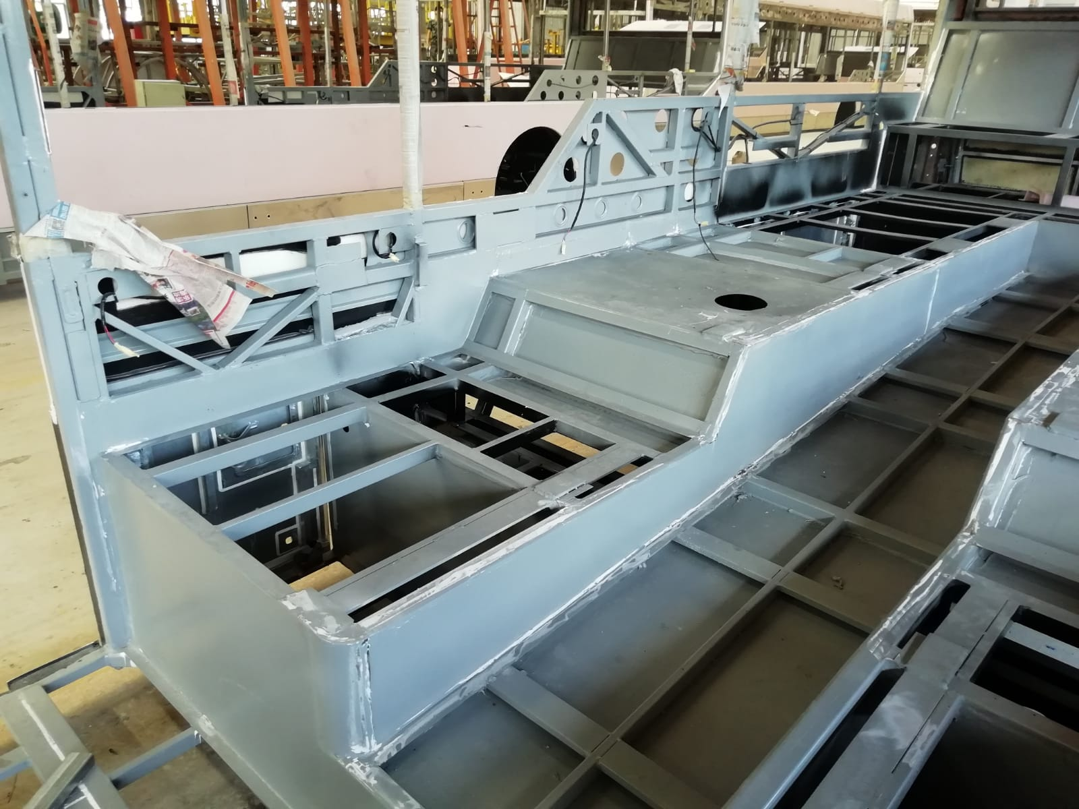
Low entry area until here
22

Slide 23
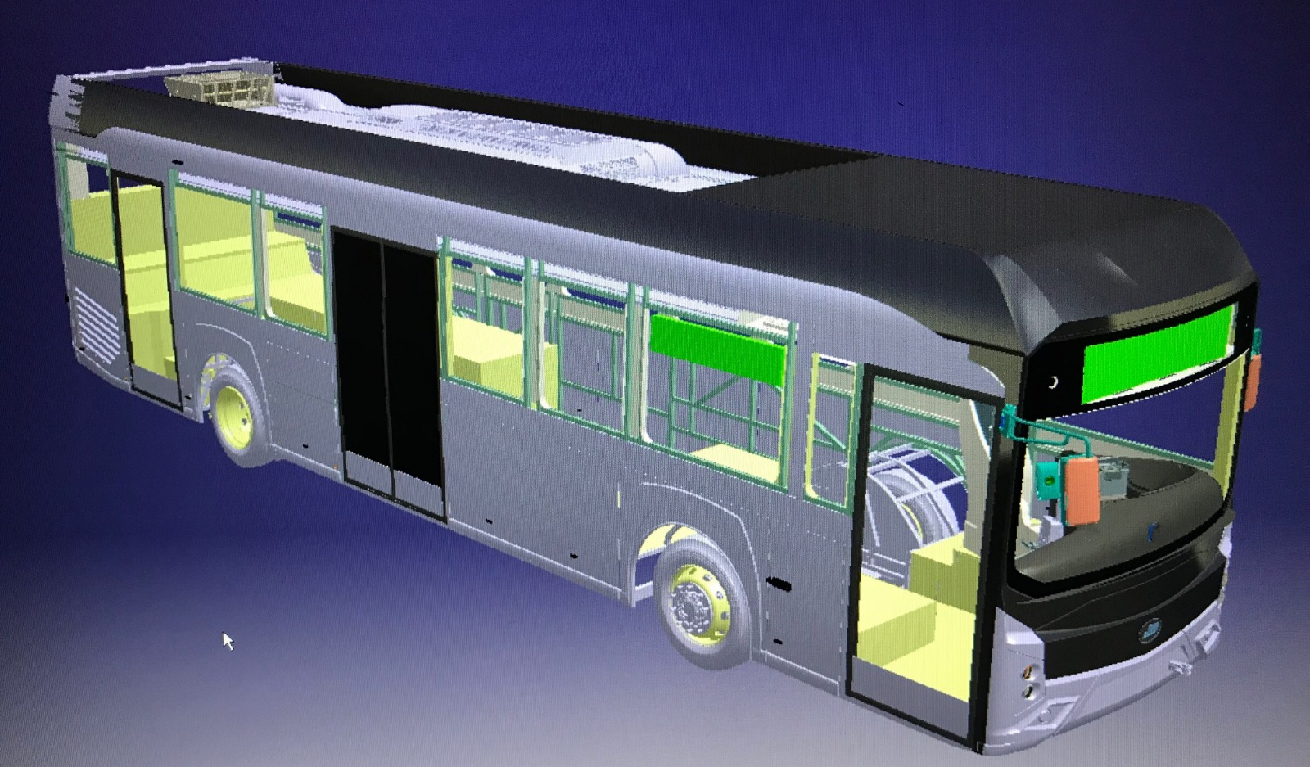
23

Slide 24
24

Slide 25
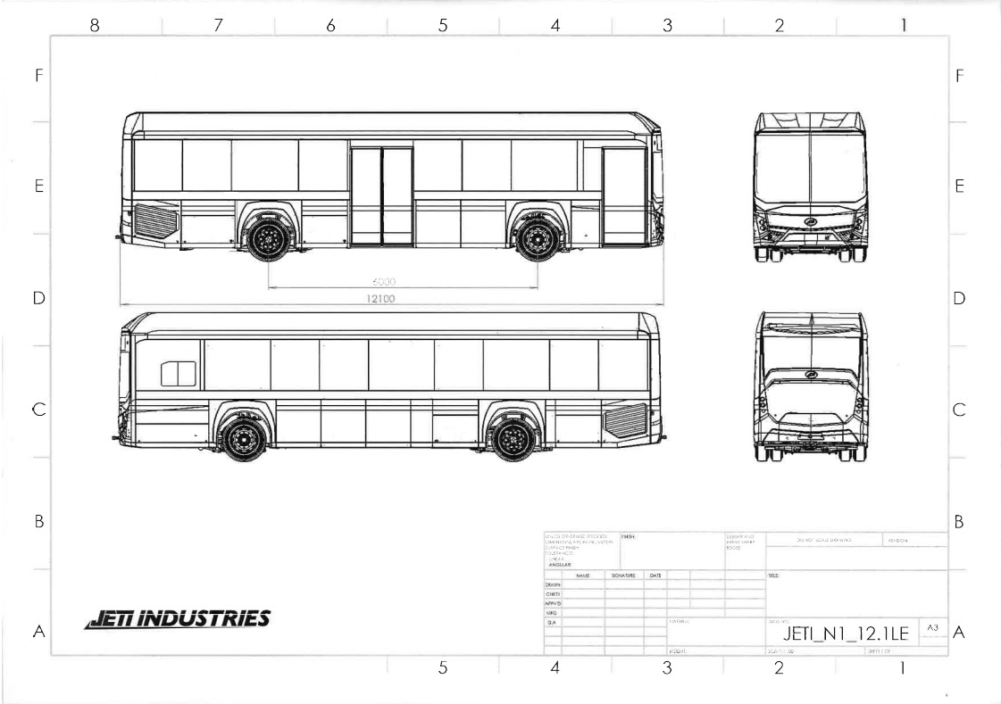
Length 12.1 m
Width 2.55 m
Height 3.3 m
25

Slide 26
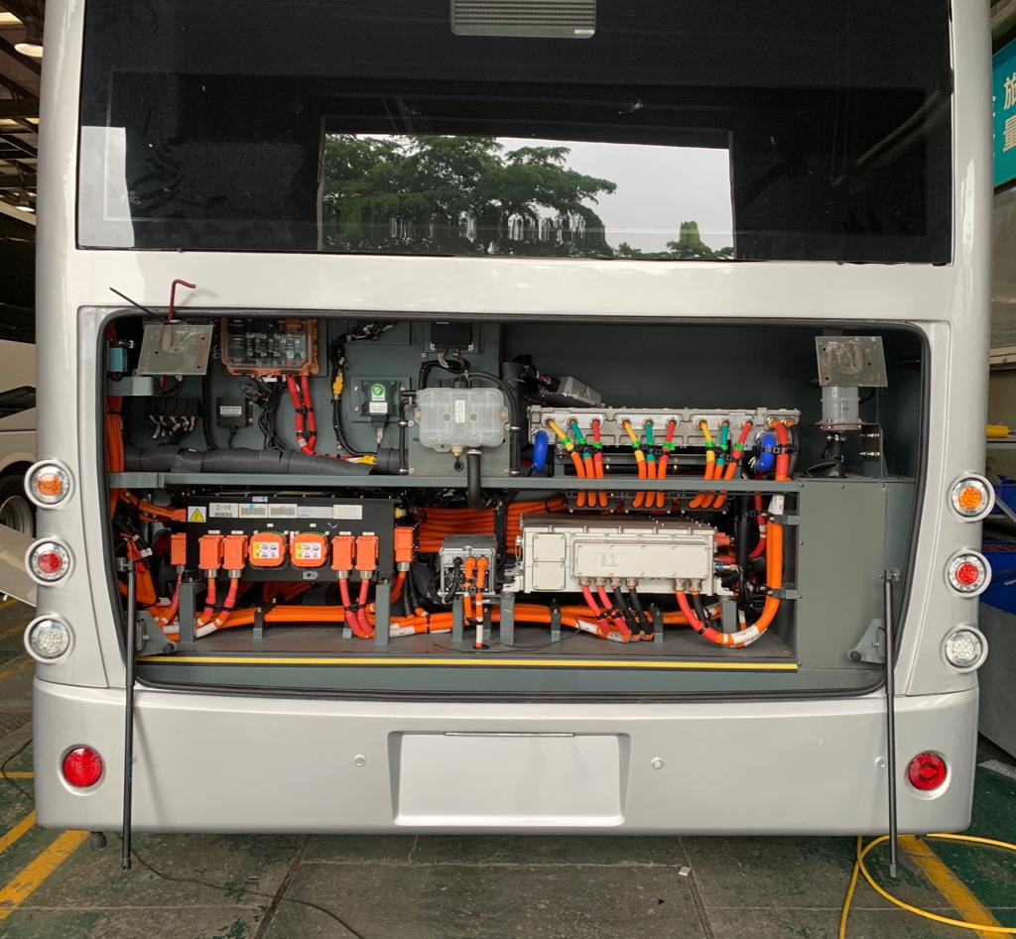
26

Slide 27
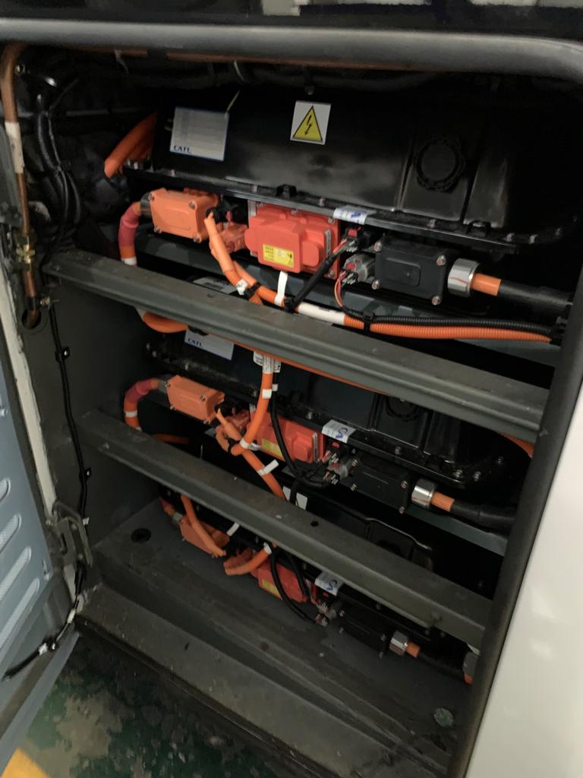
27

Slide 28
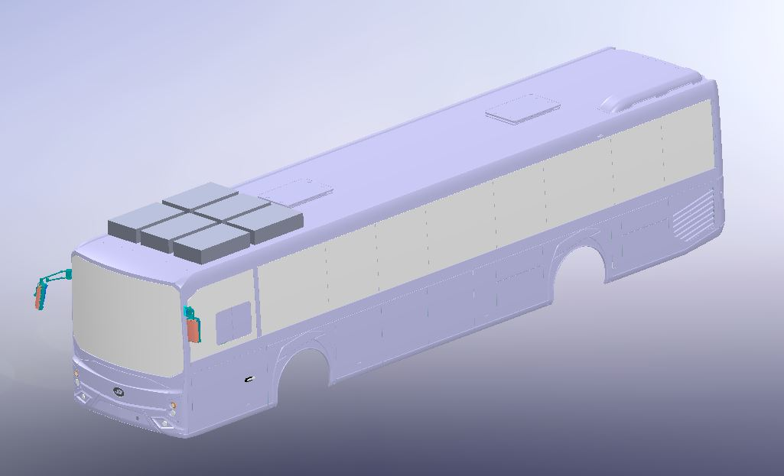
6 CATL batteries are situated on the roof
28

Slide 29
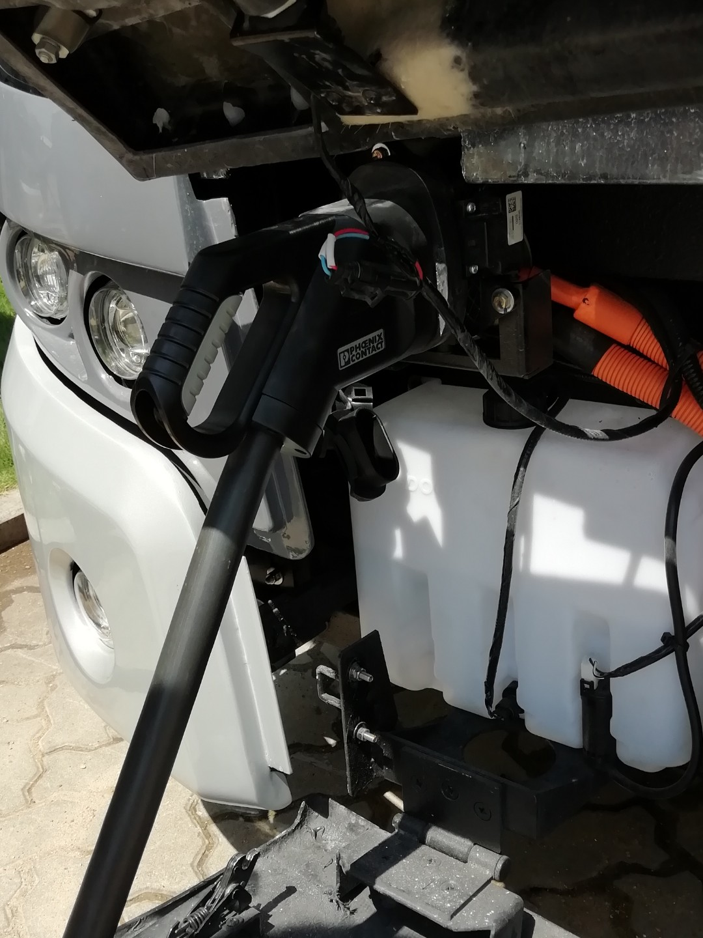
The Combined Charging System (CCS) covers charging electric vehicles using the Combo 1 and Combo 2 connectors at up to 80 or 350 kilowatts.
JETI uses CCS Combo 2
29

Slide 30
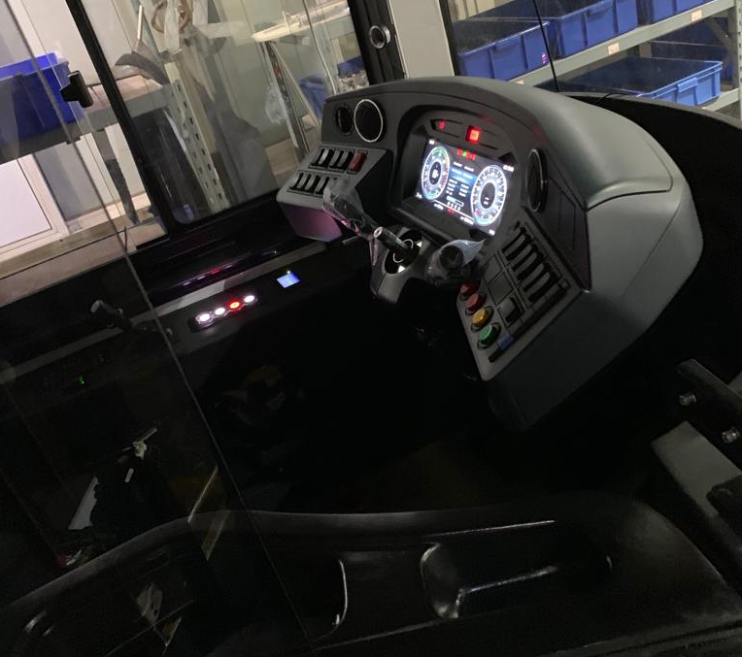
30

Slide 31
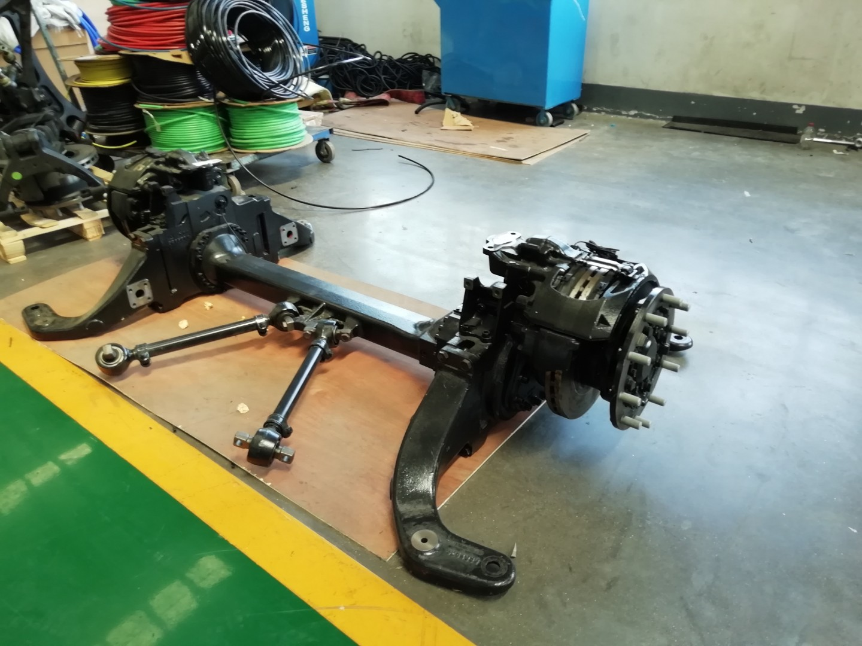
ZF portal axle
31

Slide 32
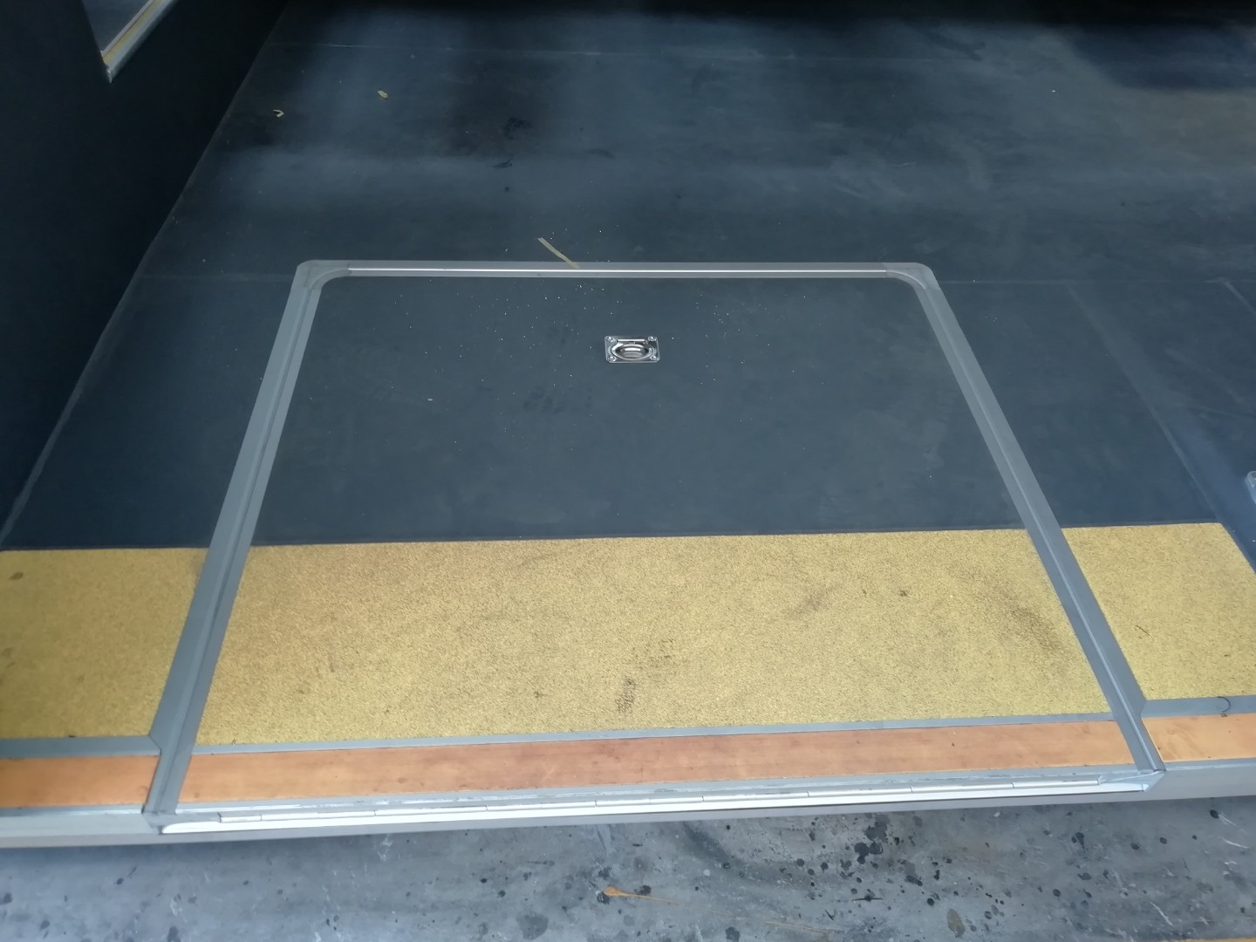
32

Slide 33
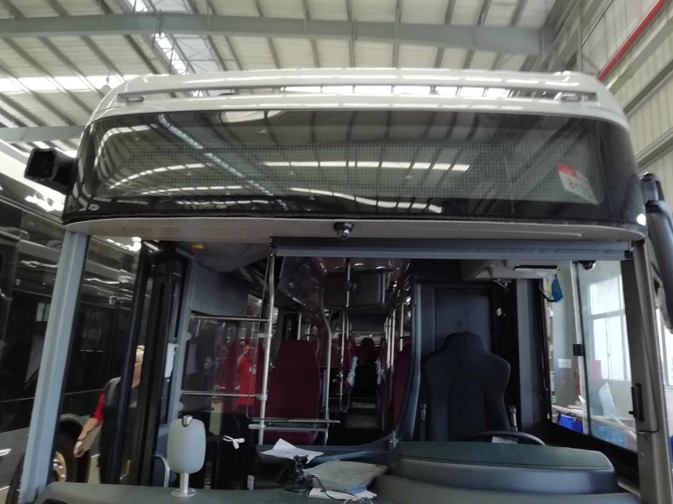
33

Slide 34
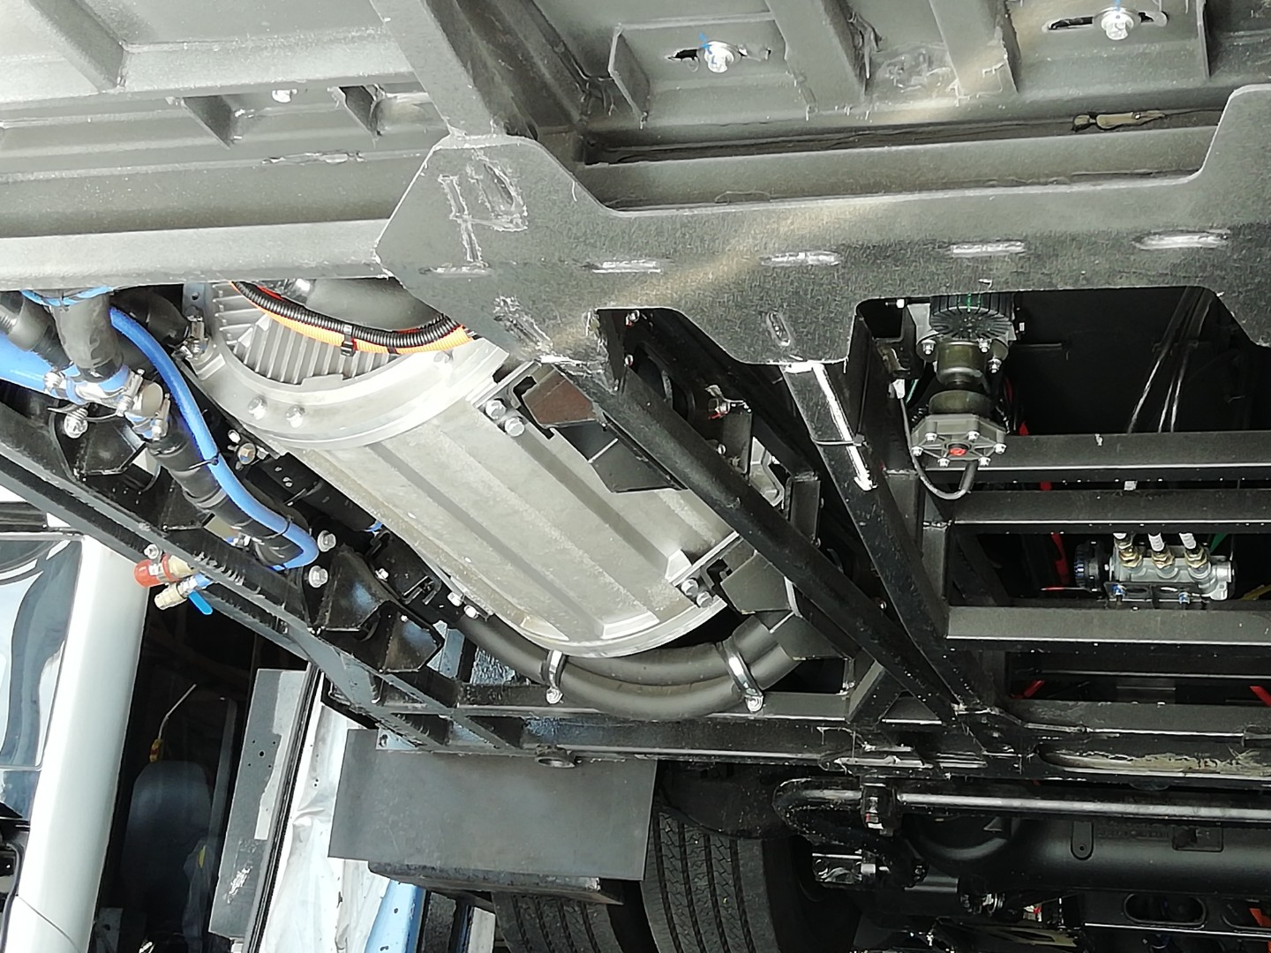
34

Slide 35
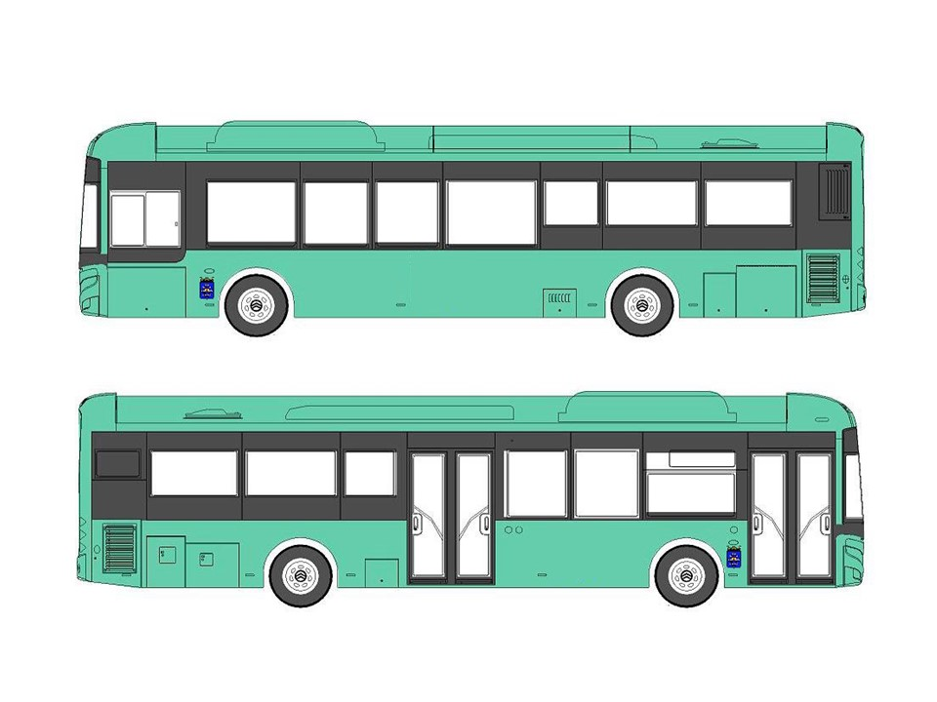
Color before masking
35

Slide 36
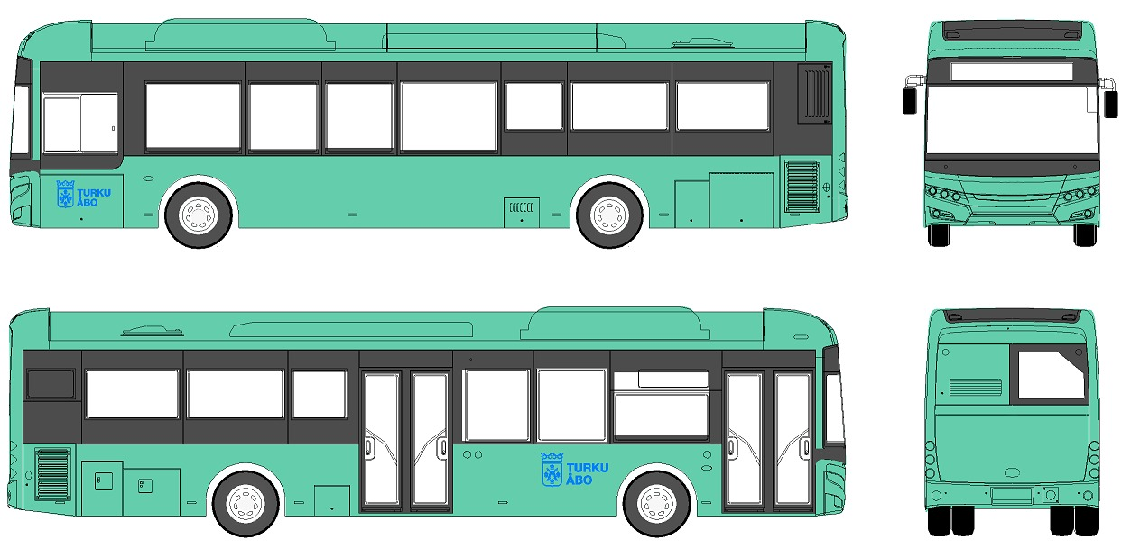
Email us at: kirjastoauto@turku.fi
Thank You
Time for questions

