Slide 1
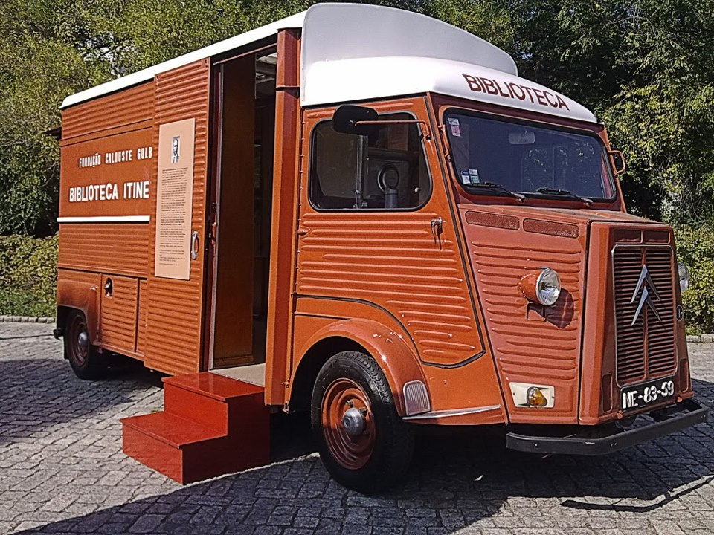
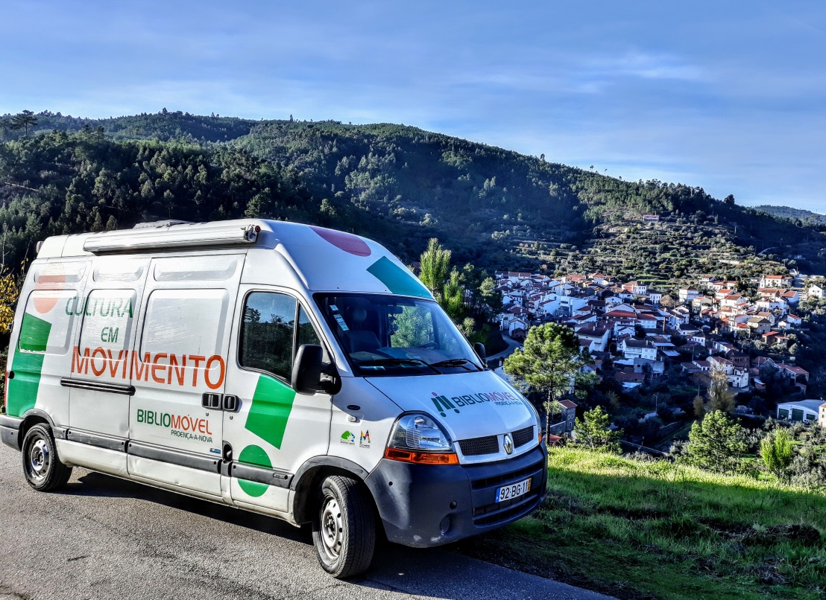
Portuguese Mobile Libraries
travelling throughout the roads
lands and people of Portugal -
between past…
…and the present!

Slide 2
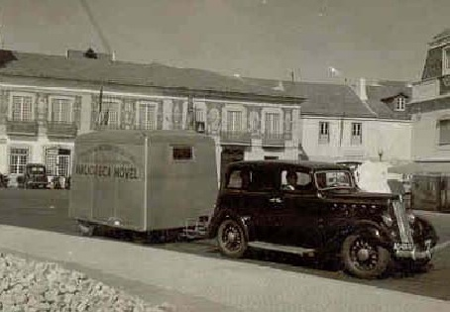
ROADS,LANDS,PEOPLES AND MEMORIES
1st PORTUGUESE MOBILE LIBRARY
Cascais Public Library - 1953
ANTÓNIO JOSÉ BRANQUINHO DA FONSECA

Slide 3
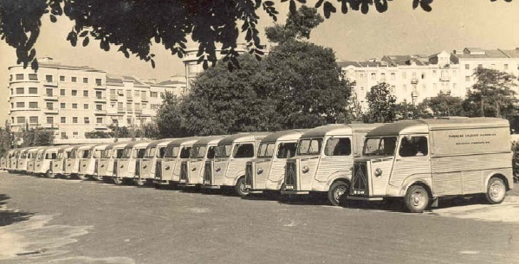
TRAVELING THROUGHOUT THE ROADS, LANDS AND PEOPLES OF PORTUGAL
Calouste Gulbenkian Foundation Mobile Librarys – 1958-2002

Slide 4
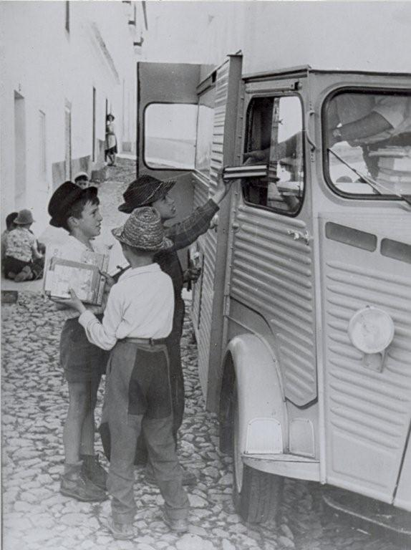
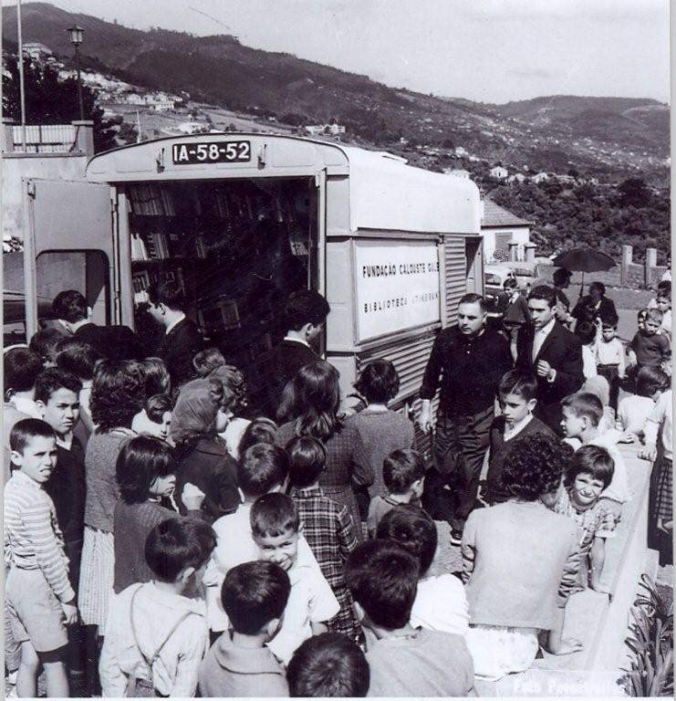
TRAVELING THROUGHOUT THE ROADS, LANDS AND PEOPLE OF PORTUGAL
CALOUSTE GULBENKIAN FOUNDATION
MOBILE LIBRARYS
1958-2002
97 million books borrowed
29 milion readers

Slide 5
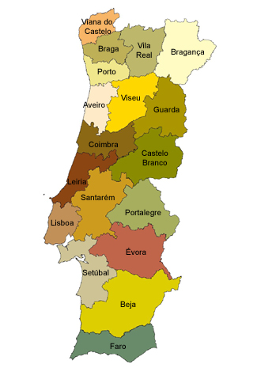
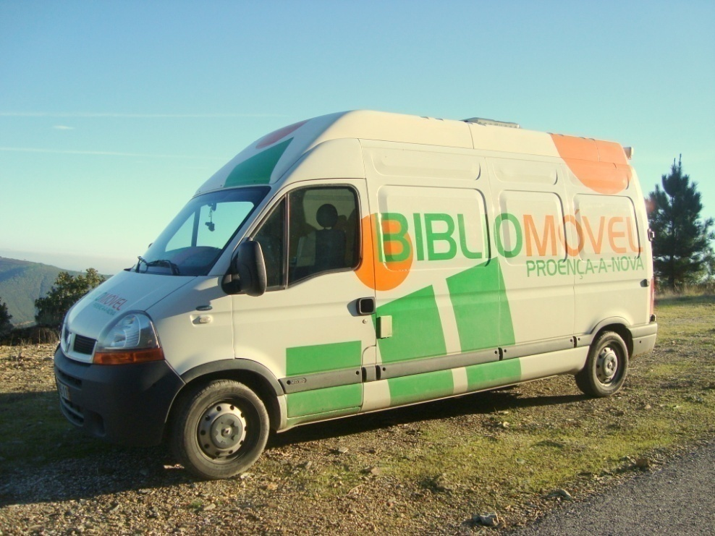
ROADS, LANDS, PEOPLES AND MEMORIES
…and present, with an eye in the future!
10 555 million habitants
194 Libraries
73/74 Mobile Libraries

Slide 6
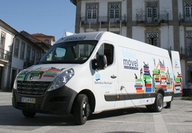
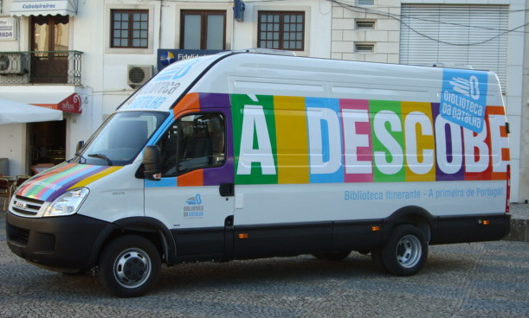
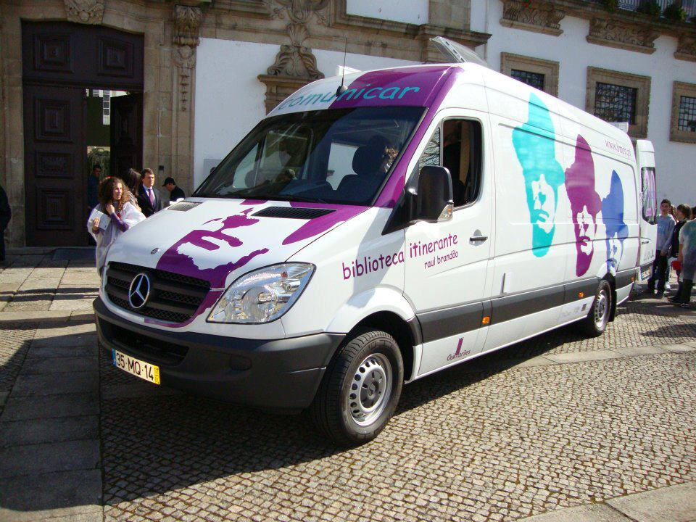
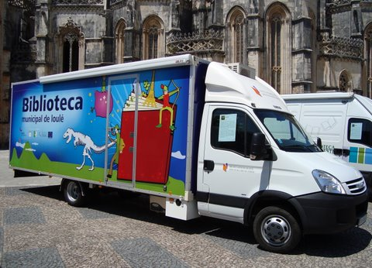
ROADS,LANDS,PEOPLES AND MEMORIES
…and present, with an eye in the future!

Slide 7
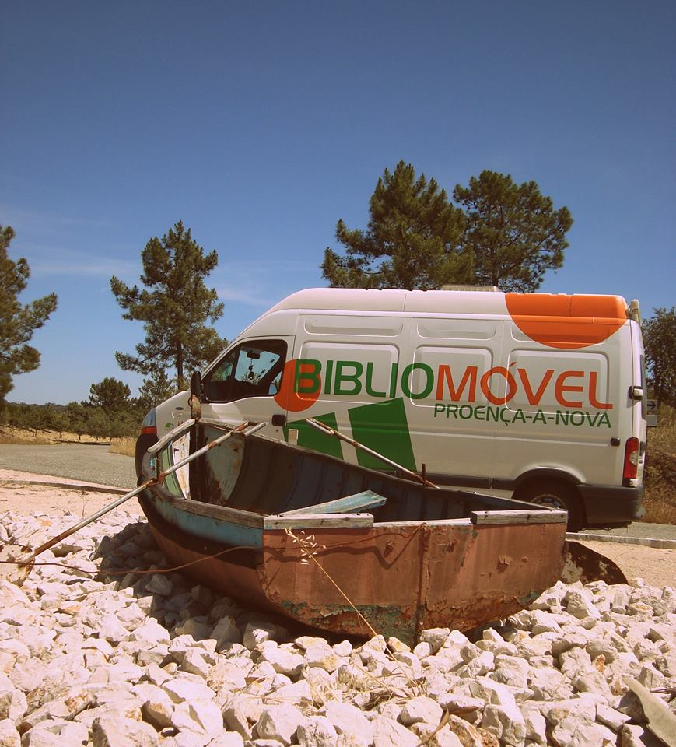
Since 2006
Mobile Library of People, with People, and for People

Slide 8
LIBRARIAN DIMENSION
Home loan (books,magazines,cd,dvd)
“ask the mobile library answers!” - Bibliographic Reference Service
Librarian support services to nursing homes,schools, trade (cafes, rural hotels)
Internet
Reading animation
Workshops
Musical entertainment (accordionists)

Slide 9
SOCIAL DIMENSION
Proximity
Periodicity
Complicity
Intimacy
FRIENDSHIP
“Request a book in a mobile library is to borrow a book to a friend or neighboor”
Roberto Soto

Slide 10
Proximity, Utility and Affectivity respect and rescue the memory
Preservation and Disclosure of Intangible Heritage
https://www.facebook.com/Ecos-de-Proen%C3%A7a-302195056579822/

Slide 11
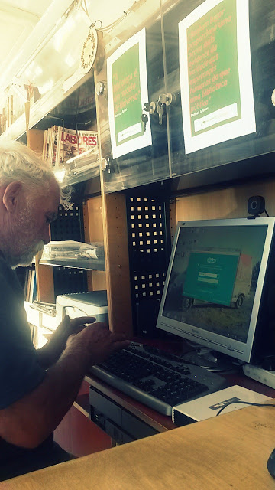
Proximity, Utility and Affectivity connect people
video-conference /video-call

Slide 12
Proximity, Utility and Affectivity Facilitating and Helping
City Hall's Mobile Command Post
Social Action ,Water Supply
Farmer and Entrepreneur Support, Education, Civil Protection
(online delivery of forms and requirements)
Ventana Móvil de
Atención al Municipio

Slide 13
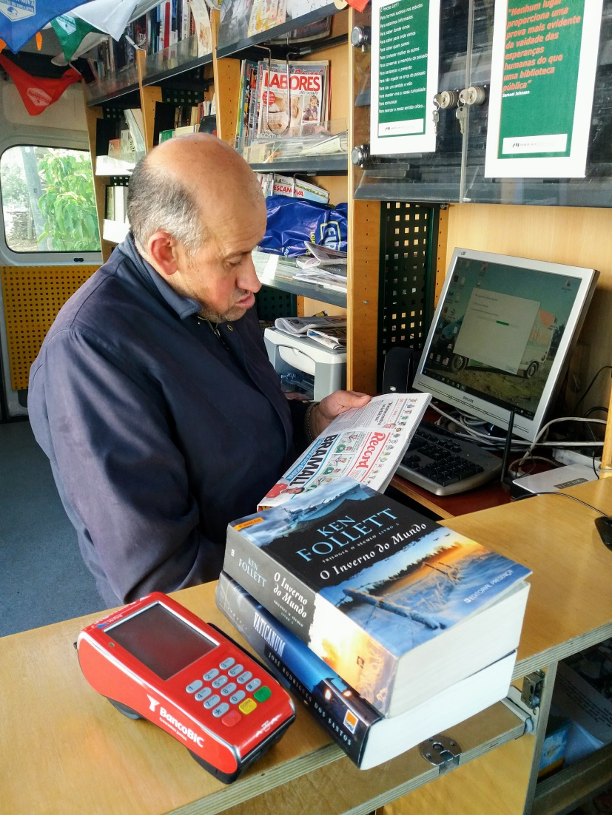
Proximity, Utility and Affectivity Basic Citizenship Wishes
Payments – Portable ATM

Slide 14
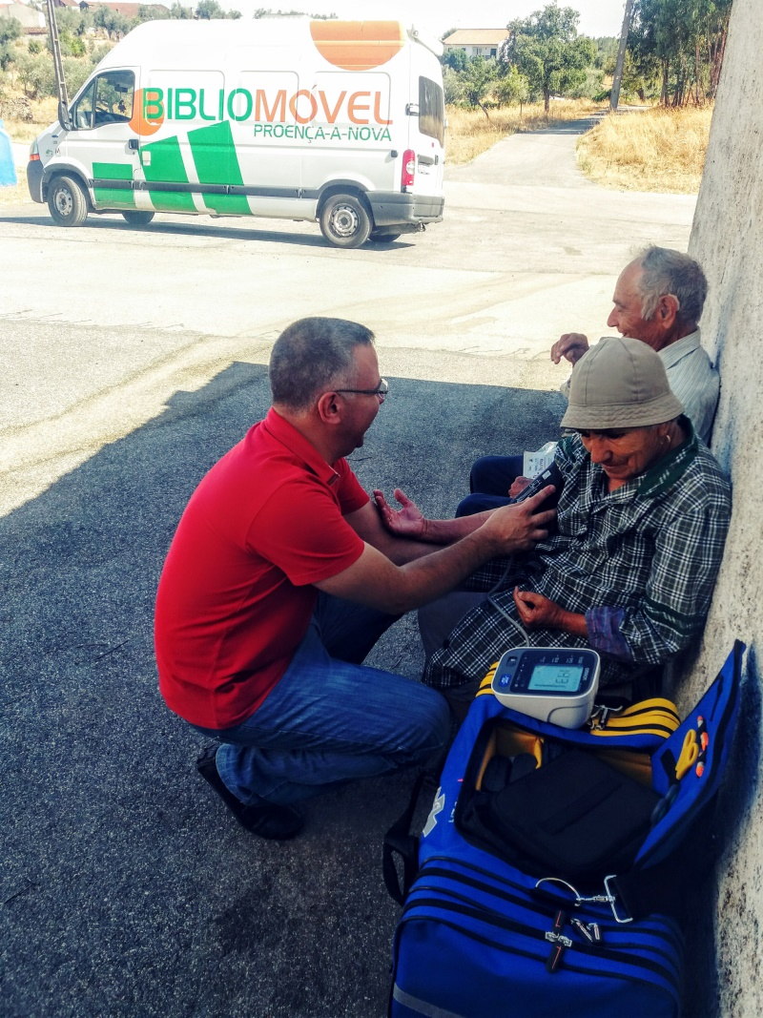
Proximity, Utility and Affectivity Physical and Emotional Health
Exámenes Sanidad - colaboración con la Unidad Móvil de Salud
health screening - cholesterol, diabetes, blood pressure

Slide 15
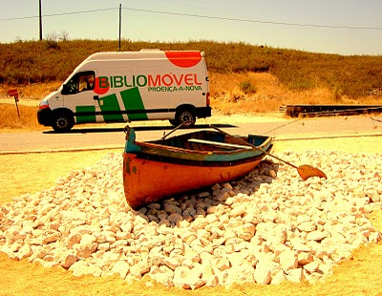
Log book of a mobile librarian throughout roads, land and people of Proença-a-Nova - Portugal
http://opapalagui.blogspot.com

Slide 16
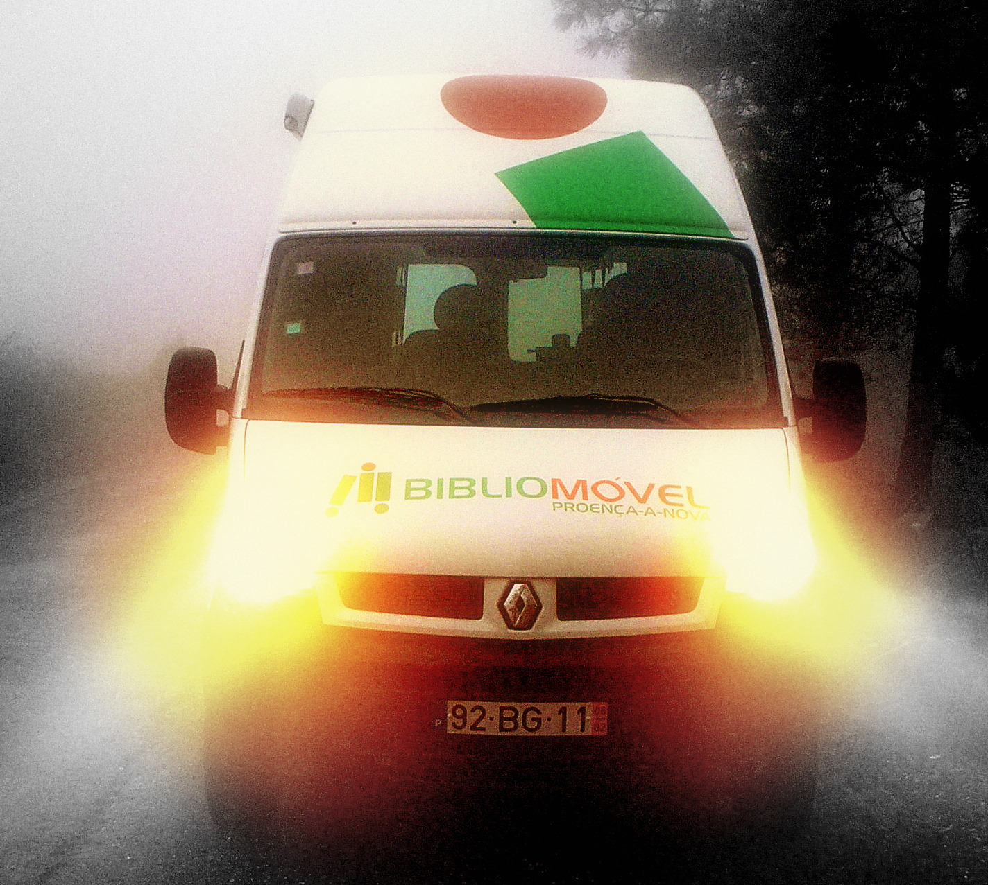
THANKS FOR YOUR ATTENTION
!
nuno marçal
opapalagui@gmail.com

