Slide 1
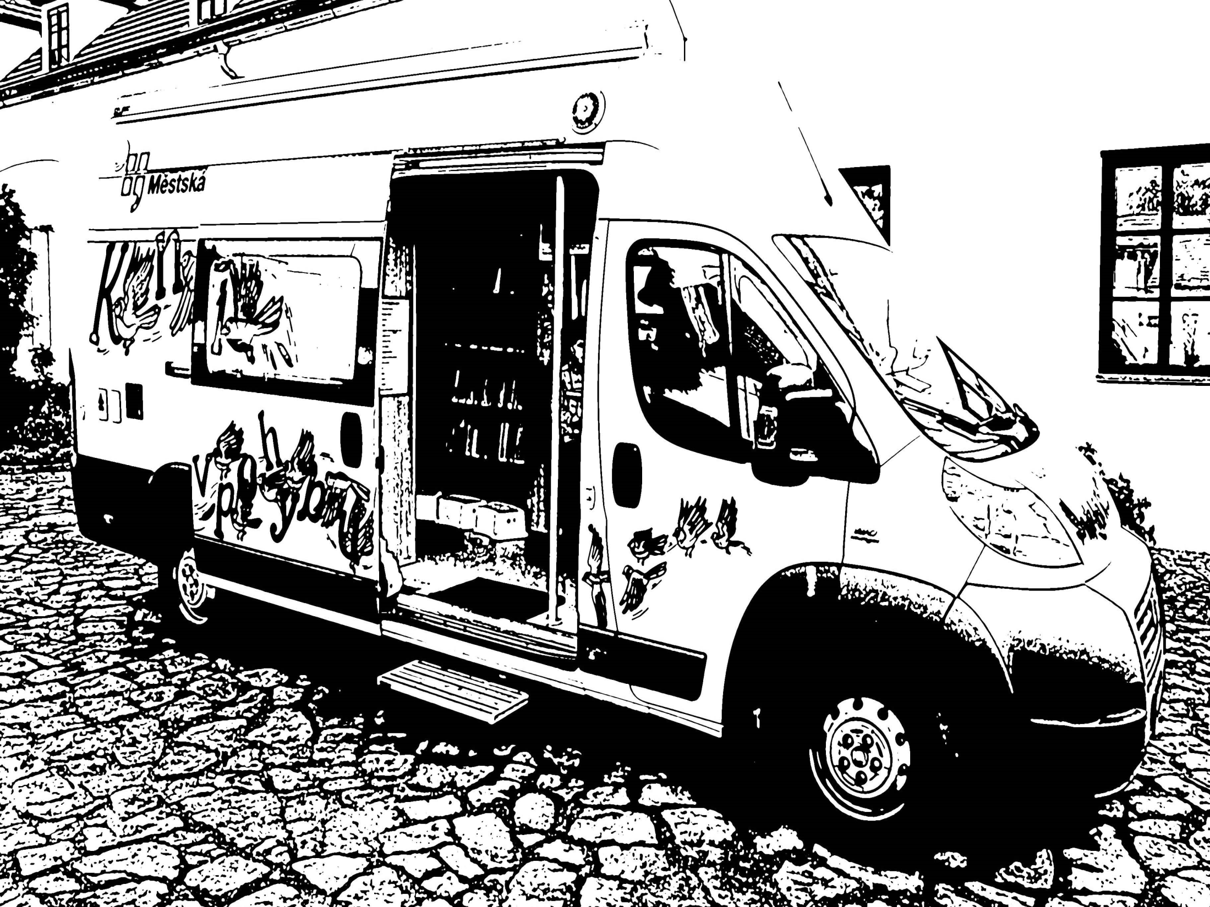
Mobile Library in Prague 1939 - 2019
August 8th 2019

Slide 2
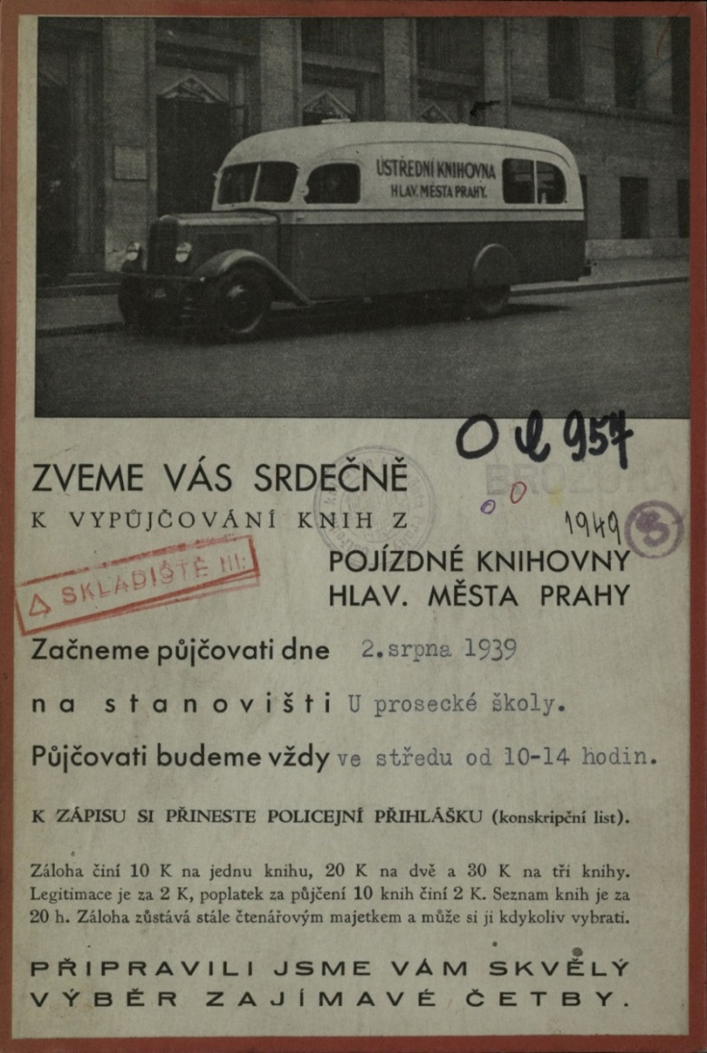
First bibliobus
opening at August 2nd 1939
14 stops at the outskirts of Prague
closed in May 1940

Slide 3
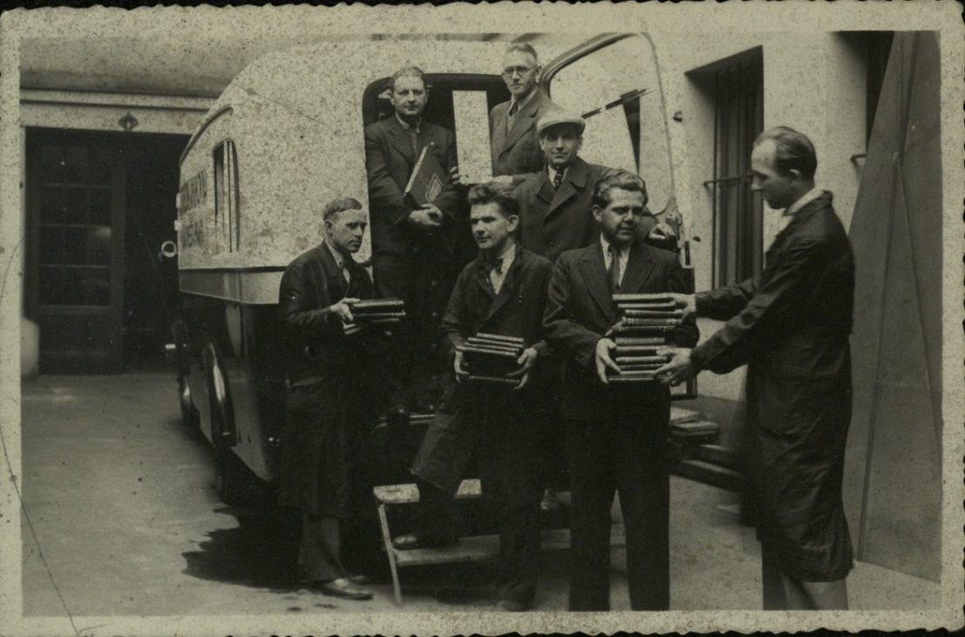
First bibliobus
The Mobile Library Department:
head of department
librarian
driver
four assistants

Slide 4
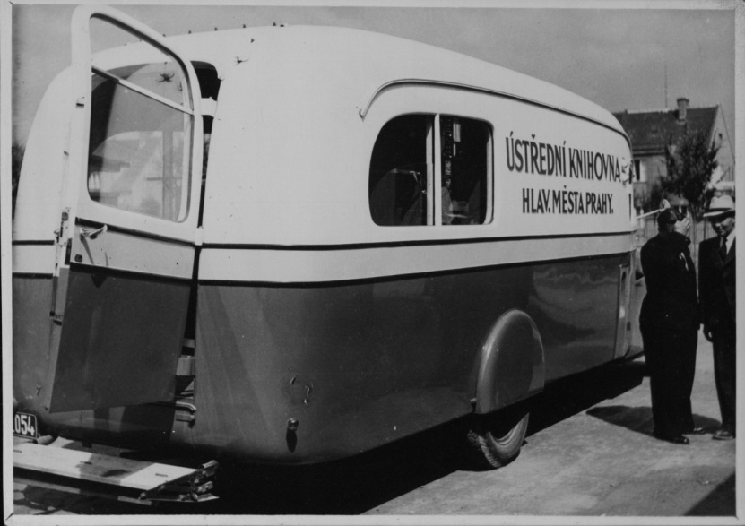
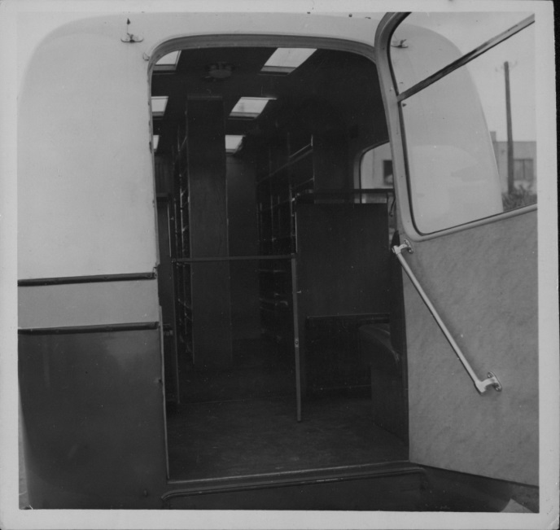
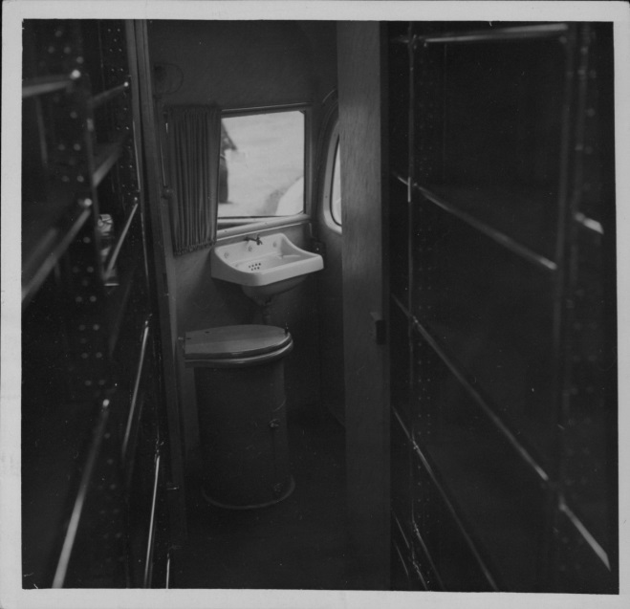
First bibliobus

Slide 5
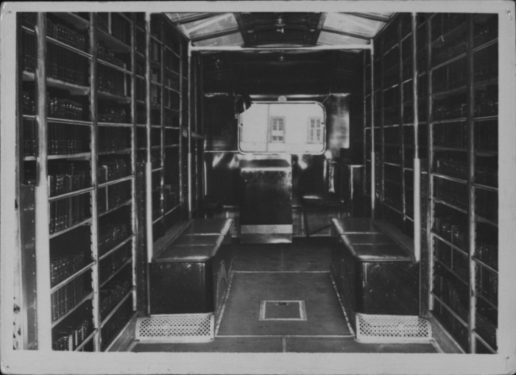
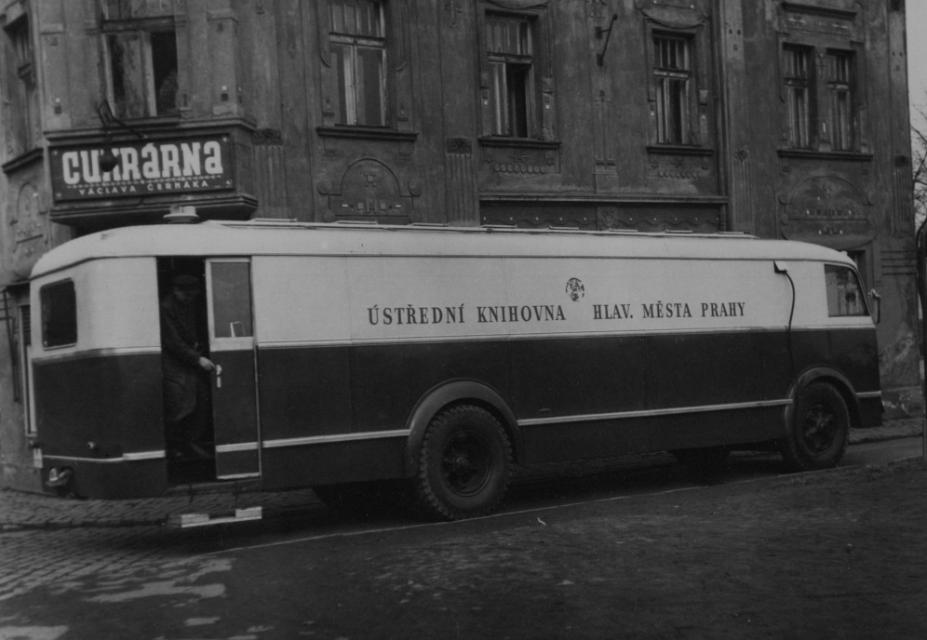
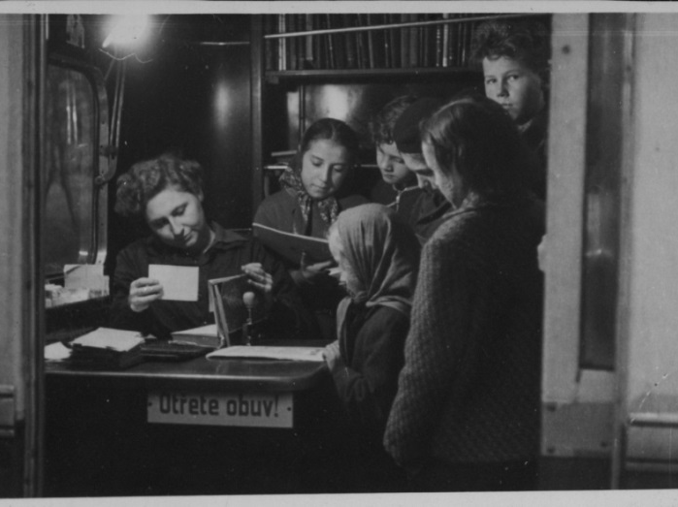
After 1947
preparation of a new mobile library in 1947
service created for 18 stops
one bibliobus for adults
one bibliobus for kids and youth

Slide 6
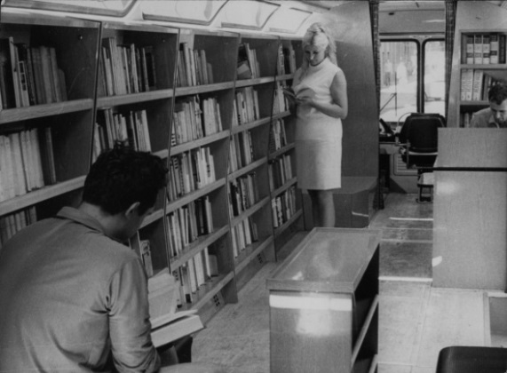
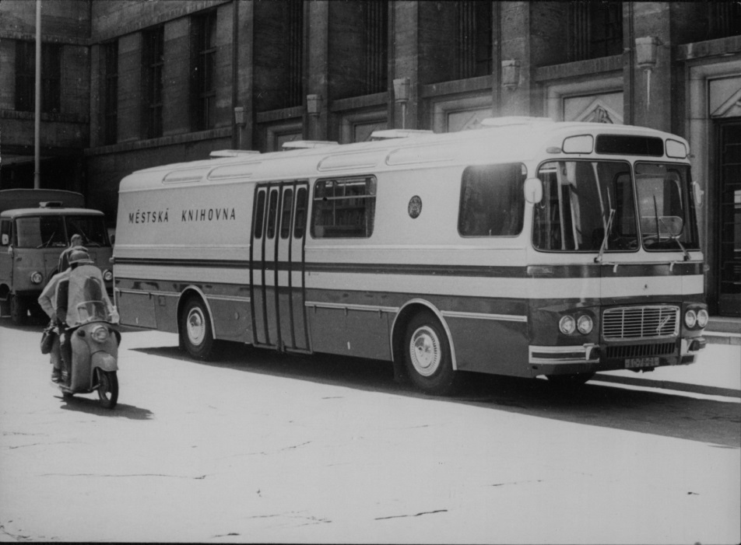
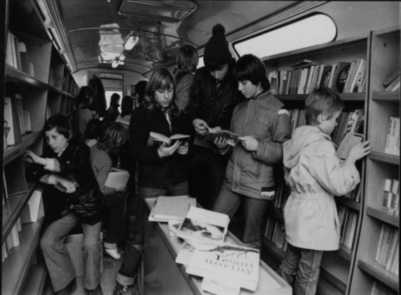
After 1969
mobile libraries as part of the Central Library
bibliobus serves both children and adults at the same time
different number of vehicles: 1 to 3
9 to 24 stops in Prague outskirts

Slide 7
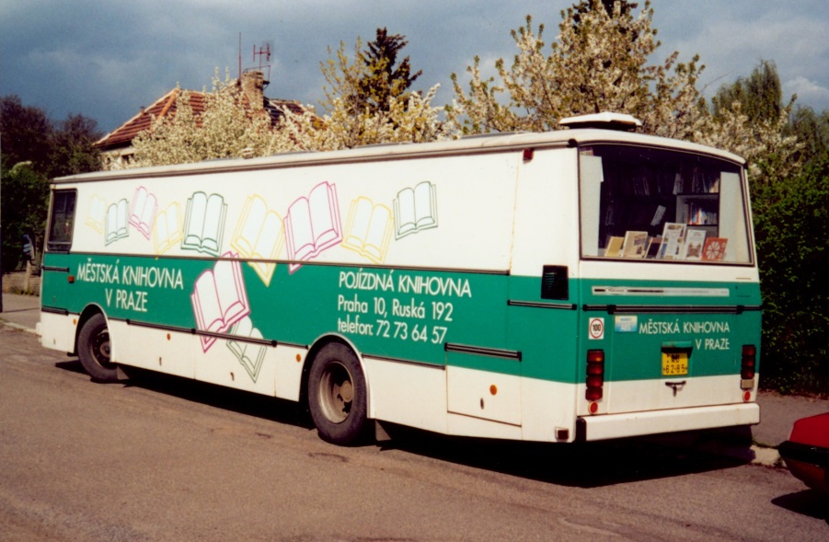
After 1989
bibliobuses were gradually replaced by newer vehicles
regular timetable
represent stone branches
in the outskirts of the city
made in 1991 made in 1995

Slide 8
After 2009
establishment of a separate mobile service department
a new concept of mobile services:
change from 3 large bibliobuses to 2 large bibliobuses and 1 small (up to 3.5 t)
change of provided services
acquisition of a small bibliobus

Slide 9
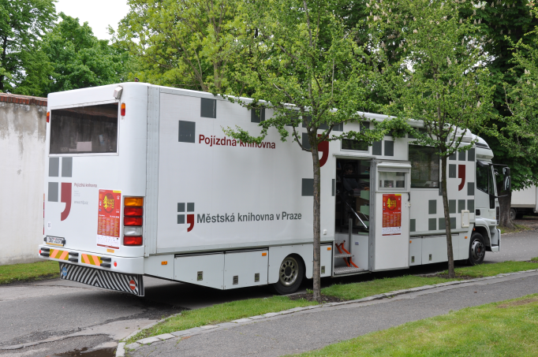
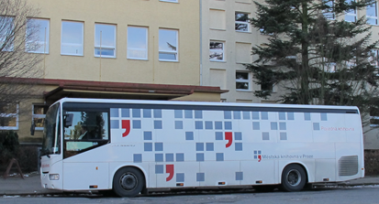
Large bibliobuses
represent stone branches
in the outskirts of the city
mostly seniors, mothers with children
regular timetable
automation library system
internet for everyone
made in 2004 made in 2008

Slide 10
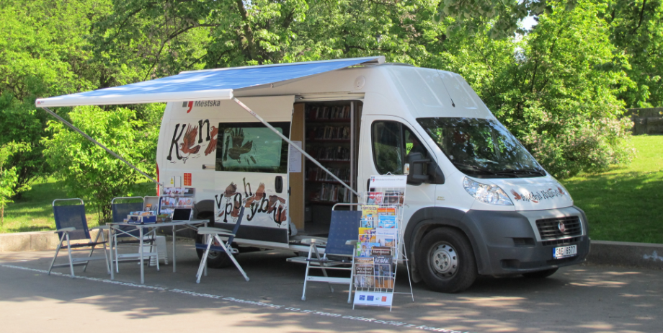
Minibus Oskar
3 main concept points:
operate in places that large bibliobuses cannot reach because of their size
provide cultural and educational services for all ages
support the marketing and promotion activities of the MLP

Slide 11
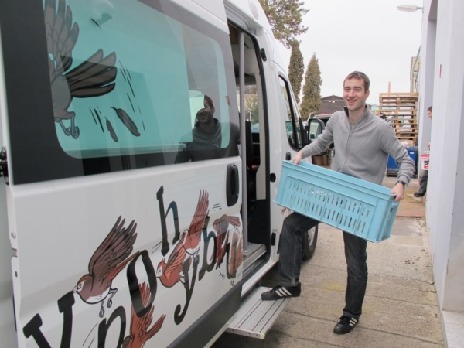
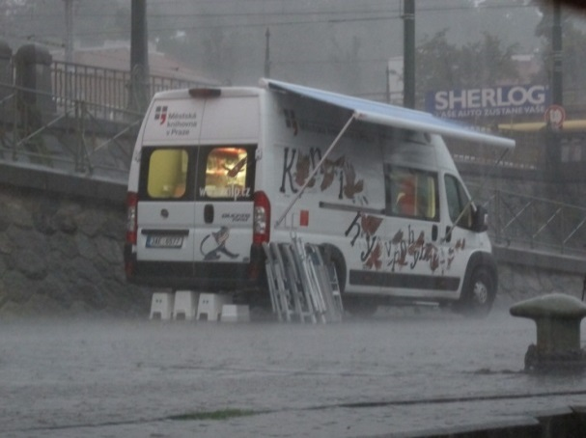
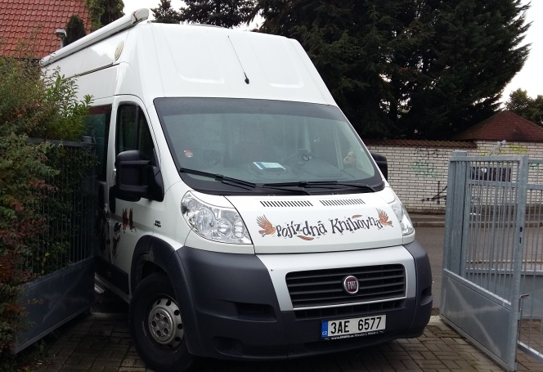
Oskar - specifics and limits
highly flexible, changable schedule
no indoor possibility - events only outside
more complicated logistics
weather influence
demands on staff - varied work, flexible working hours

Slide 12
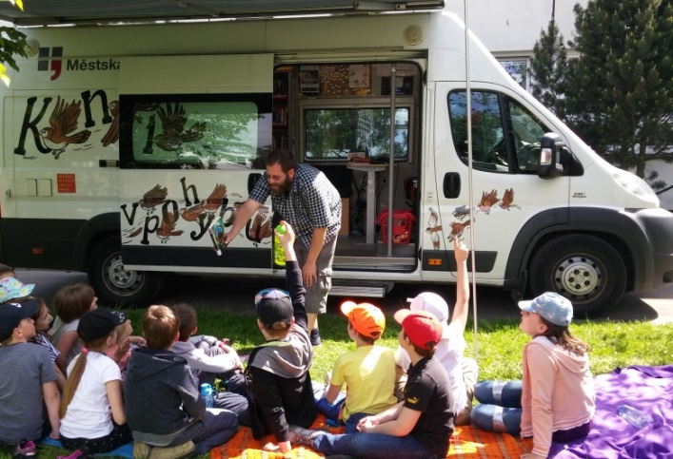
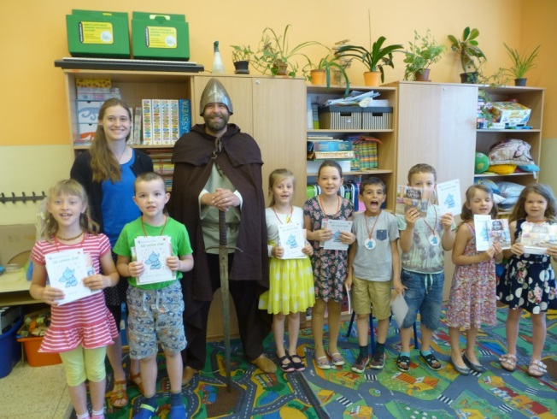
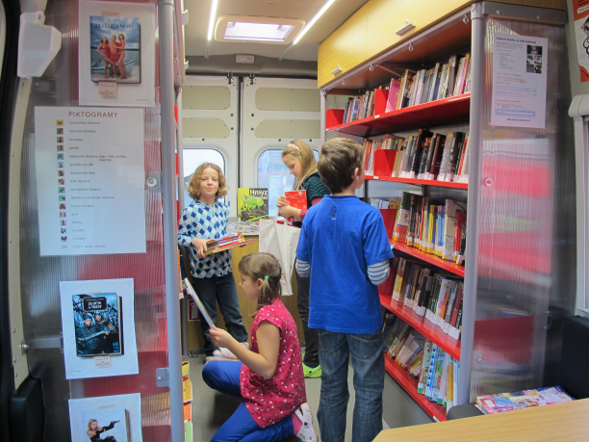
Oskar - regular stops
elementary and nursery schools
senior housing
public stops rarely (as a stand-off for a closed branch or for a large bibliobus)
shopping centres

Slide 13
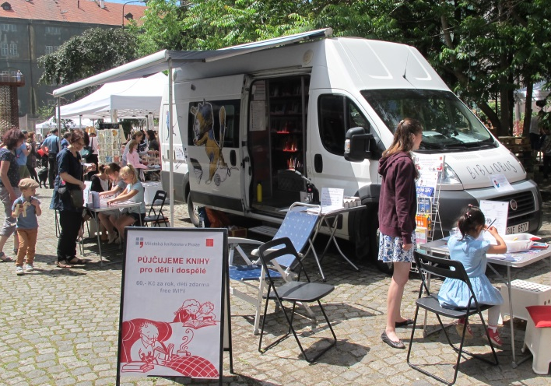
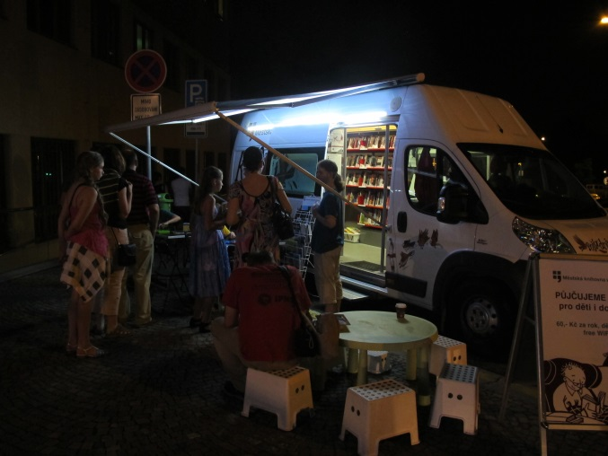
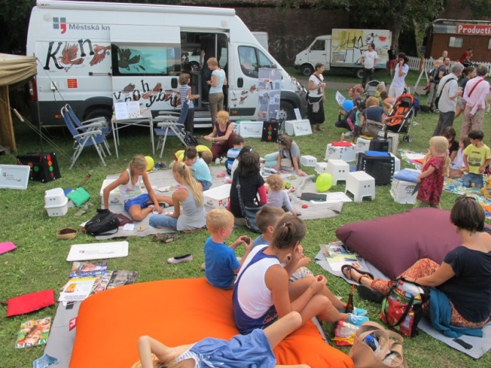
Oskar – irregular stops
events - festivals, children's days, fairs
children and youth centres, city day camps
schools events
about 80 events in a year, 7000 unregistered visitors

Slide 14
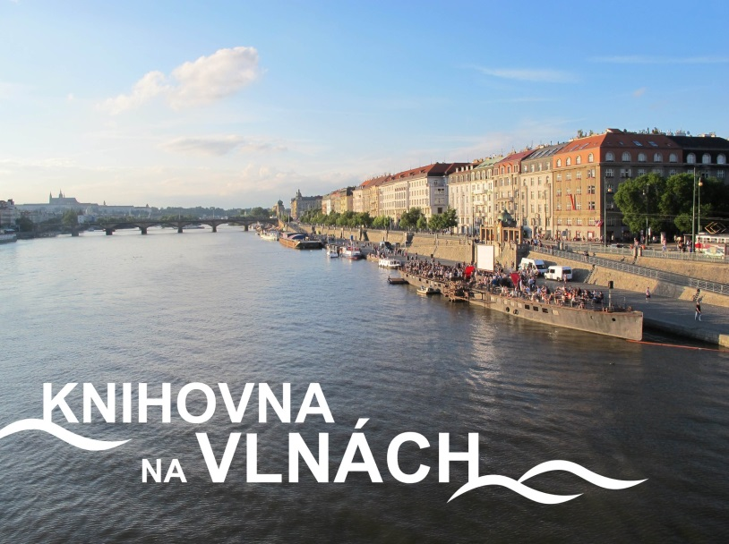
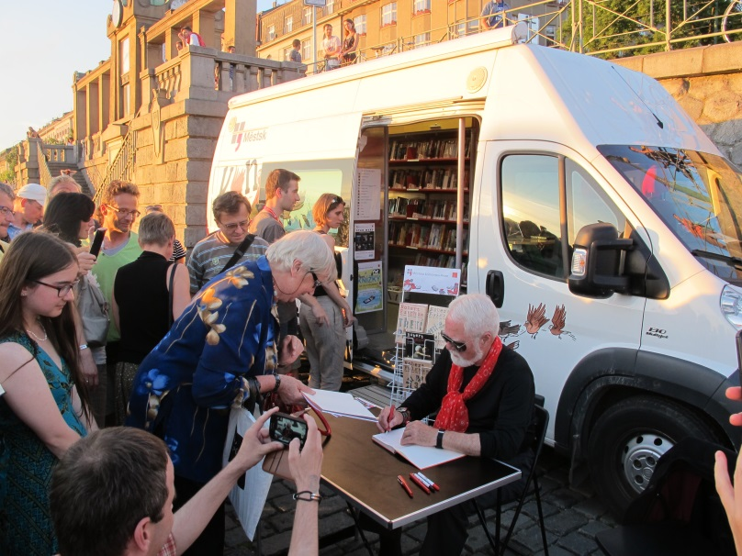
Promotion
library as a part of a cultural life in Prague
cooperation with Prague cultural organizations
closer cooperation with city district administration and the City of Prague institutions
addressing other potential users, raising MLP awareness

Slide 15
Promotion
advertisement to the mobile library
Year in motion (2014) - a complex communication scheme oriented at movement, travel and mobility
printed materials (postcards, cutouts, bookmarks, library cards, info leaflets)
media
many media links
television and radio spots, articles média

Slide 16
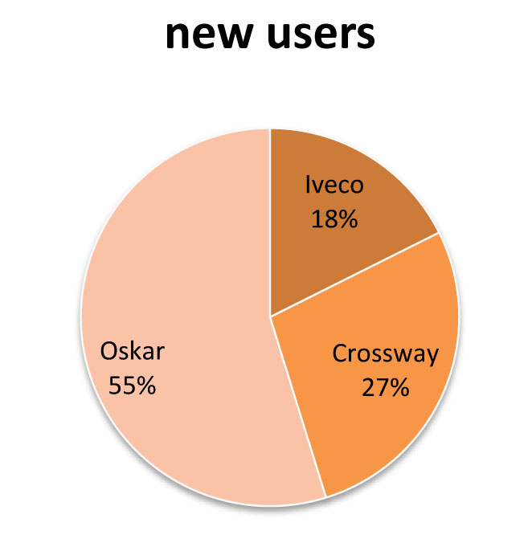
Comparison

Slide 17
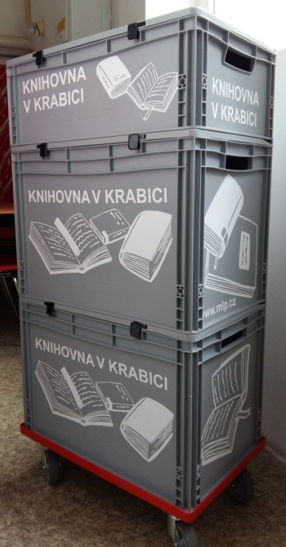
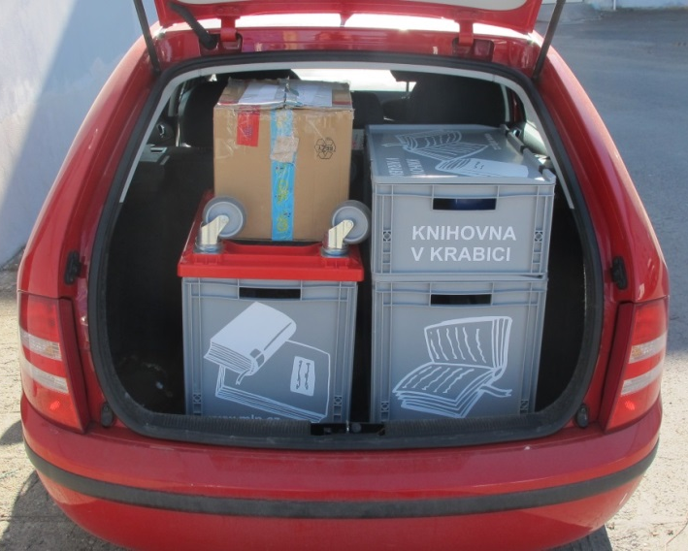
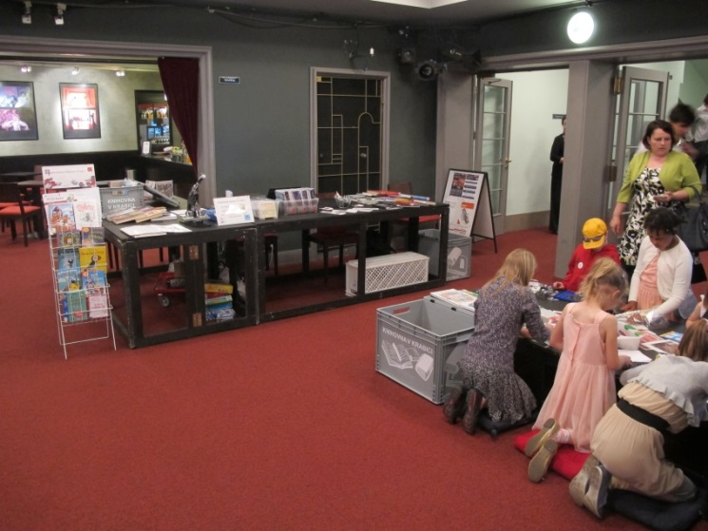
We tried „Library in box“
possibility to be “anywhere”
library services
accompanying program
fulfilled by a personal car
IT and other equipment
books, etc.

Slide 18
Possible developments for mobile services
„Library without Barriers“
librarian activation worker
for older readers and disadvantaged groups of readers
senior housing projects and similar institutions
few books, smaller equipment
cultural and educational programs
home delivery
for older and handicapped readers
delivery book to home

Slide 19
Possible developments for mobile services
„If you do not come to us, we will come to you“
delivery of set of books
delivery to a specific place and at a specific date
delivery comfort (possibility of evening and weekend schedules)
company benefit – order a library/librarian up to your placepaid service
paid service
delivery of the reserved books outside the library
lending books "anytime anywhere"
increase reader comfort
possible cooperation with a delivery service

Slide 20
Thank you for your attention
Vanda Fritschová
vanda.fritschova@mlp.cz
Pavel Machart
pavel.machart@mlp.cz

