Slide 1
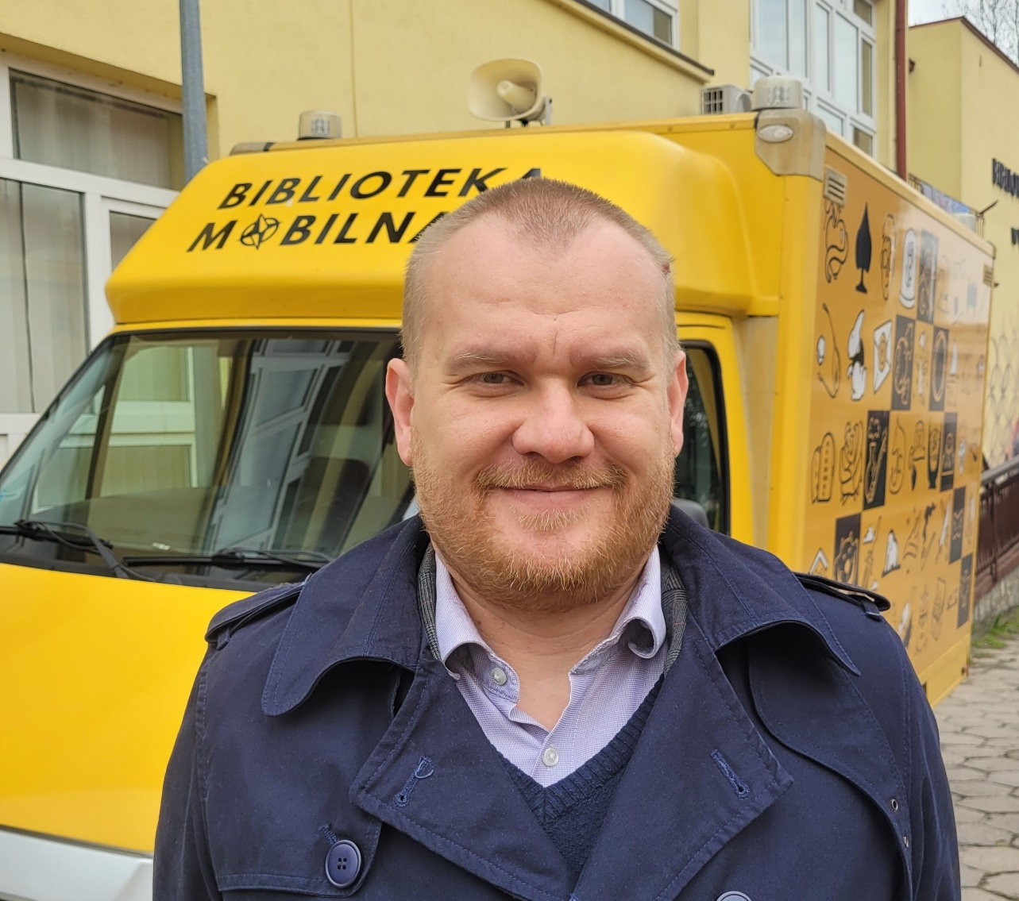
#IFBK23 – Bibliobuses in Poland
Przemysław Pawlak – Director of the Public Library in Gostyń; President of The Polish Association of Mobile Libraries

Slide 2
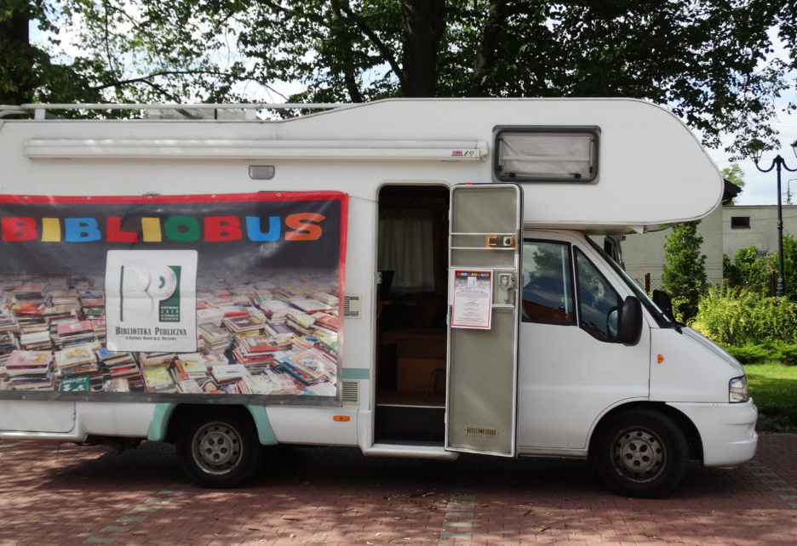
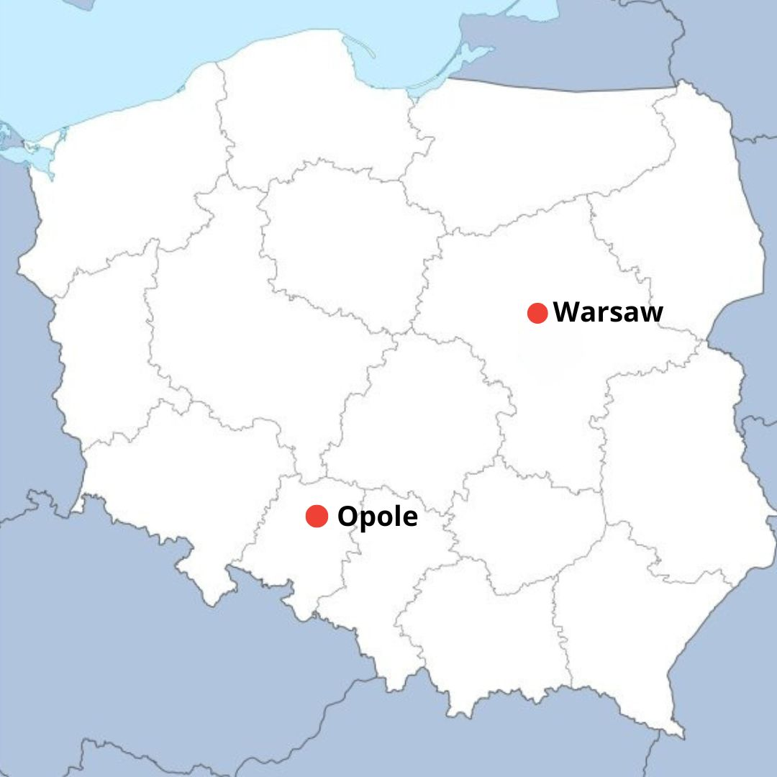
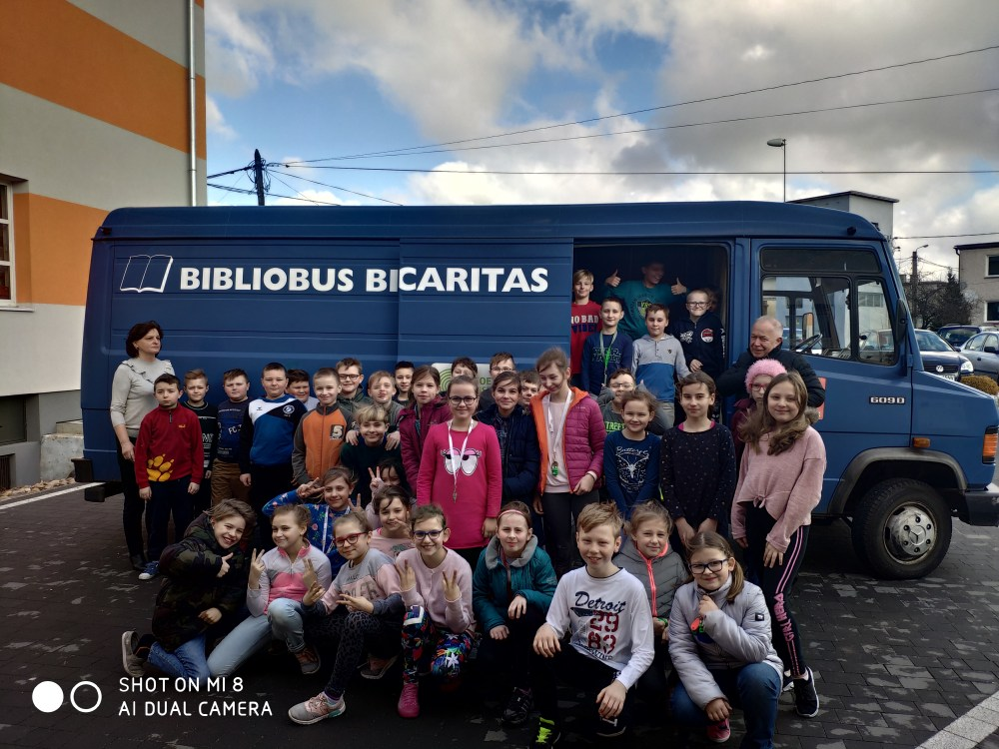
In 2017, there were only two mobile libraries in Poland – in Opole and in Warsaw

Slide 3
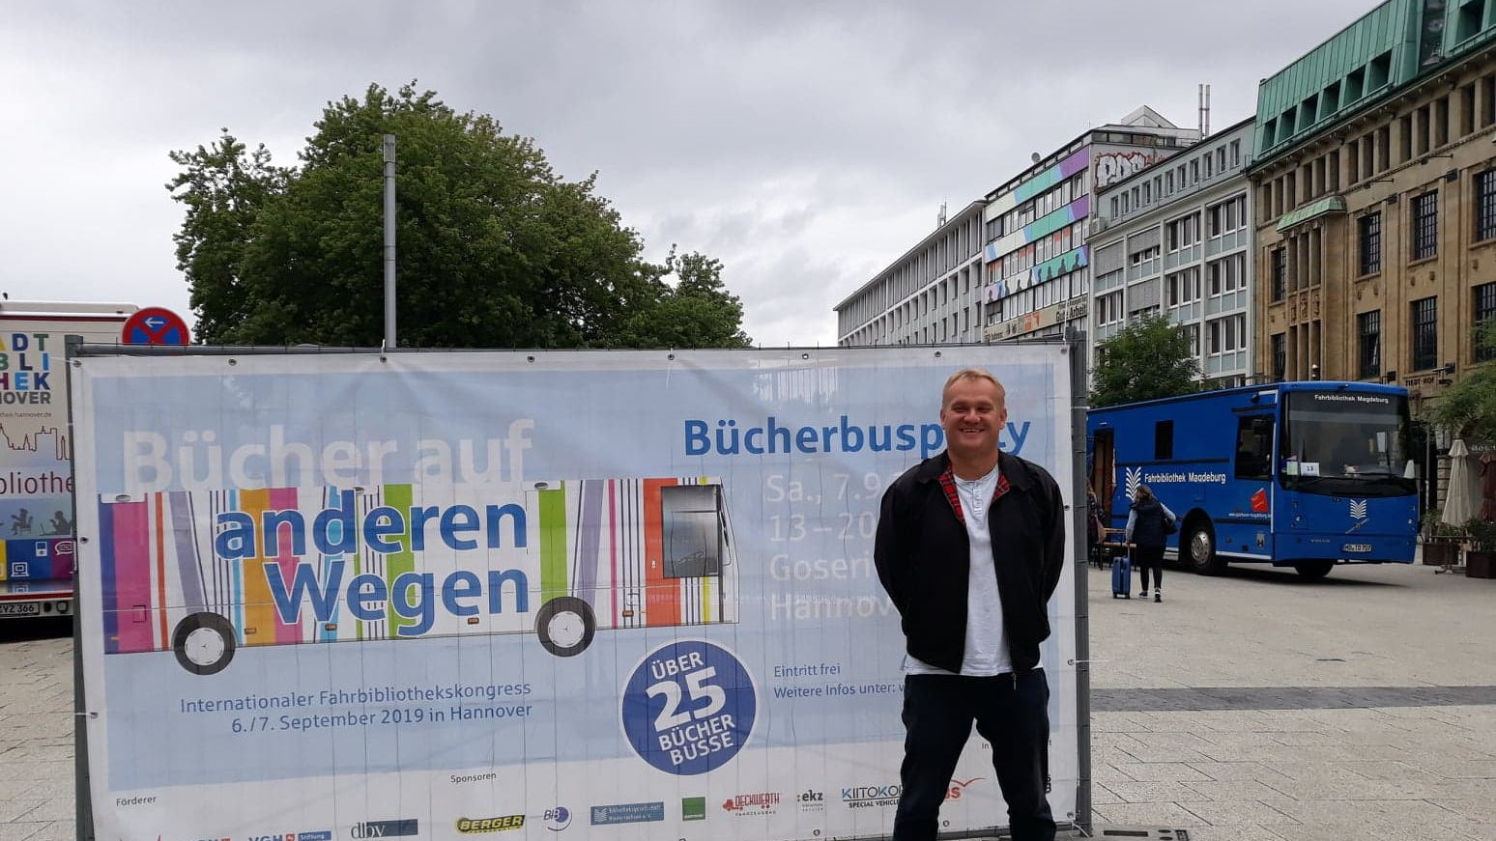
In 2019 we went to Hannover for IFBK and have looked at the best solutions

Slide 4
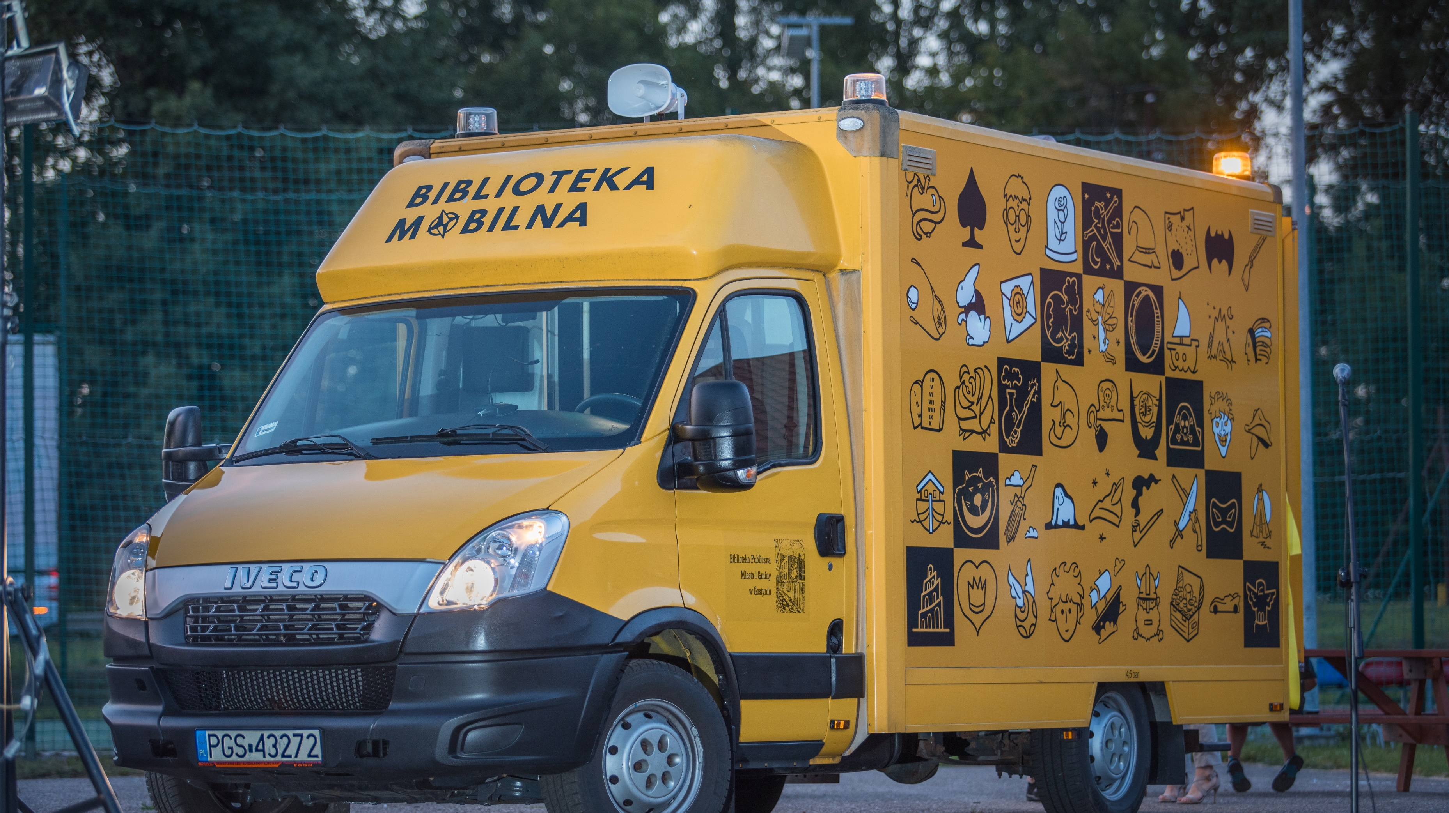
First of all, we launched our own bibliobus in Gostyń

Slide 5
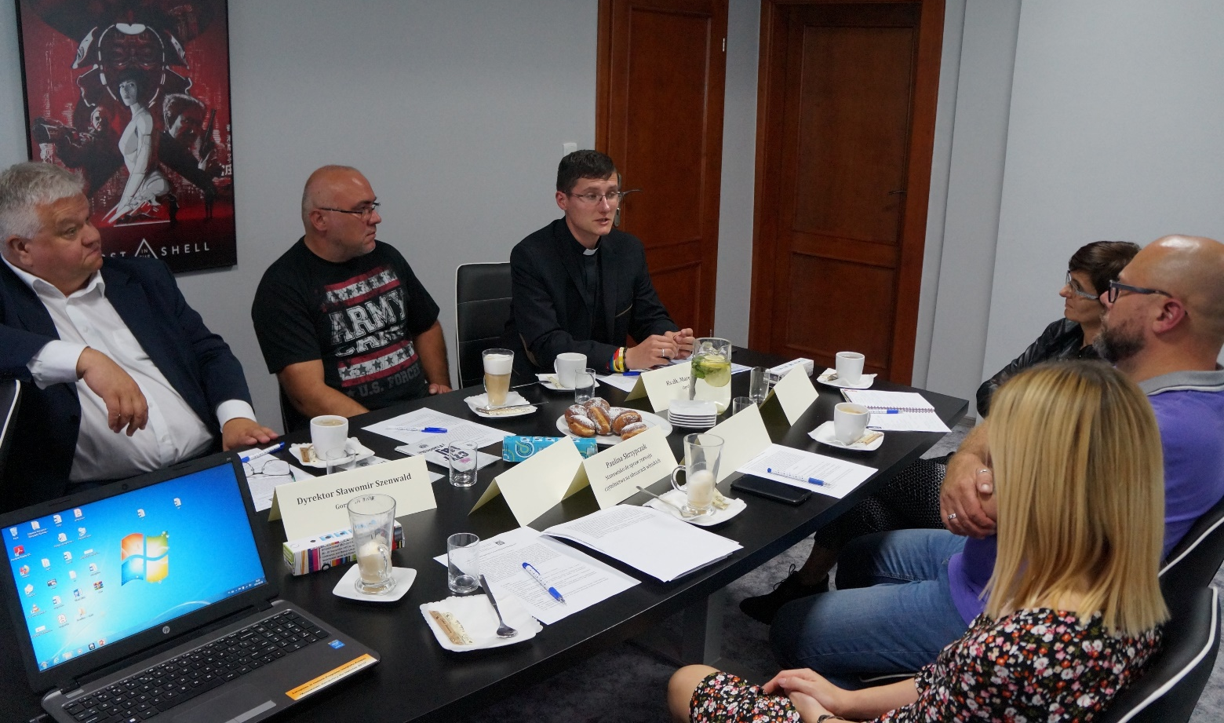
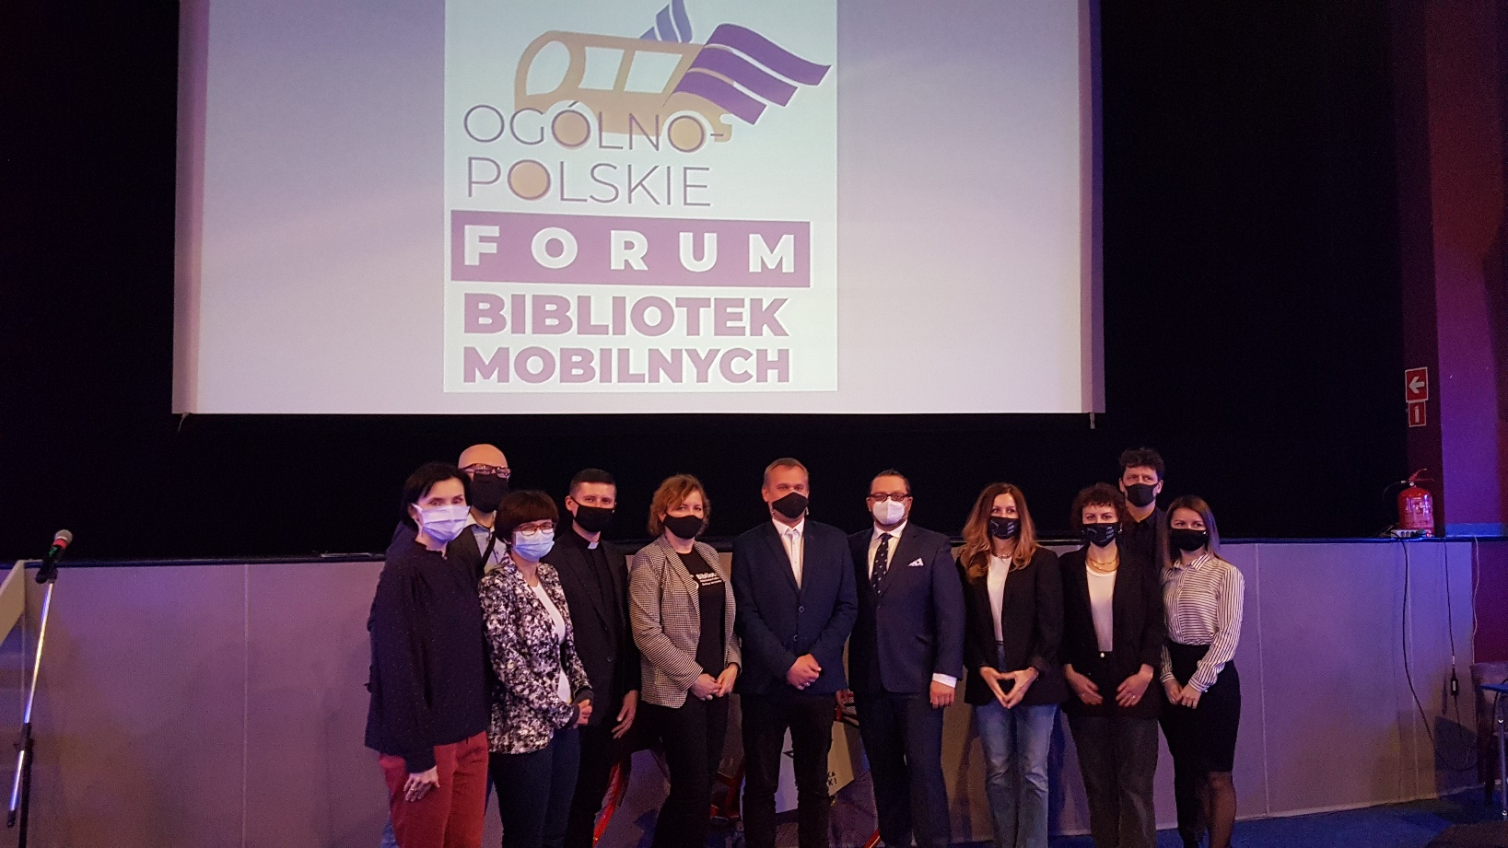
Secondly, we made contacts with other libraries that want to have library buses

Slide 6
Thirdly, we got interested important institutions in the subject: The Polish Book Institute, The National Library and The Ministry of Culture and National Heritage

Slide 7
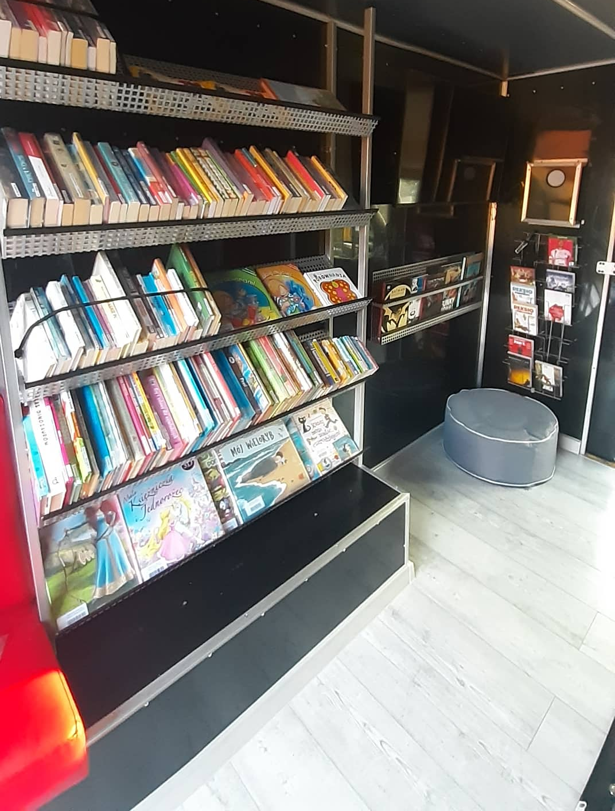
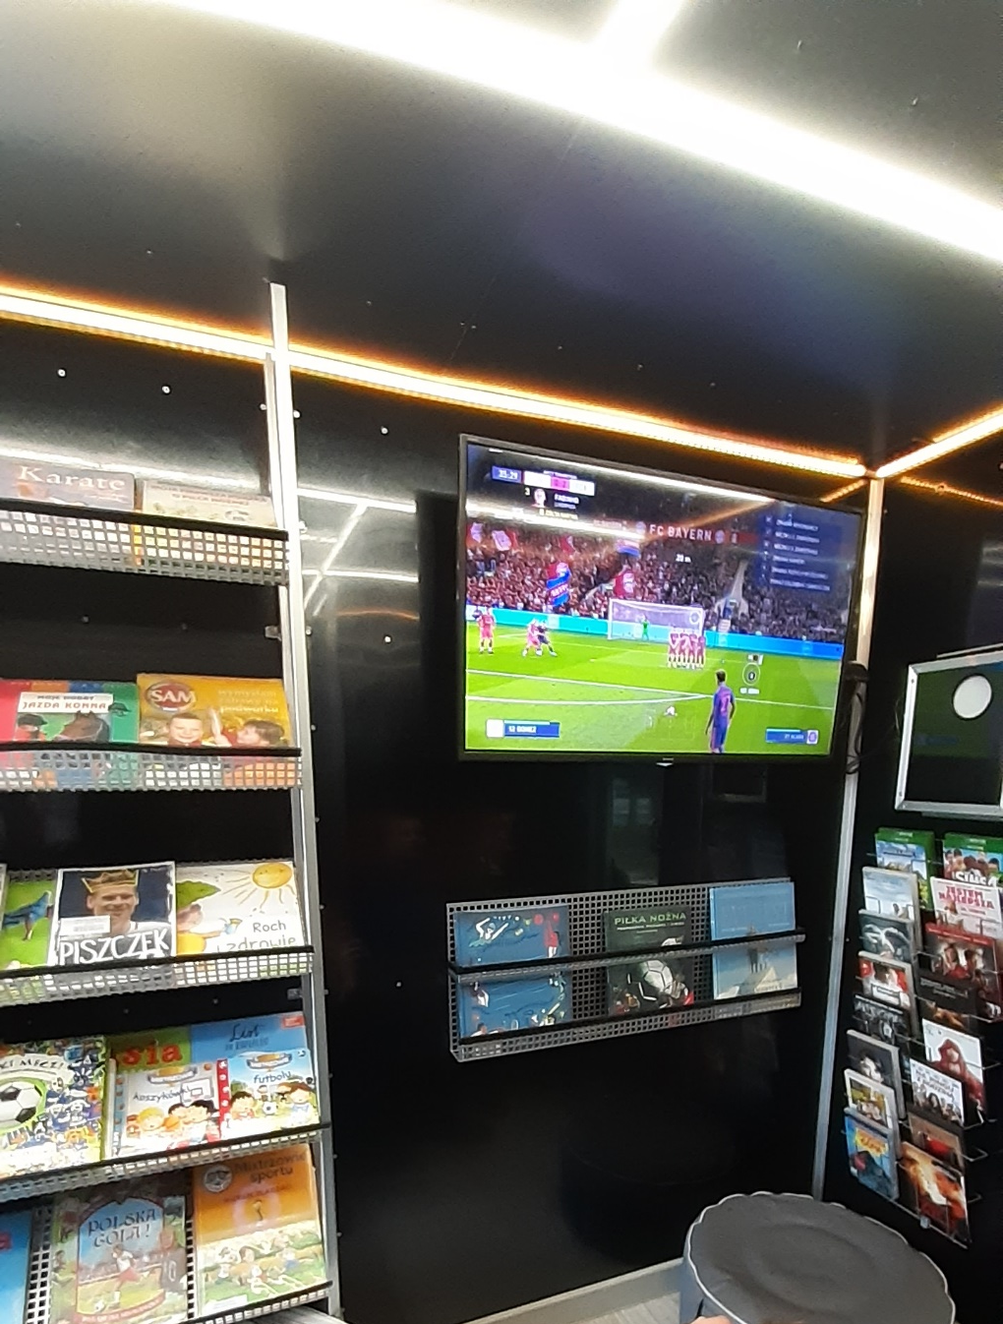
We made a mini library in our library bus. We have books, movies, video games, cinema, newspapers, we do educational and cultural activities for children.

Slide 8
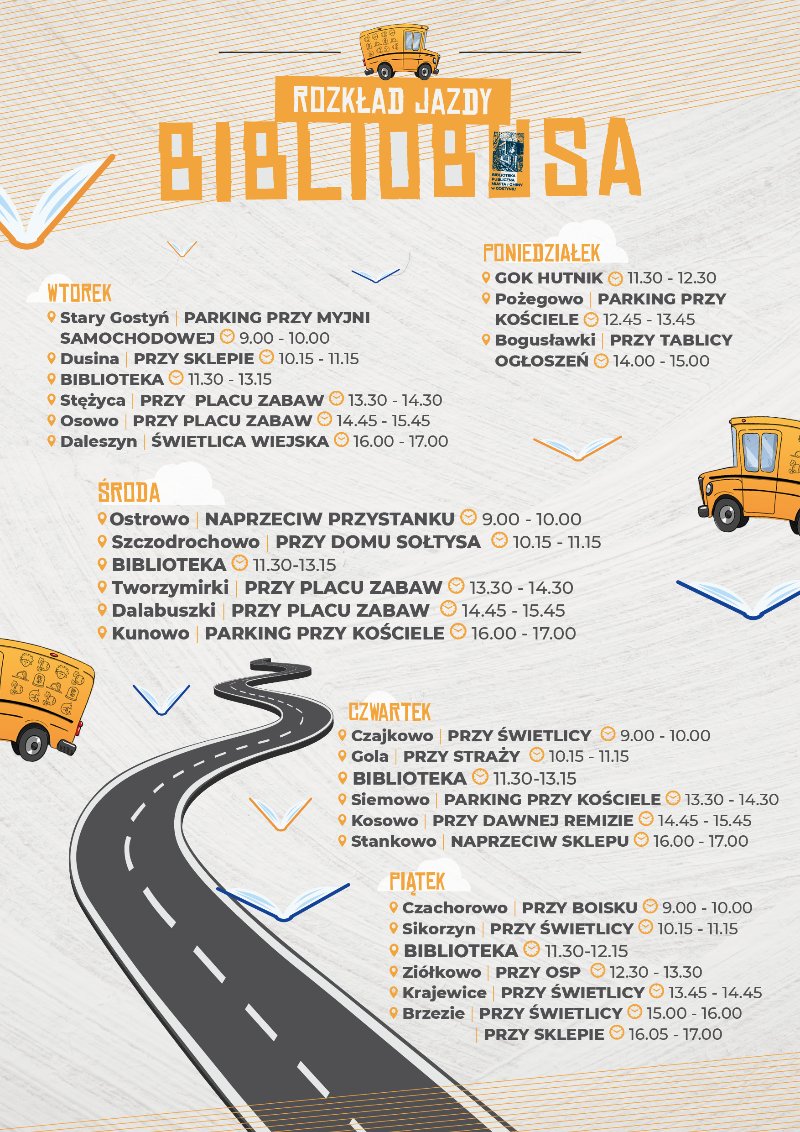
We reach 21 villages and two housing estates in the city each week

Slide 9
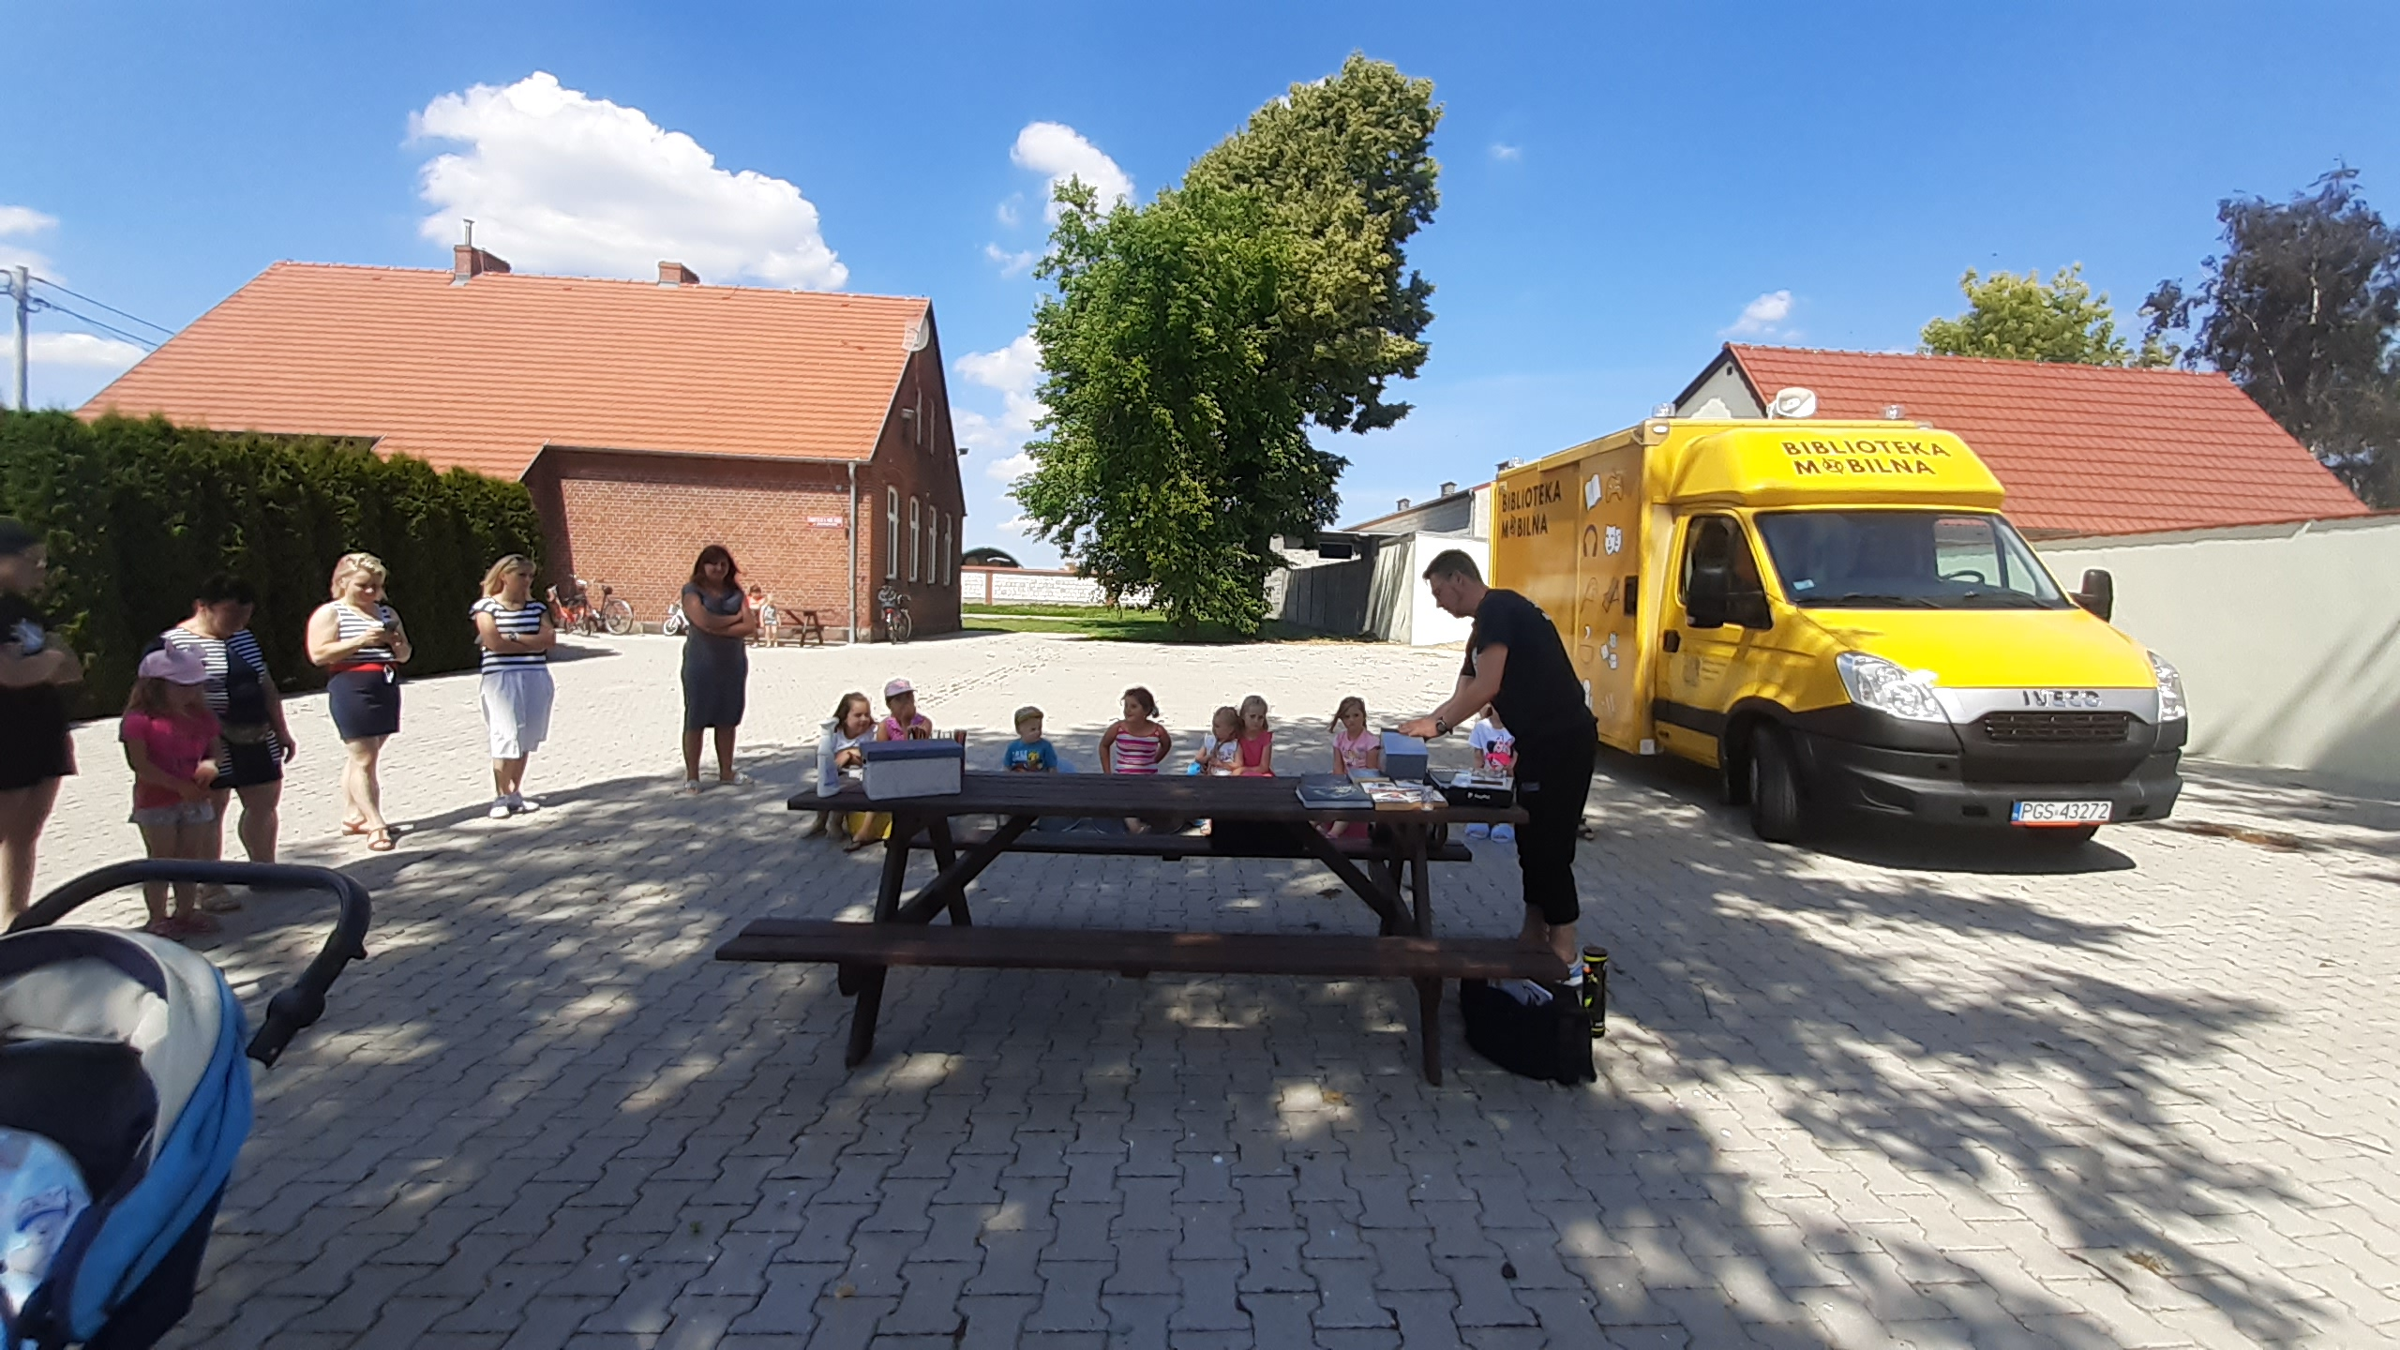
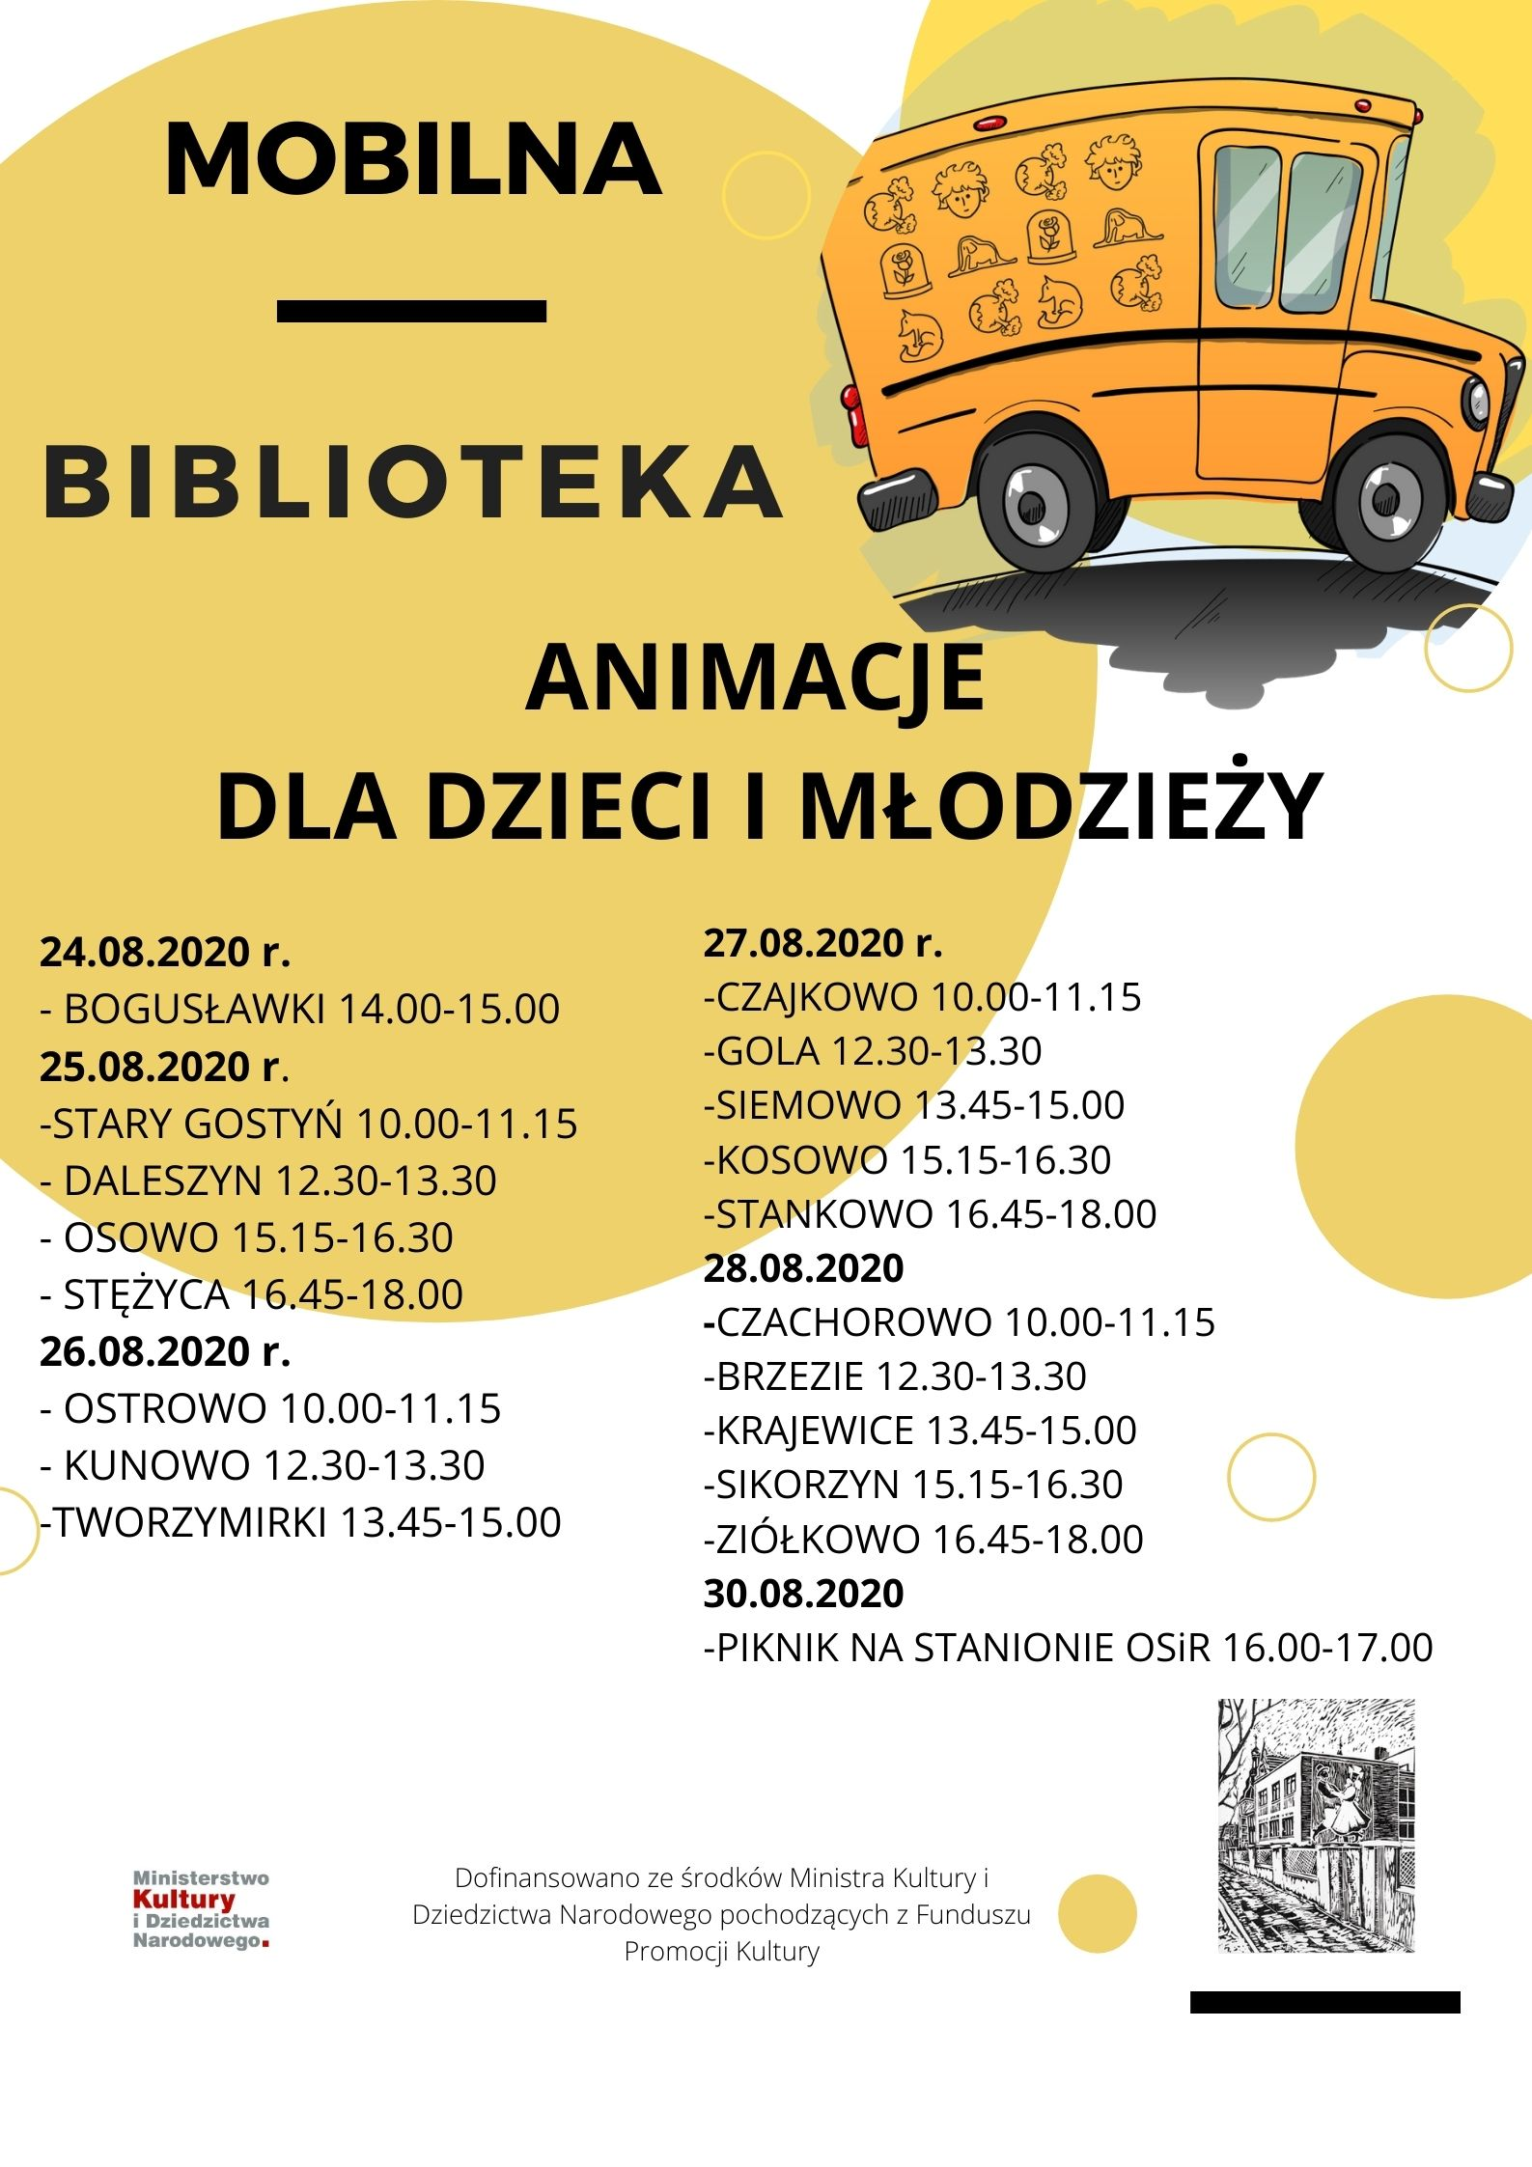
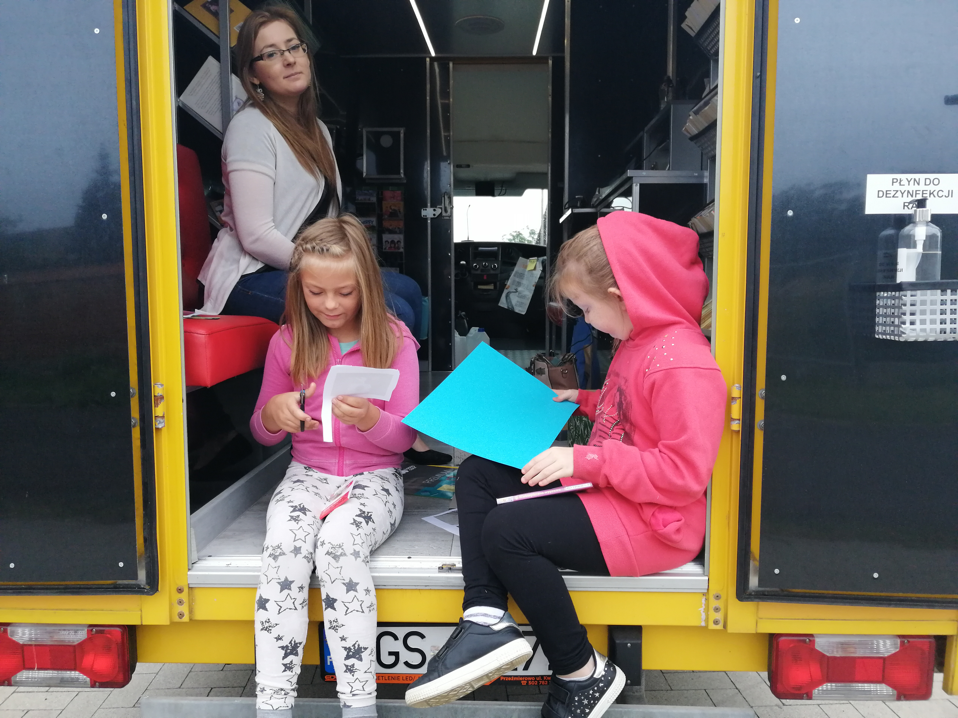
Projects - We have a financial support from The Polish Book Institute – as a result, we have been able to realise over 200 cultural activities for children in the years 2020-2023.
Library on the way – 2020

Slide 10
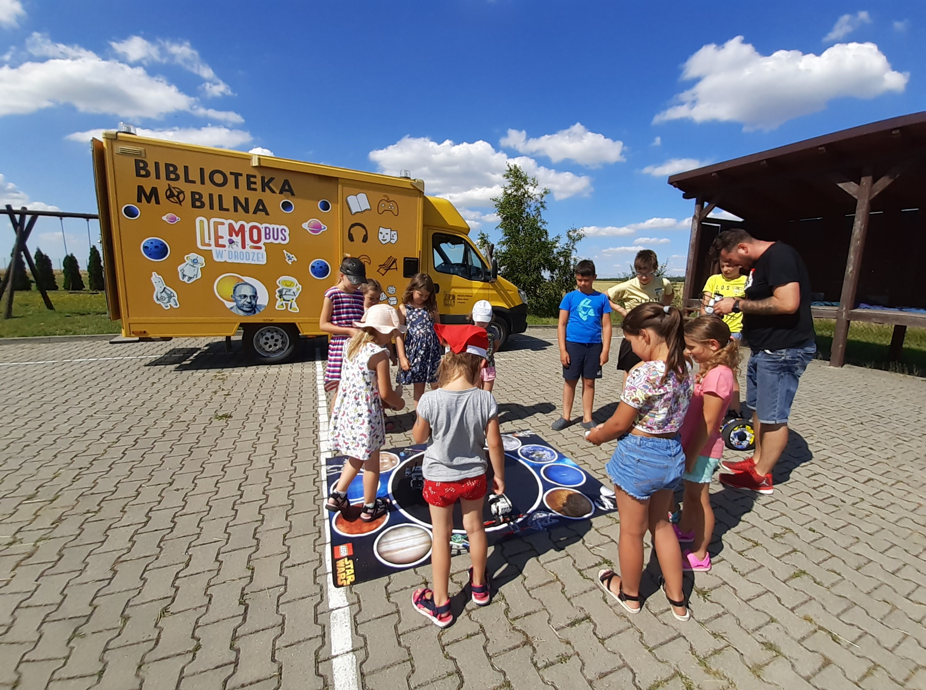
LemoBus - 2021

Slide 11
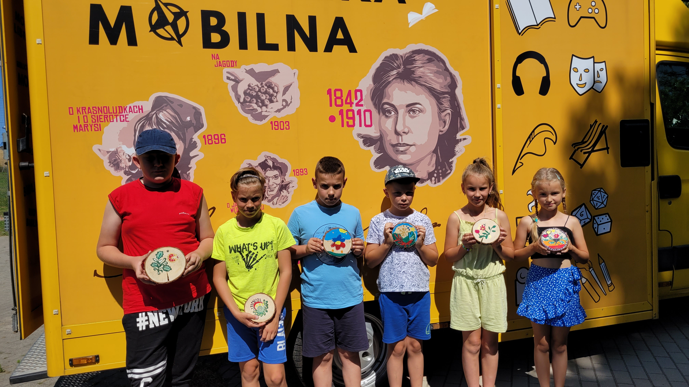
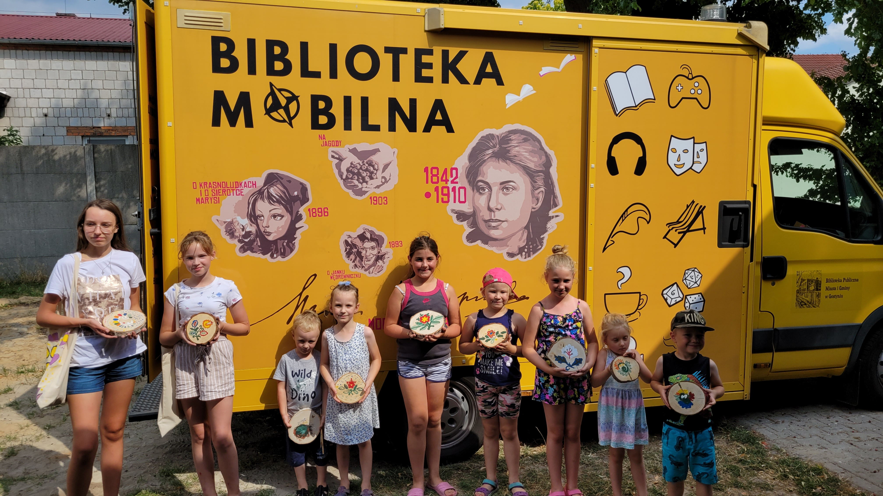
Mobilna eM-Ka - 2022

Slide 12
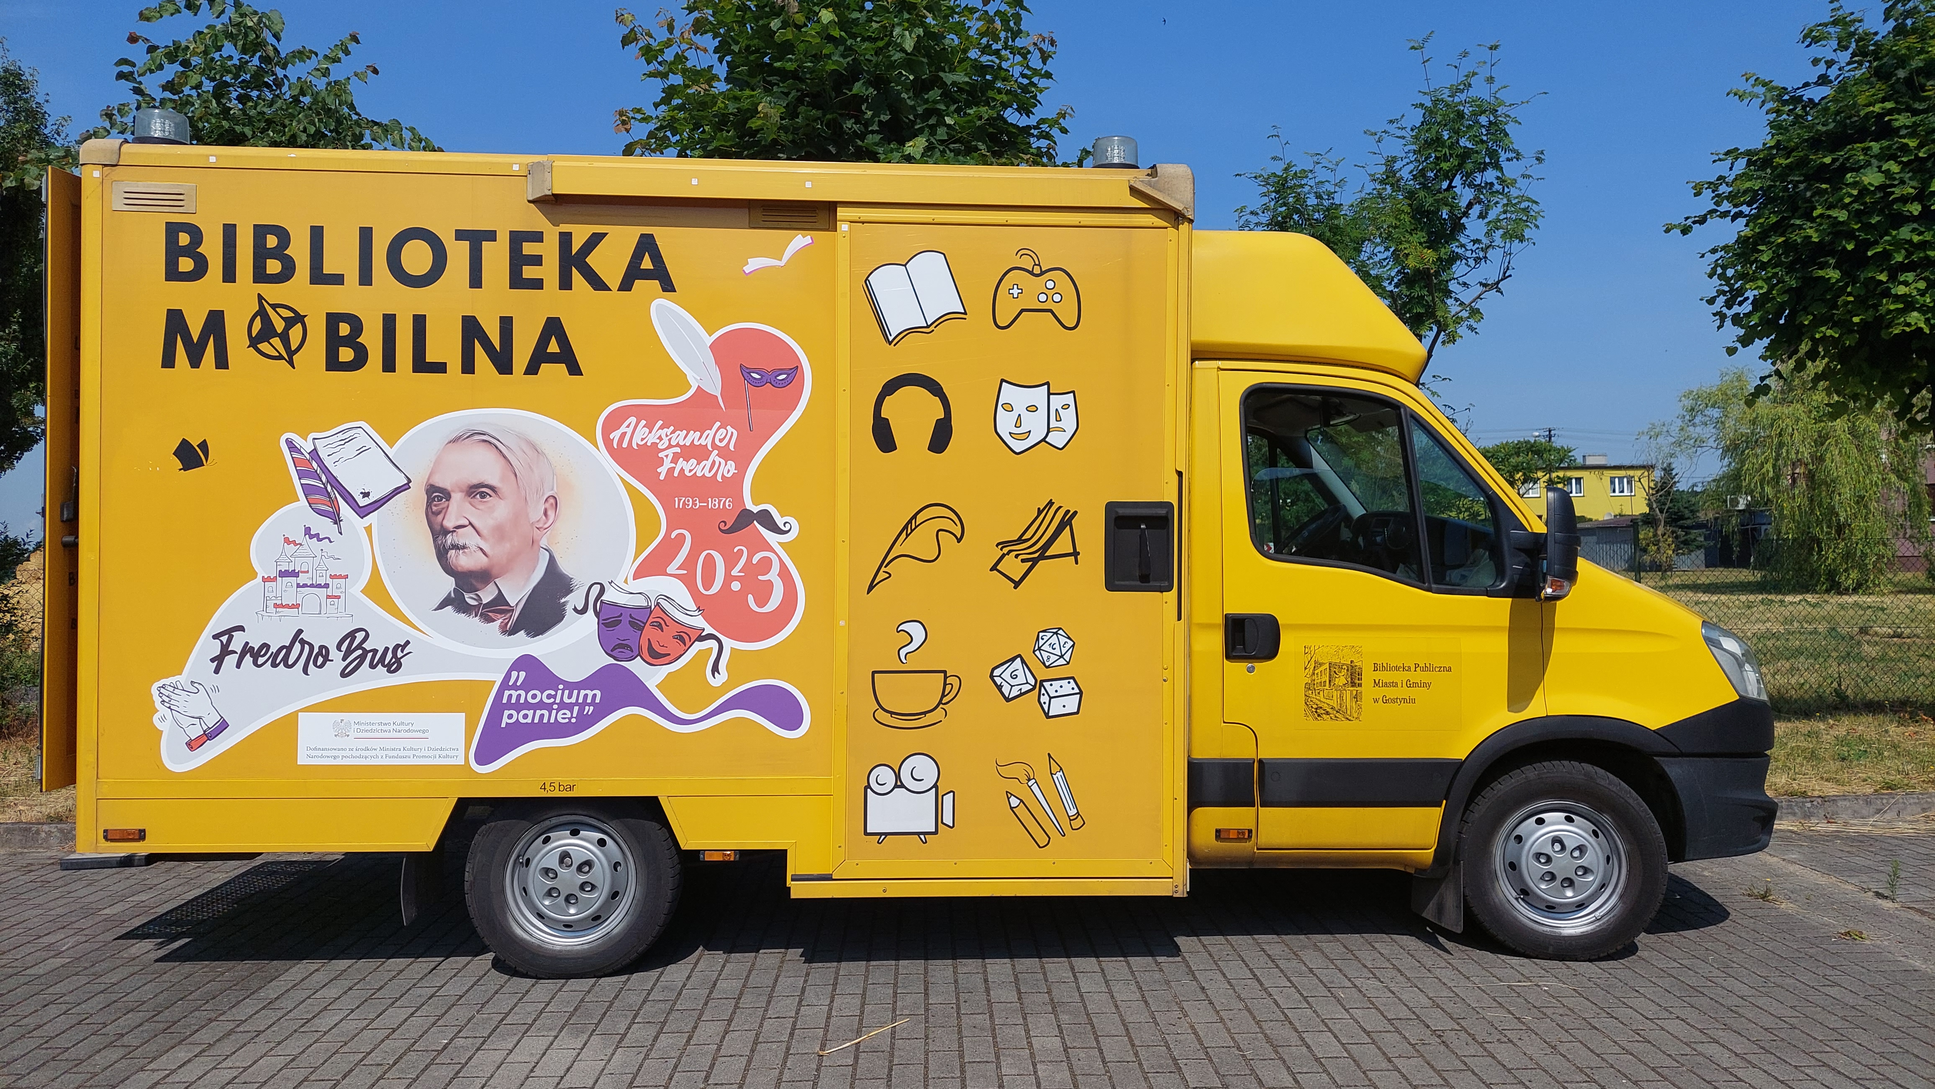
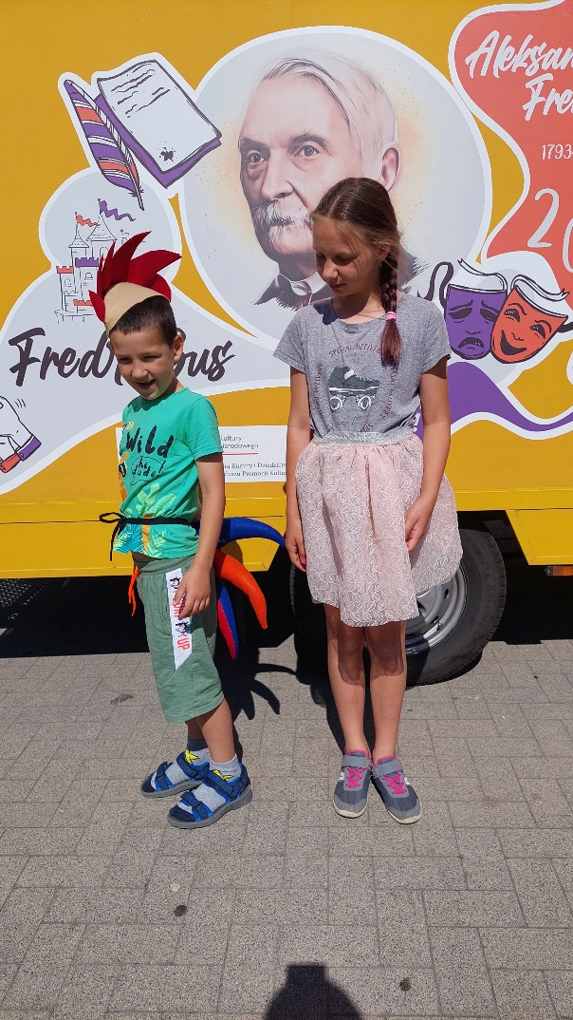
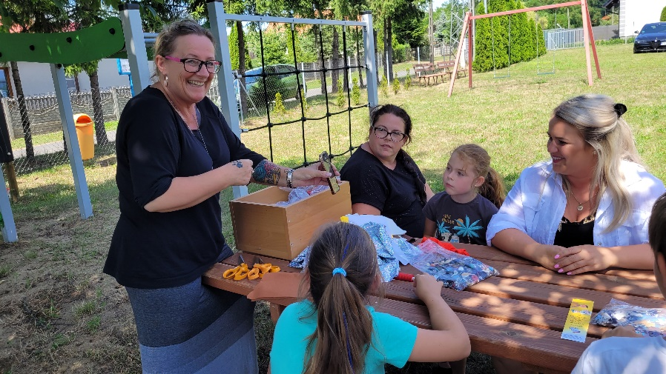
FredroBus - 2023

Slide 13
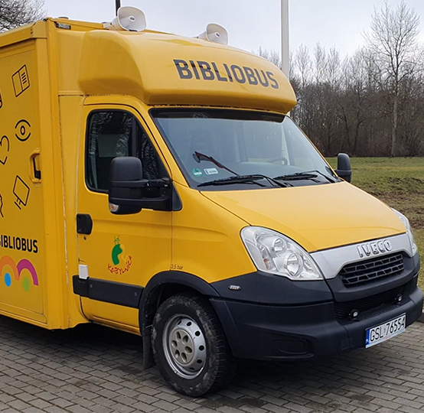
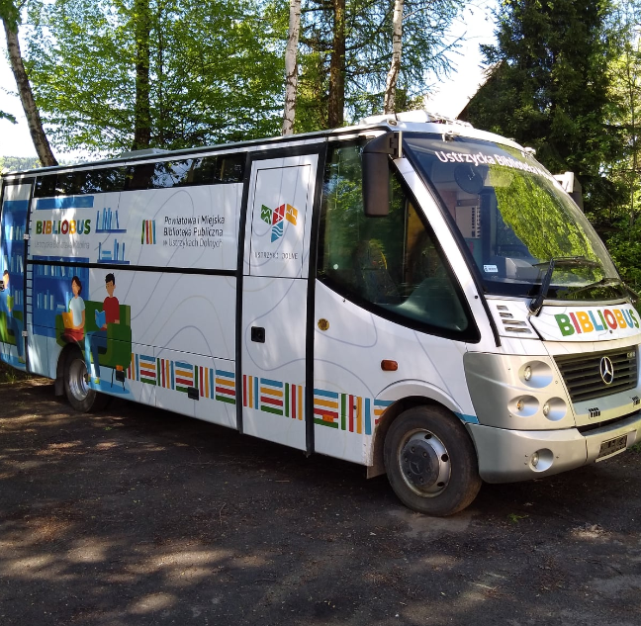
We have become an example for other libraries in Poland. Due to this two new bibliobuses modeled on ours were created. These are Kobylnica near Słupsk in Pomerania and Ustrzyki Dolne near the border with Ukraine.

Slide 14
Another about 10 libraries are interested in introducing library buses. In order to encourage city and country authorities to allocate money for library buses, we show how effective library buses are.

Slide 15
We estimate that in Poland there is a need for about 40 bibliobuses in the next few years.

Slide 16
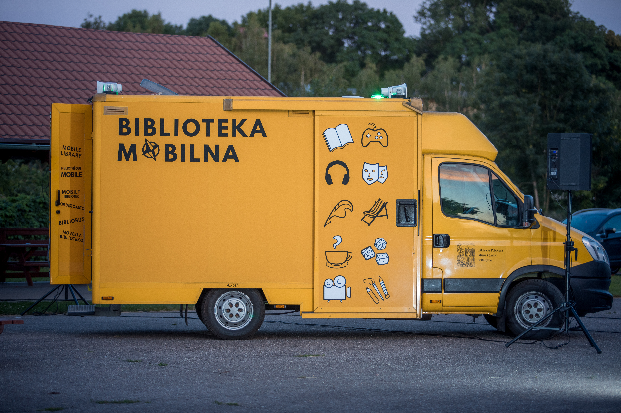
Thank you for your attention

