Slide 1
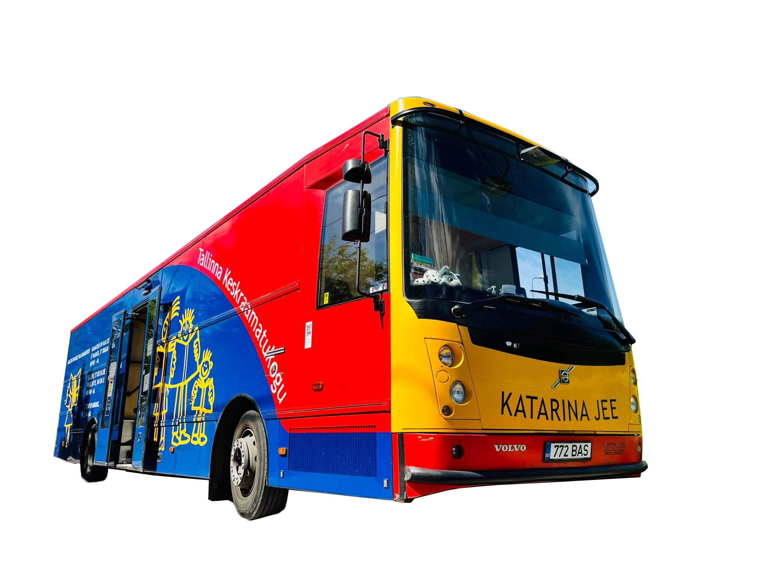
Service in tallinn
The Estonian Mobile Library
Notes:
Note 1

Slide 2
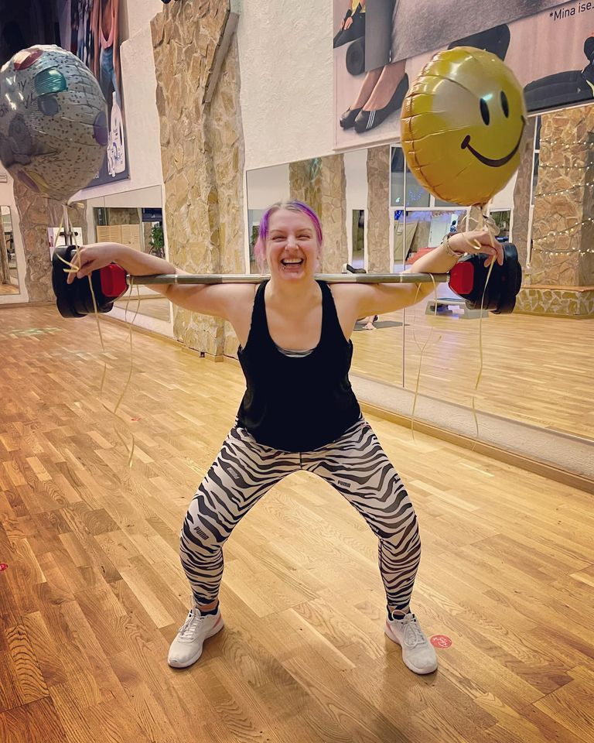
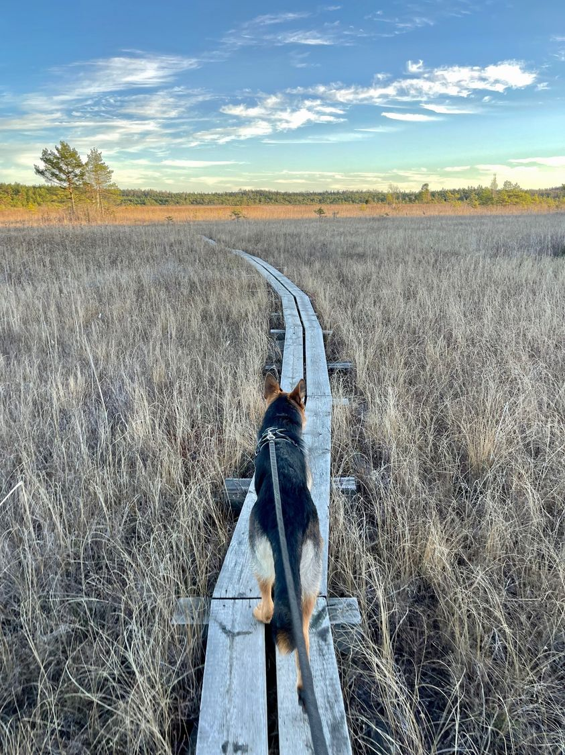
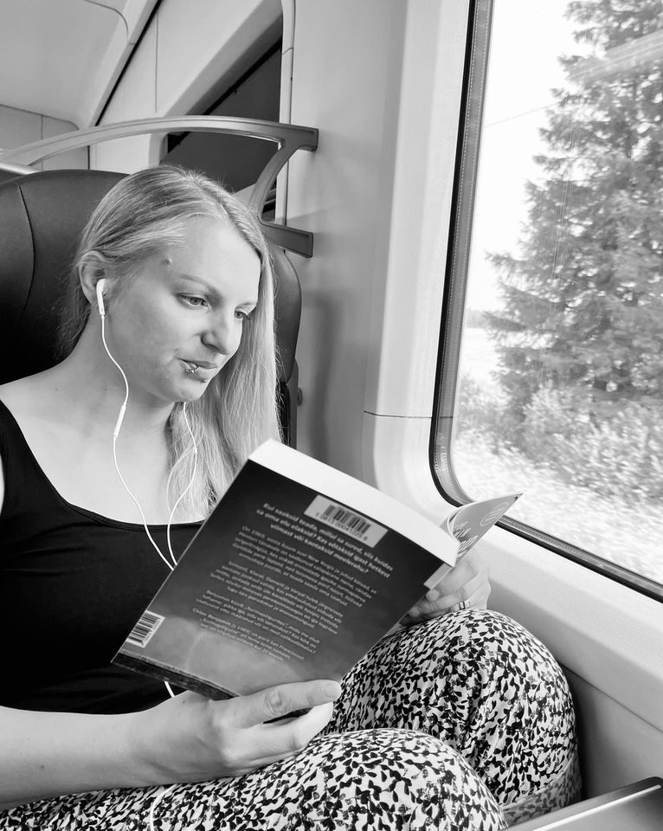
Annika Marsh, Chief Librarian
University of Tartu Viljandi Culture Academy
(B.A, Library and Information Science)
Tallinn Central Library, 15 years
(Manager of the Mobile Library, 13.5 years)
Recognition:
The Annual Colleague Award, 2022
TCL Best Children’s Service, 2018
Tallinn’s Best Library Award, 2017
The Special Award from ANDRAS, 2017
Notes:
Note2

Slide 3
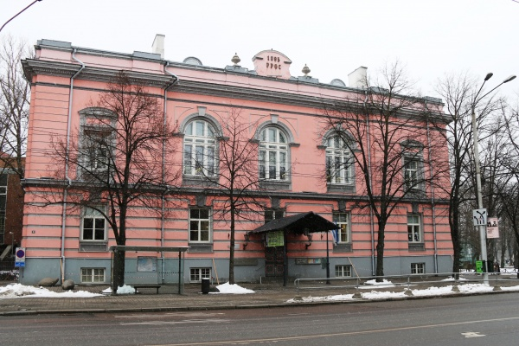
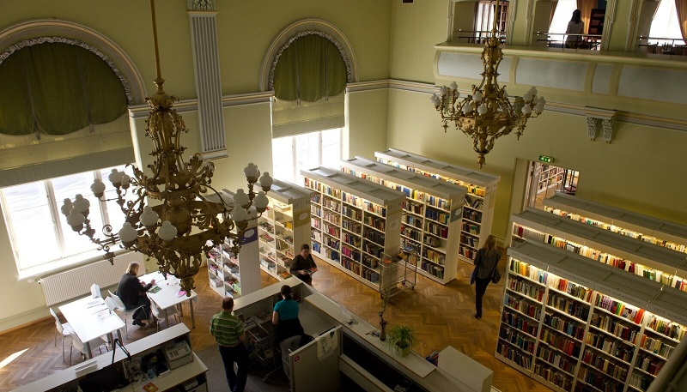
Tallinn Central Library
2 Departments
(Estonian Literature, Foreign Literature)
17 Branch Libraries
1 Mobile Library
1 Library Bicycle

Slide 4
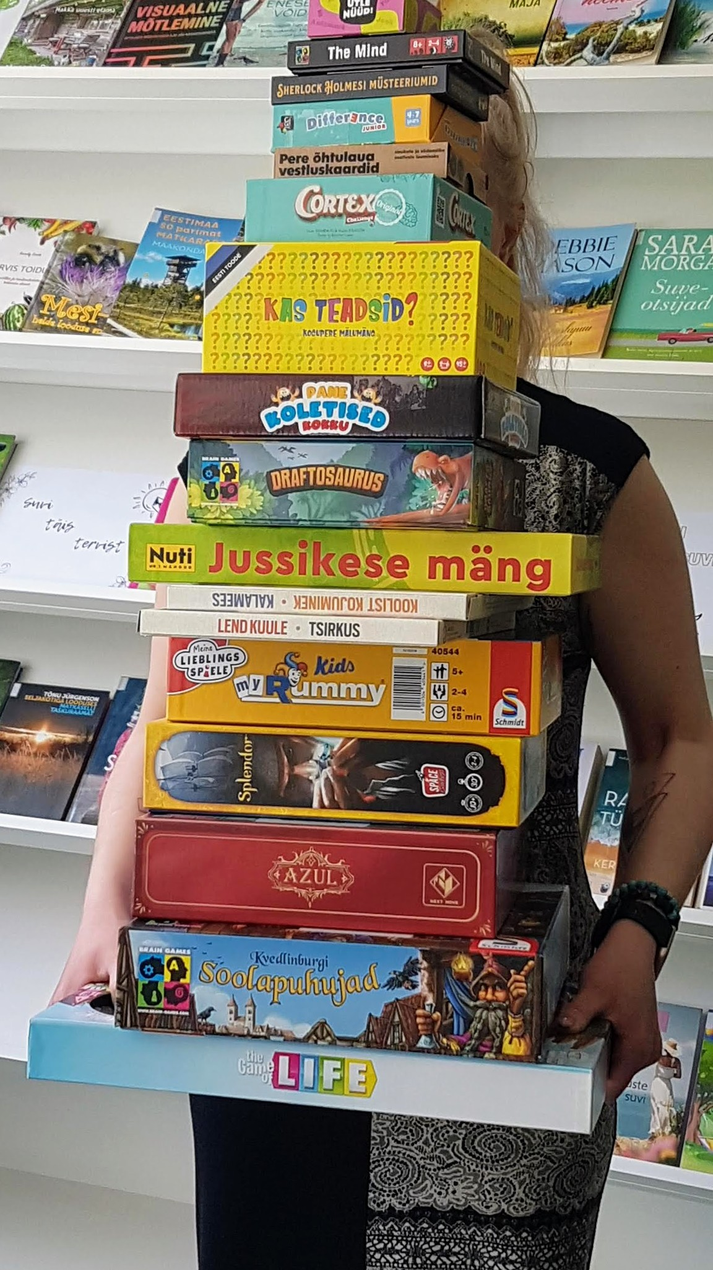
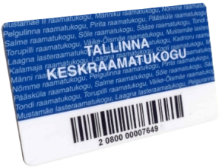
TCL Home Lending
E-catalogue ESTER/ Sierra Library System
Books and audiobooks, DVDs and CDs
Magazines and newspapers
E-readers for e-books
Boardgames and card games

Slide 5
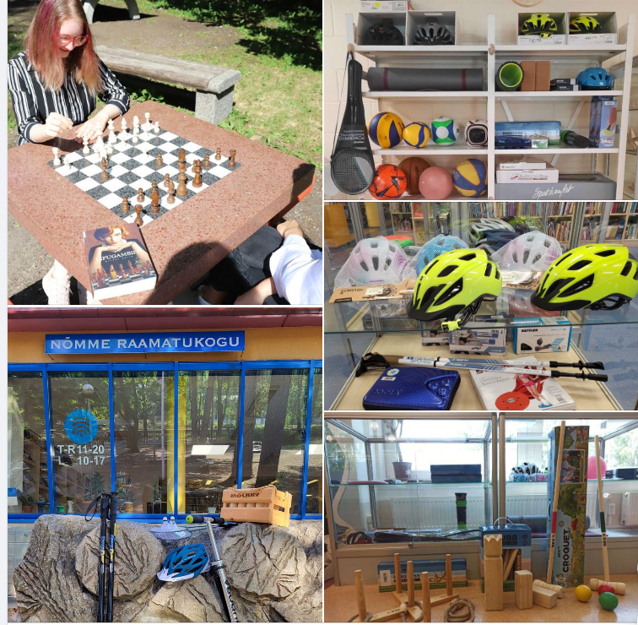
TCL Home Lending
Music Box (Main Library)
Seed Box (Laagna Branch)
Tool Box (Pelguranna Branch)
Sporting Equipment (various)
Museum Tickets (Kalamaja, Kadrioru Branch)
Innovation Lab (Kännukuke Branch)
Sewing Room (Sõle Branch)
E-libraries (ELLU, Overdrive, Naxos)

Slide 6
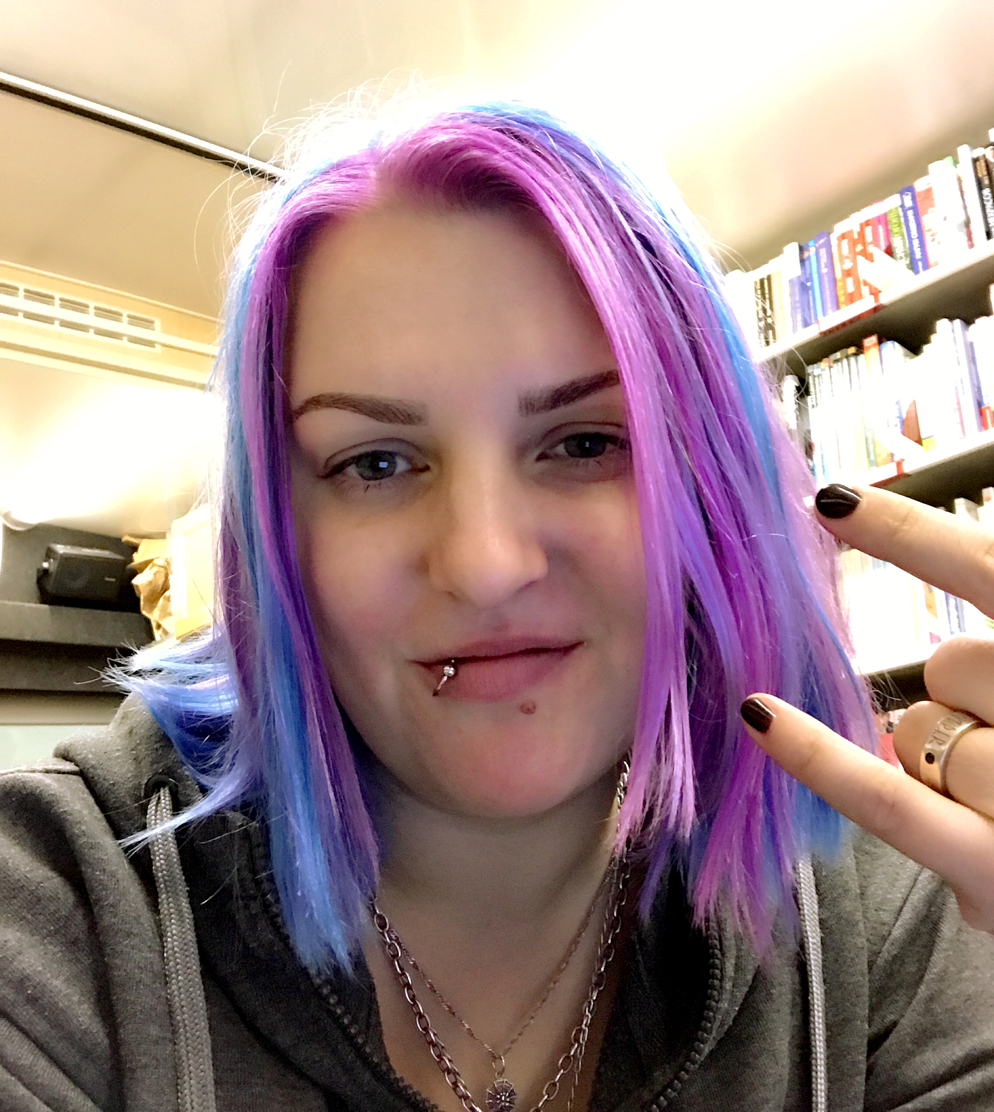
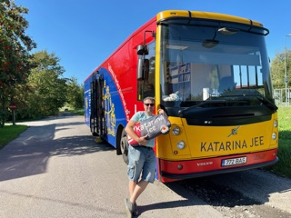
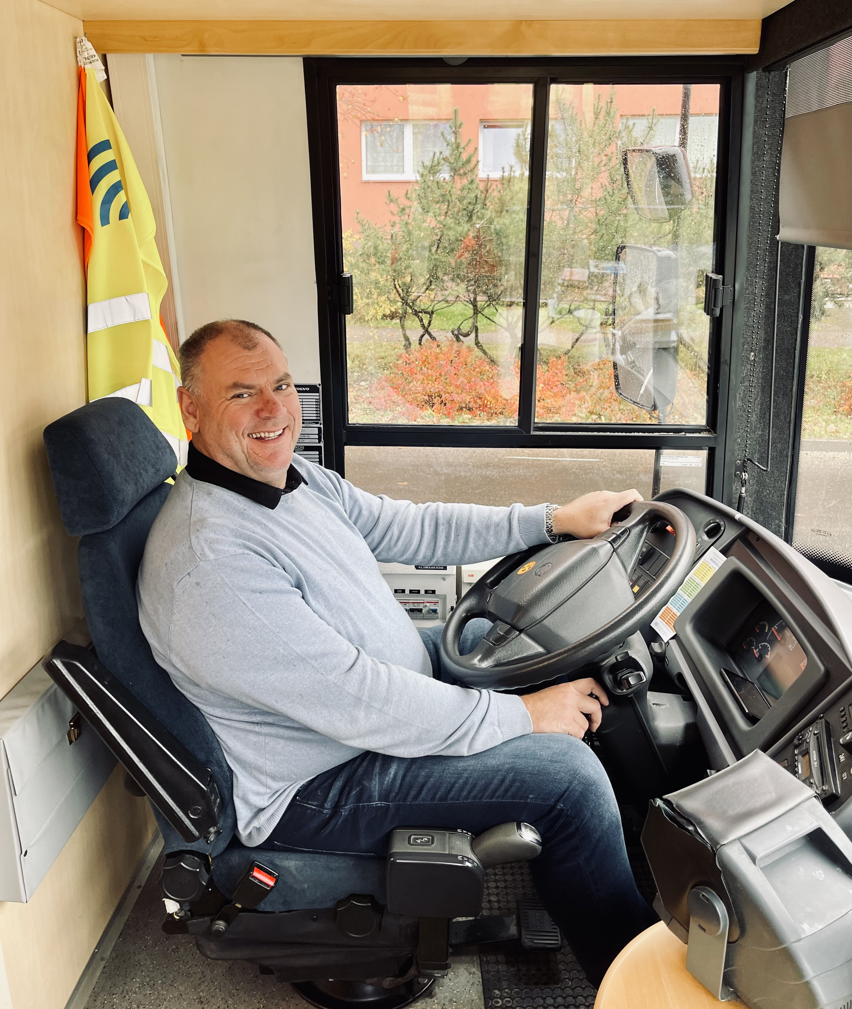
ANNIKA
MEELIS
MART
Chief Specialist
Mon, Tue, Thurs | 11.30 AM – 7.30 PM
Wed | 11 AM – 7 PM
Fri | 9 AM – 5 PM
Bus Driver/Assistant
Mon - Thurs | 12 PM – 8 PM
Fri | 9 AM – 5 PM

Slide 7
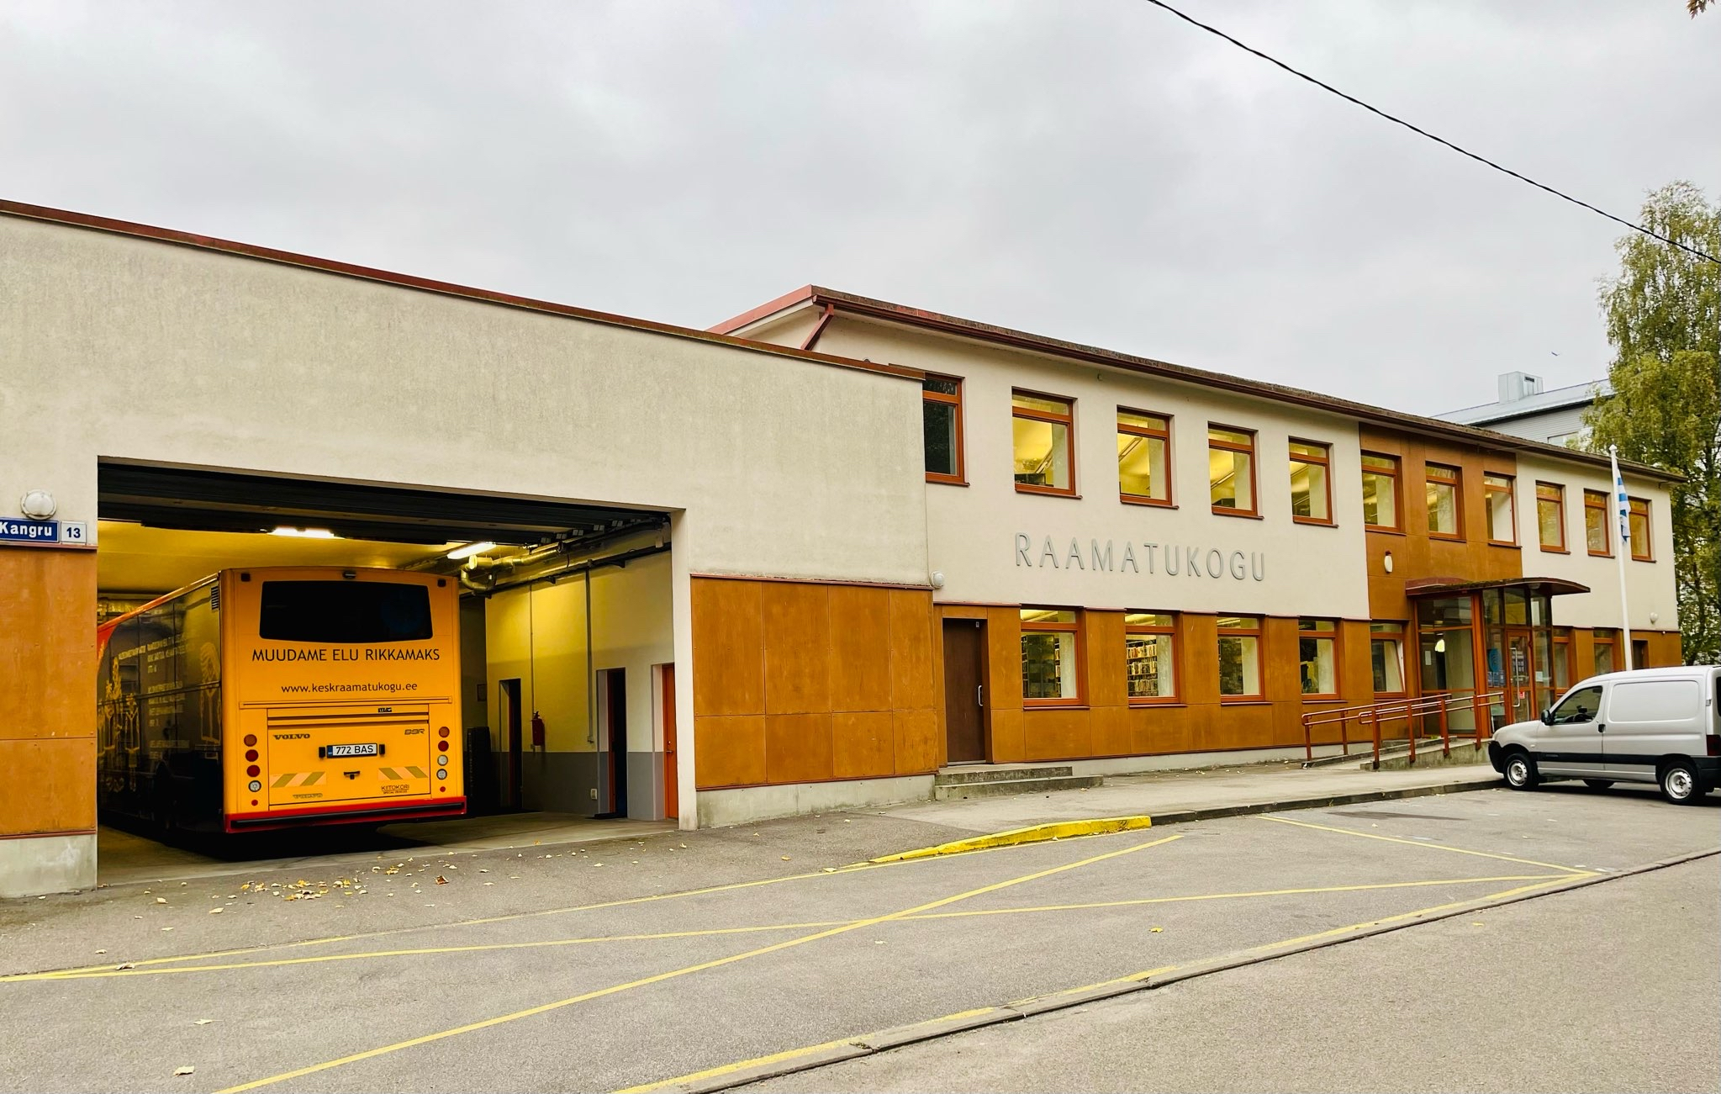

Slide 8
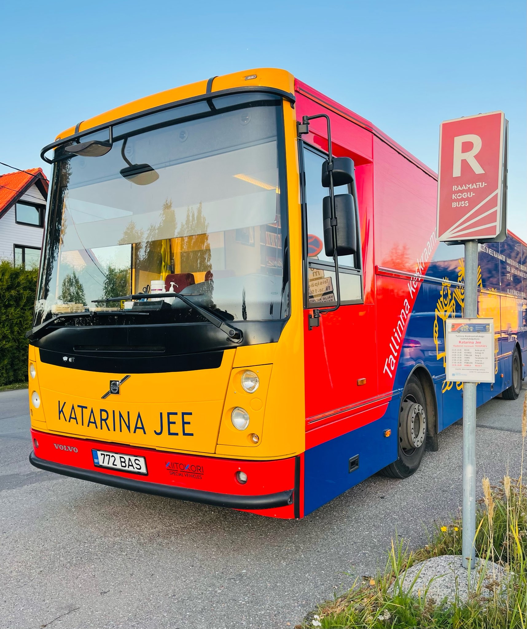
Over 15 years - May 13, 2008
4 administrative districts in Tallinn
Monday – Thursday
26 stops in 4 days
30 minutes per stop
Open to the public 13 hours a week
Fridays – Educational Programs at Schools or Kindergartens
Special events on the weekends

Slide 10
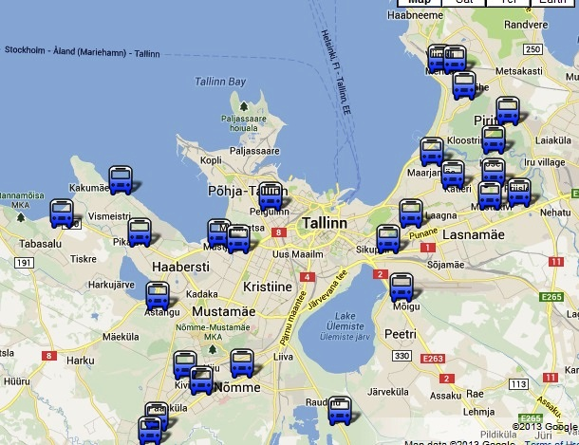

Slide 11
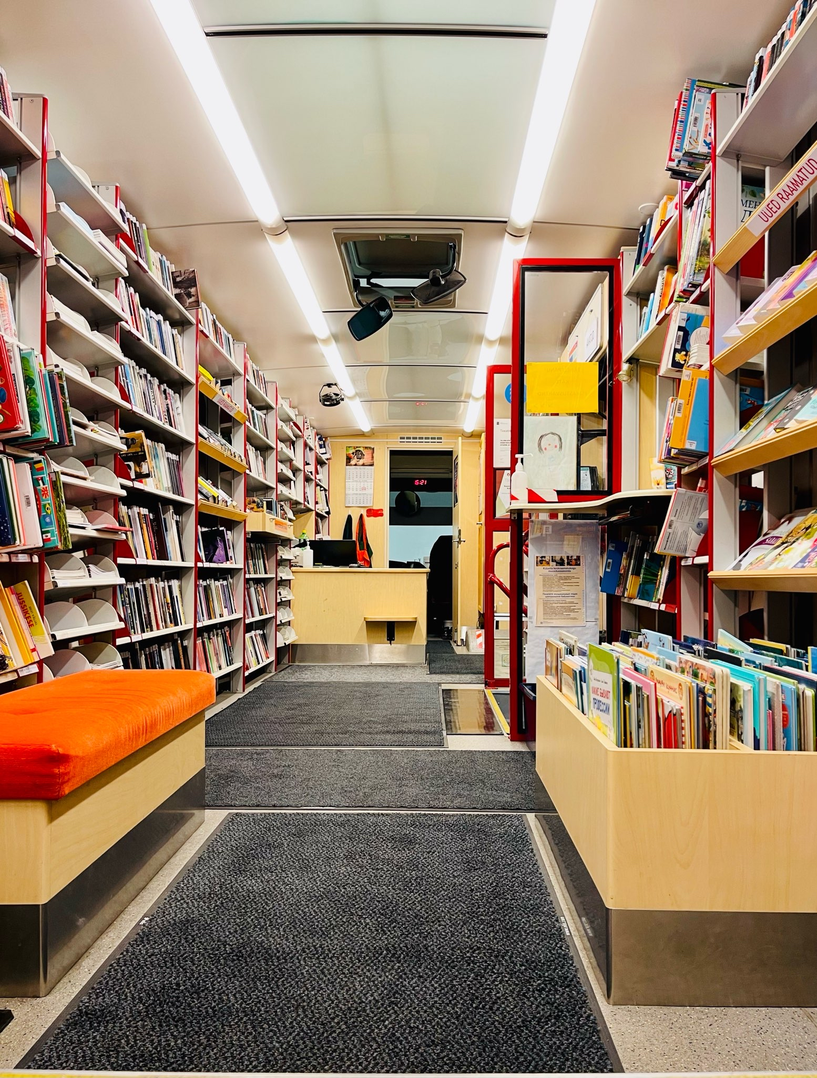
Bus’ Collection
4,000 books on board
Collection updated regularly
Book ordering from Pelguranna Branch
Books for adults, youth and children in Estonian, Russian and English, also Ukraine
Magazines for adults and children in Estonian and Russian
Audiobooks for adults and children in Estonian
E-reader for e-books

Slide 12
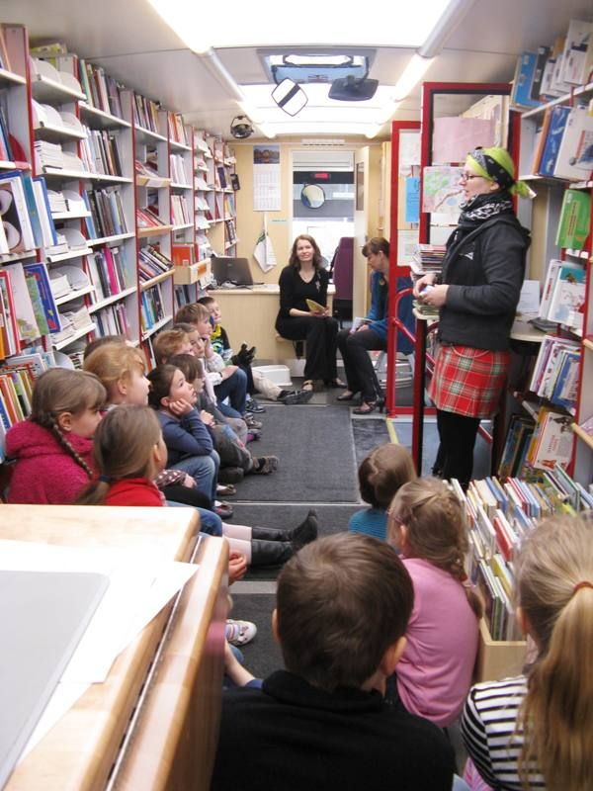
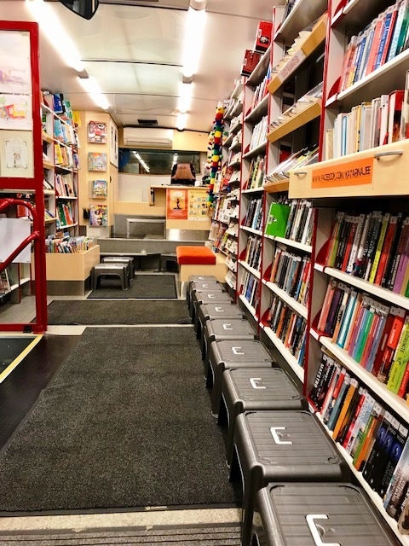
Educational Programs
Only on Fridays
Schools, Kindergartens and Childcare Centres
25 minutes for one group
4 groups, 25 kids in a group

Slide 13
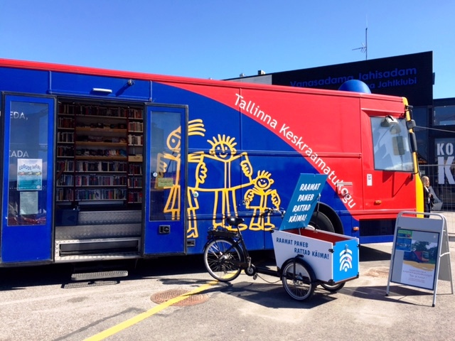
Events
Only on Fridays or on weekends
Participating in citywide events - community events, festivals etc
Pop-up Library Bus in different locations
Joint events with other Branch Libraries
Visiting adult care homes
Visiting people with special needs

Slide 14
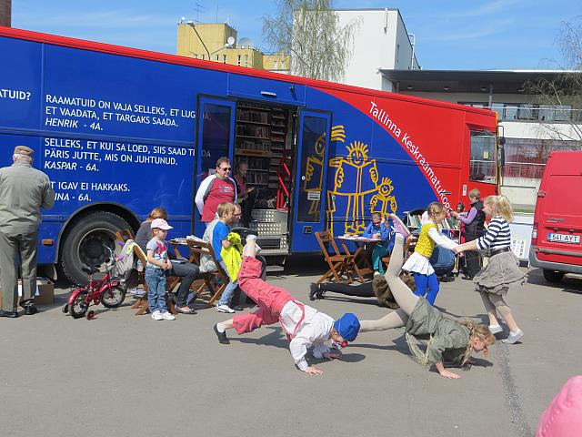
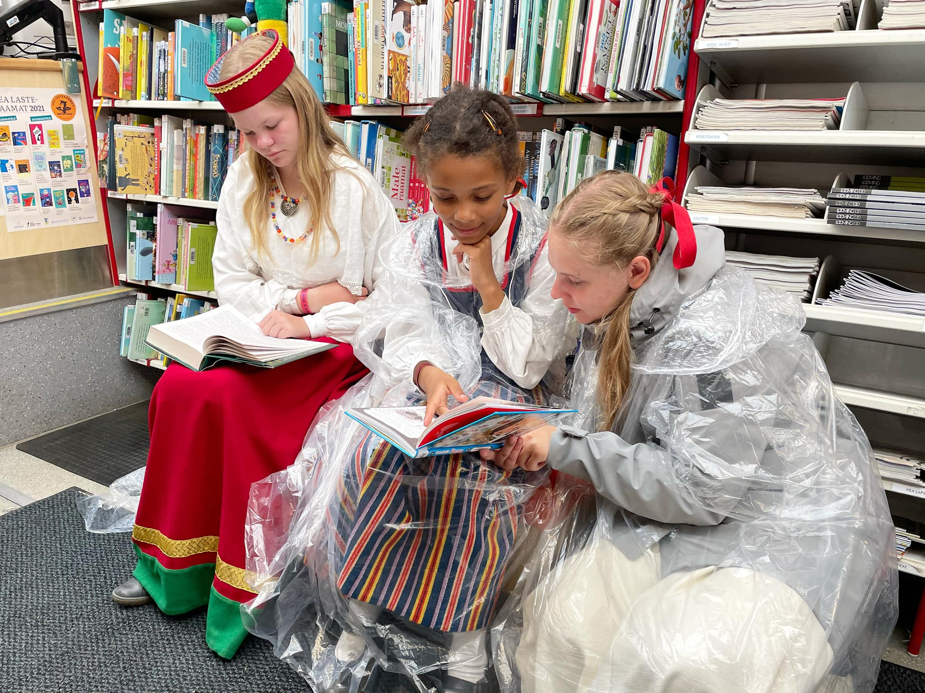
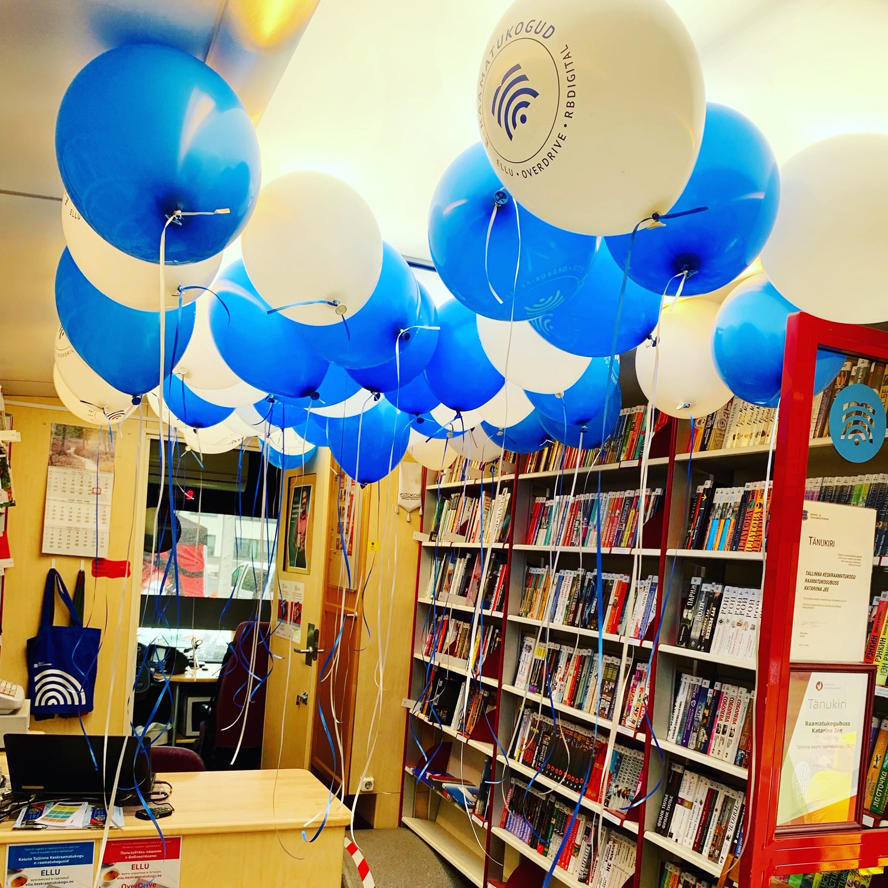
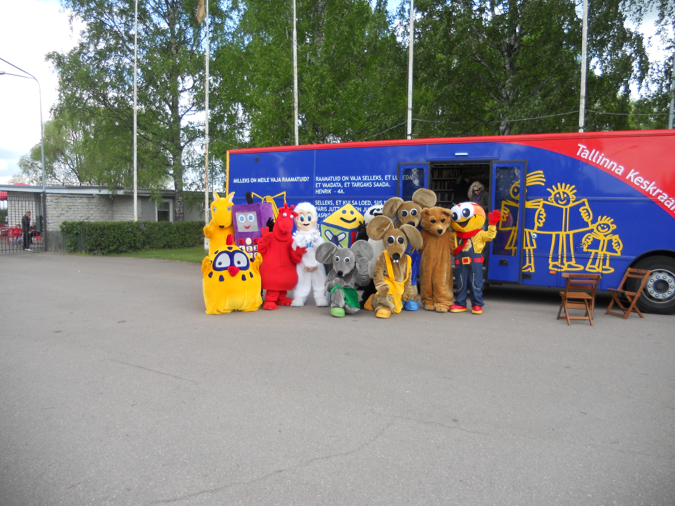
Events
Tallinn Maritime Days (3,000 visits)
Tallinn Old Town Days (2,000 visits)
Literary Street Festival (1,500)
Tallinn Zoo Birthday Celebrations (1,000)
June 1st , National Children’s Day (1,000)
Youth Song and Dance Festival (1,500)
Maarjamäe Community Fair (300)
Food Truck Festival (1,500)

Slide 16
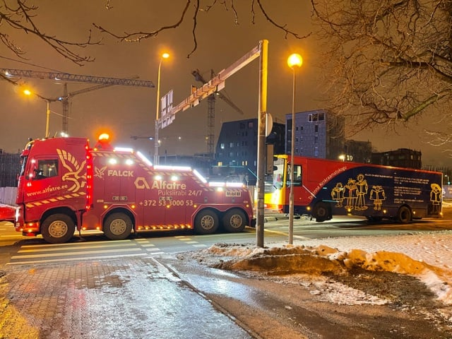
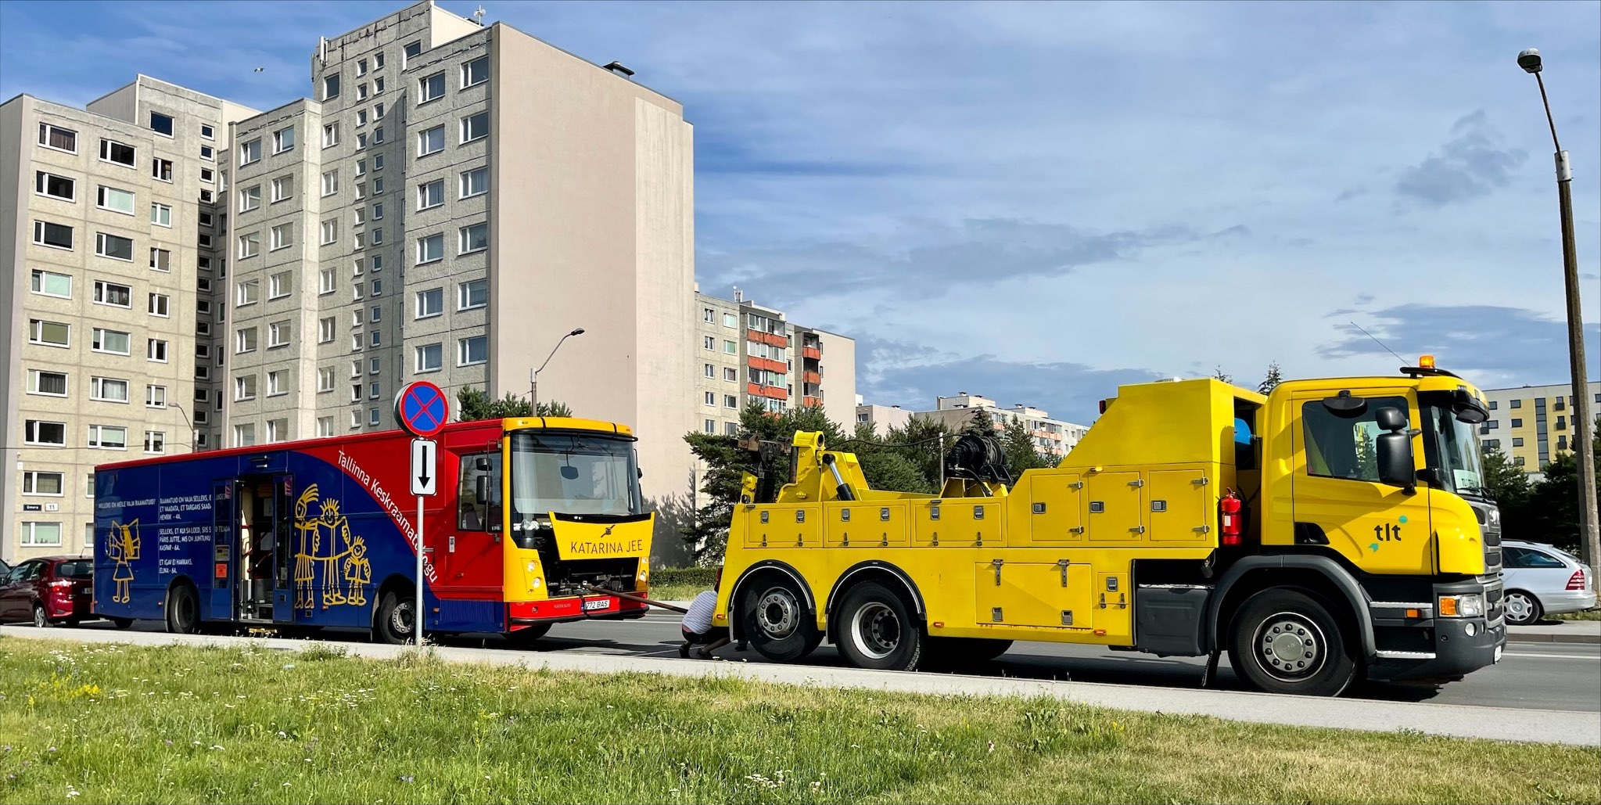

Slide 17
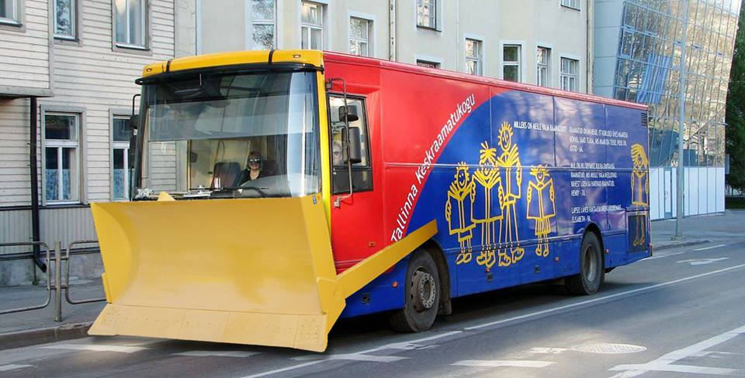
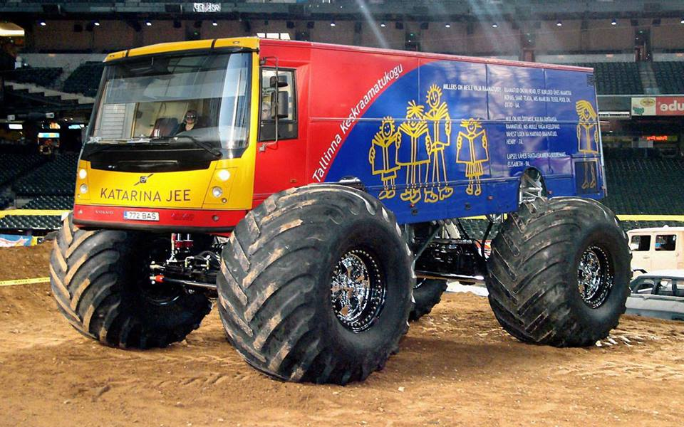
THE FUTURE!
Planned to be completed in 2024
1,000,000 euros
public procurement
Contest for the bus’ name
2 teams / 2 shifts?
More stops?

Slide 18
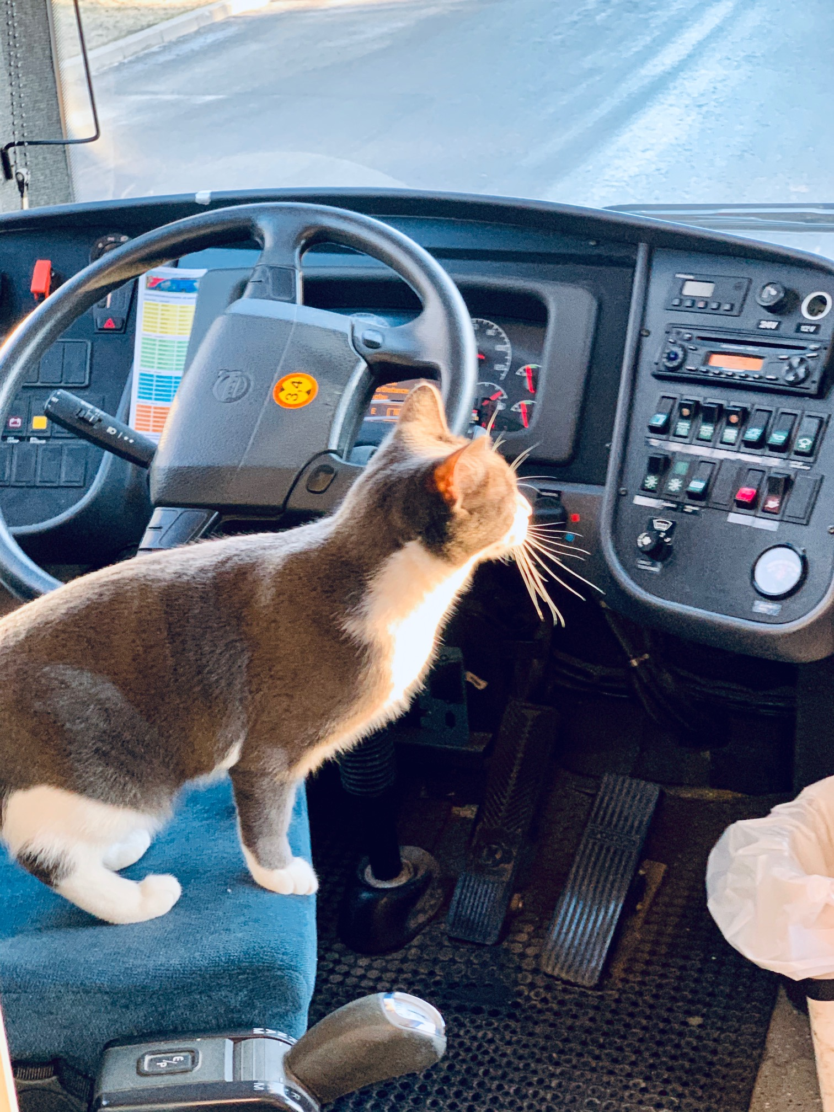
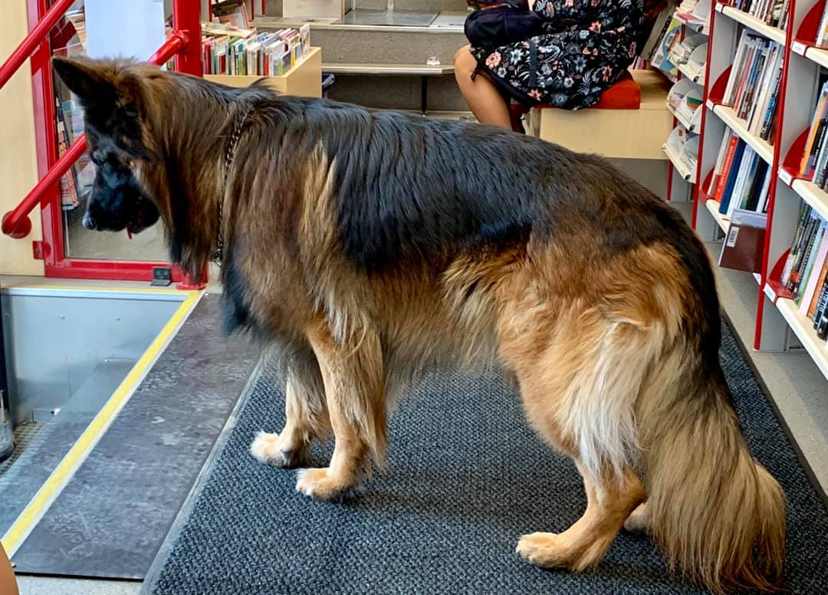
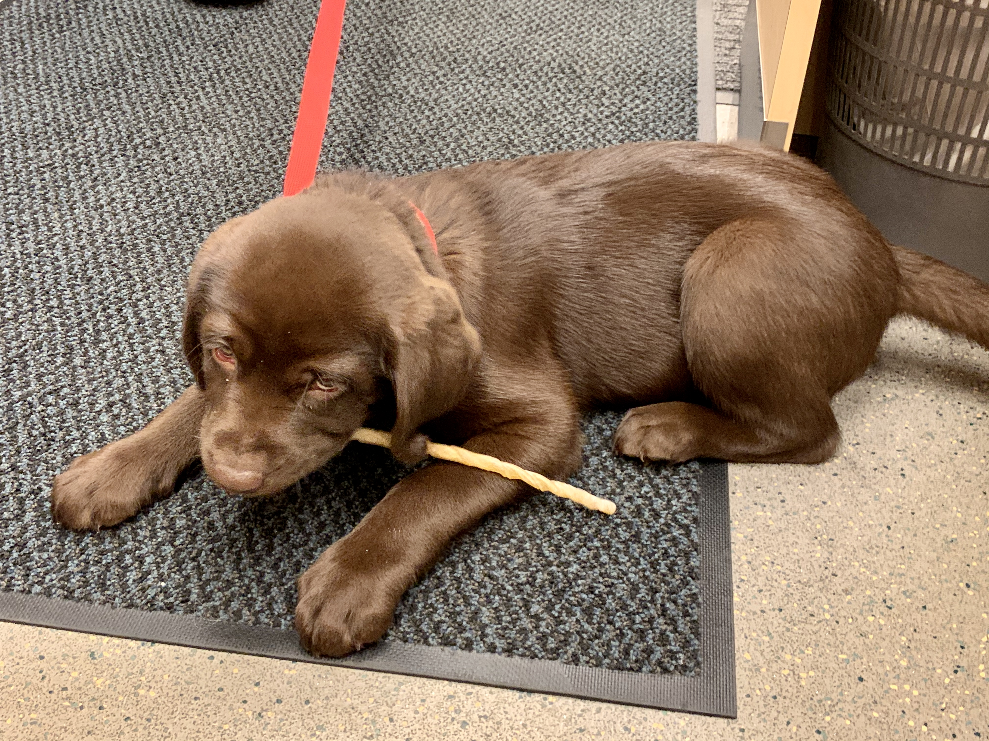
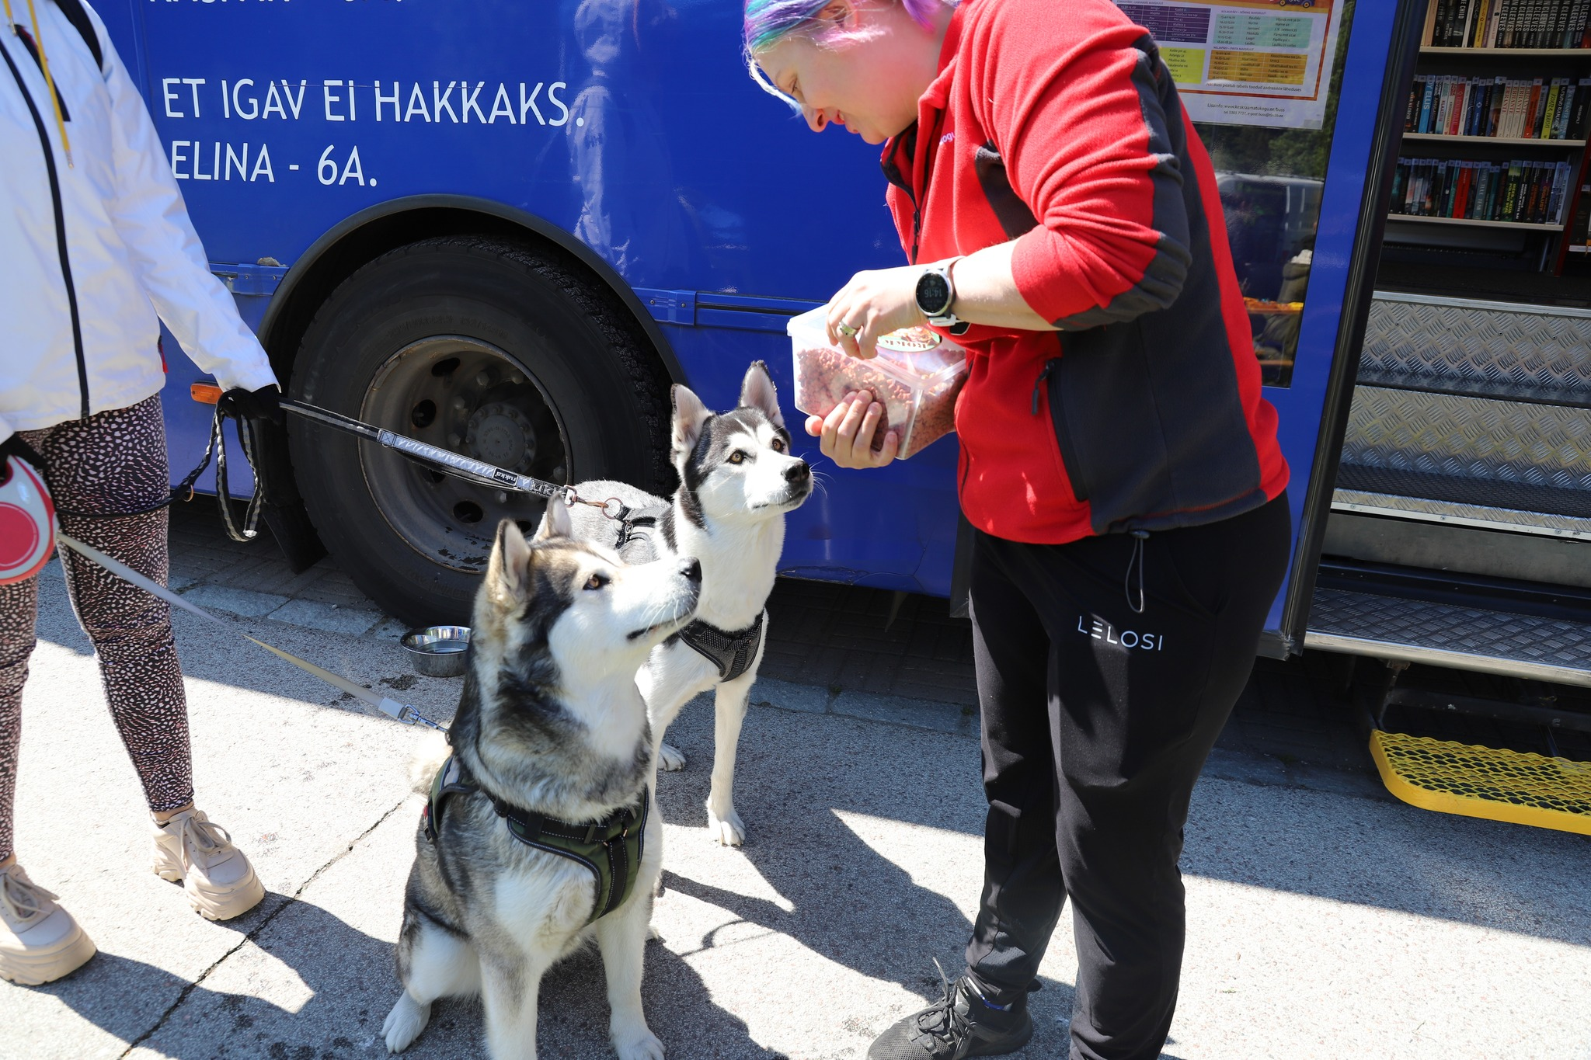
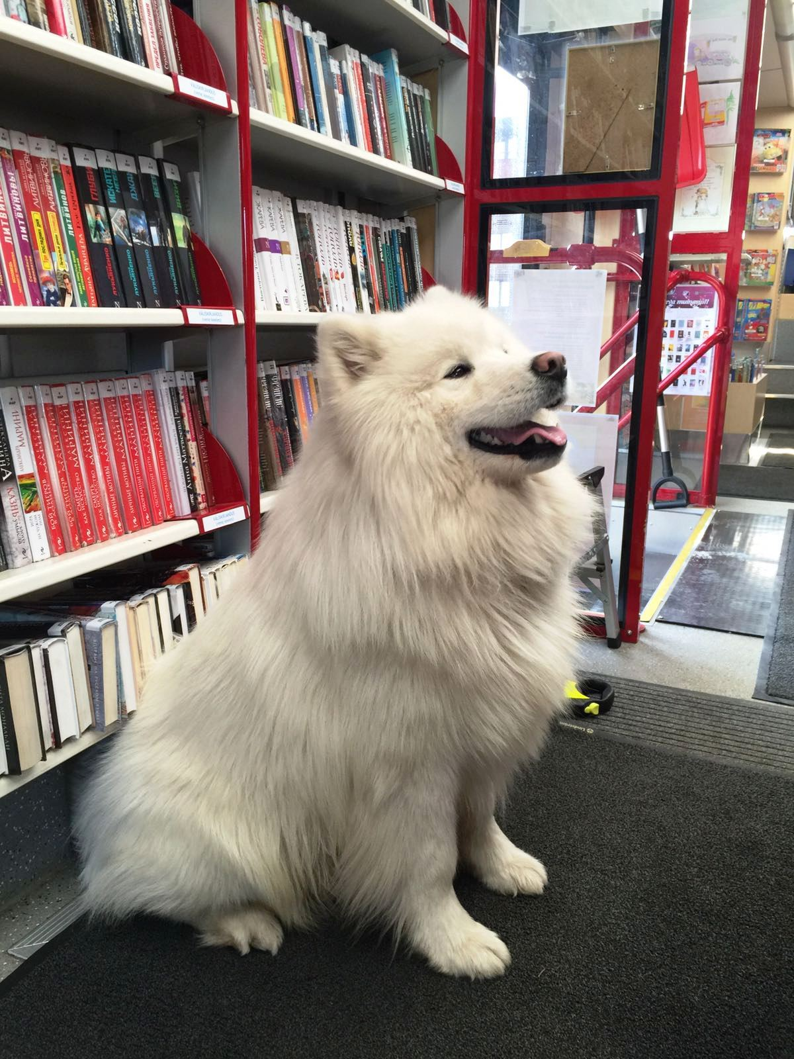
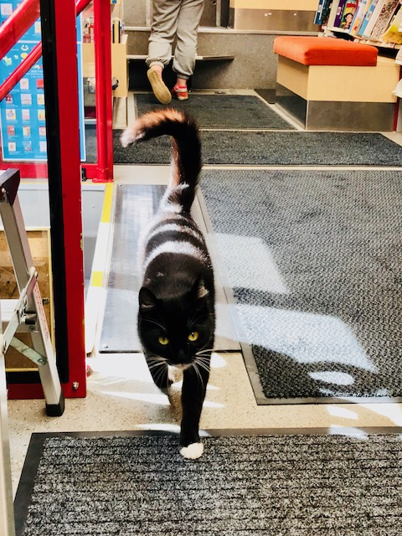
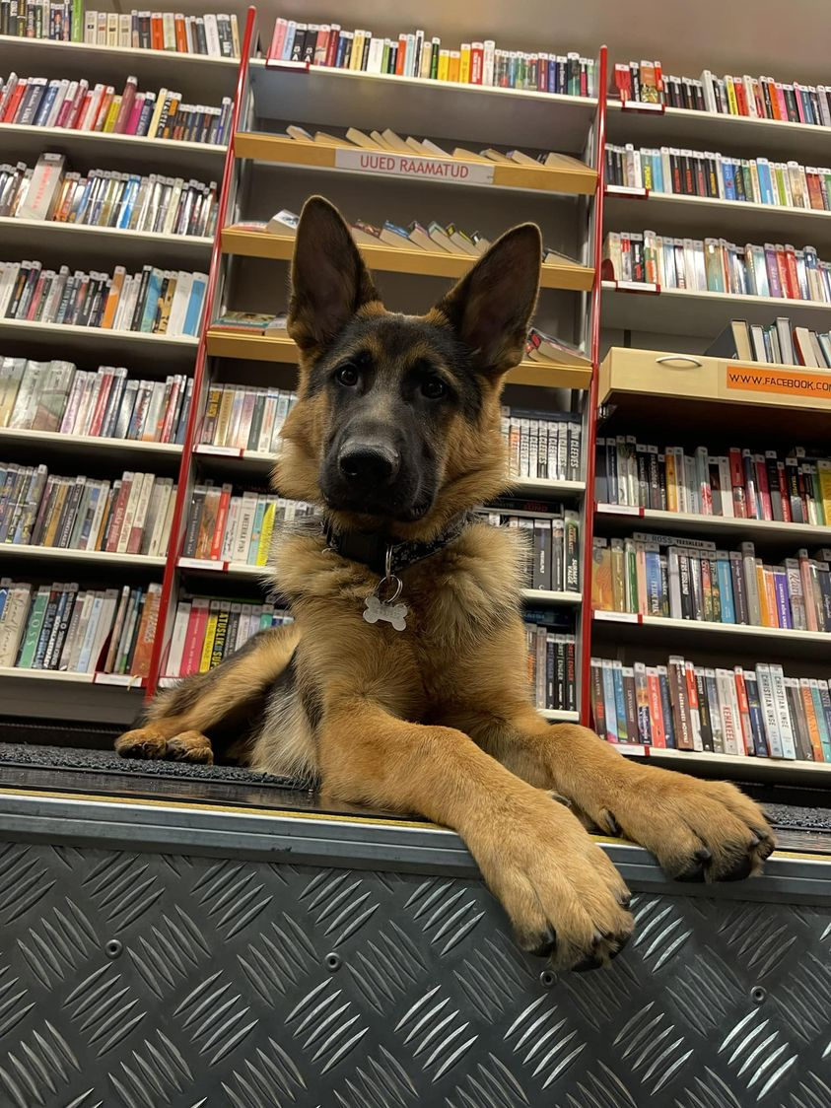
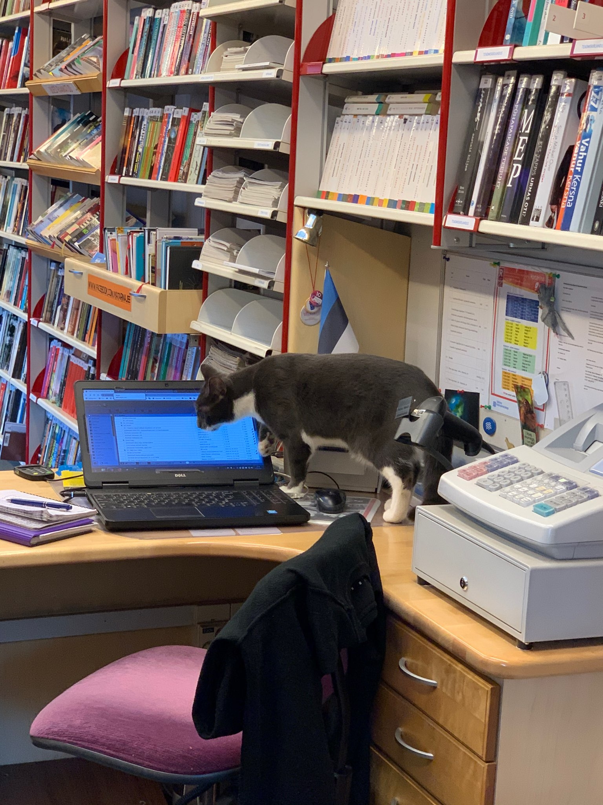
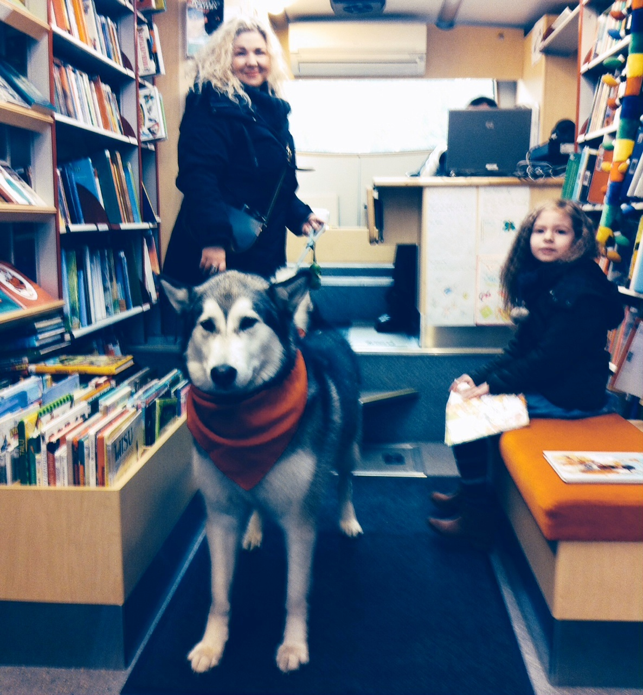
VERY SPECIAL VISITORS

Slide 19
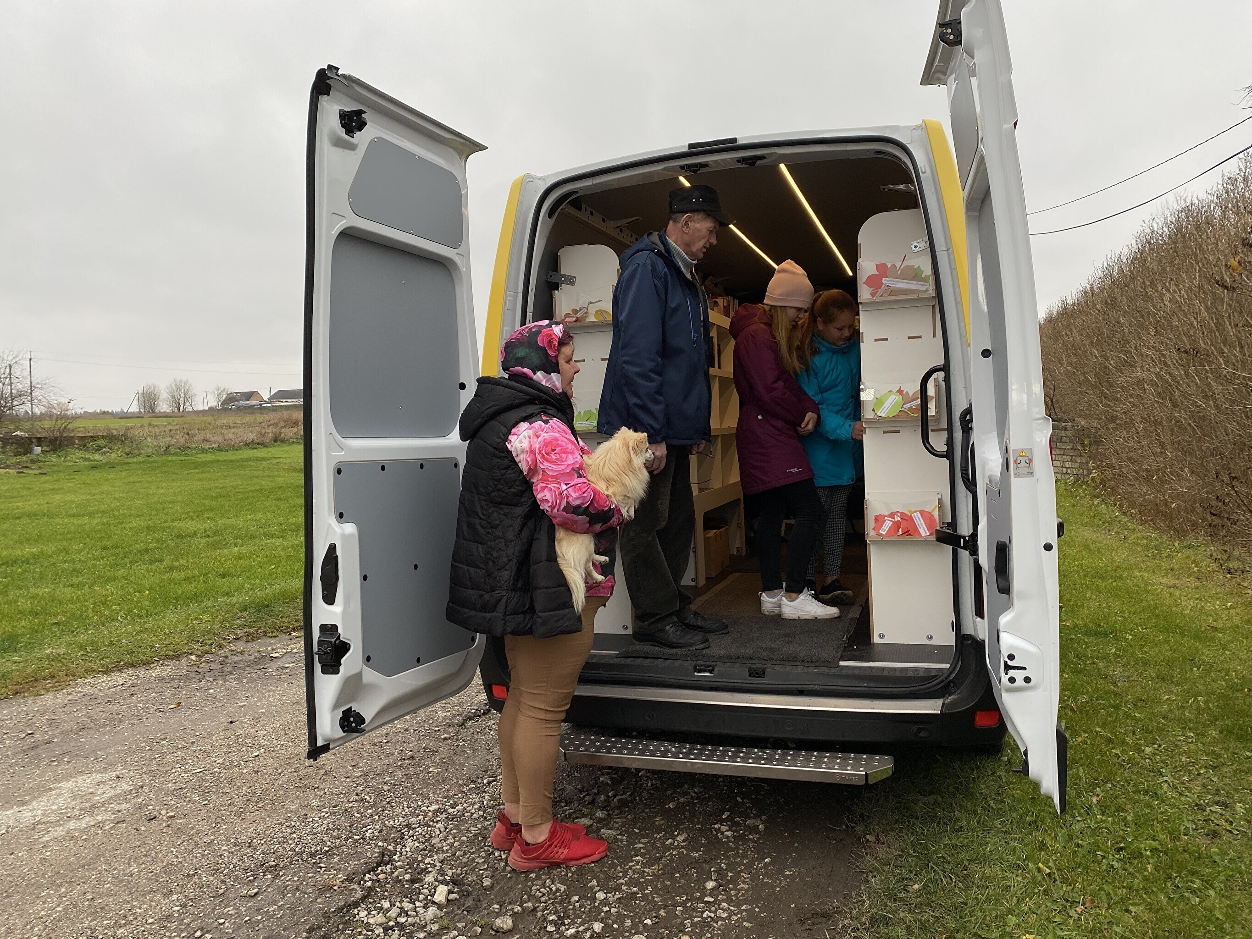
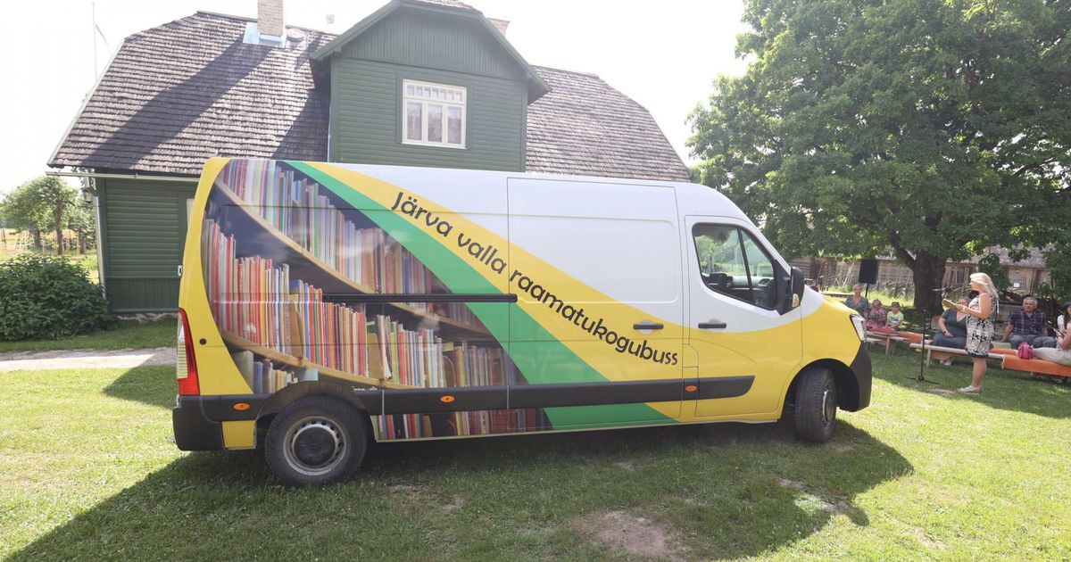
JÄRVA MUNICIPALITY LIBRARY BUS „KRÕÕT“
since 2021 (July 1st)
1,000 books
50 stops
145 patrons
4,500 visits
2,000 loans

Slide 20
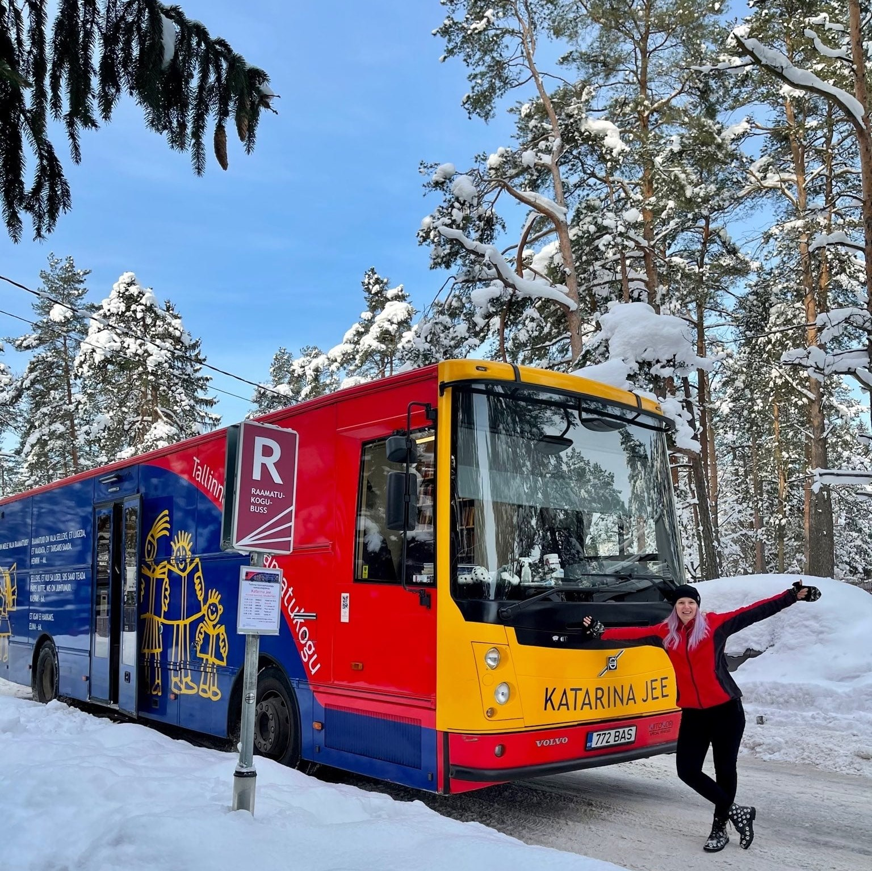
Thank You!
Questions? Comments? Contact Me
 | Annika.Marsh@tln.lib.ee
 | +372 5303 7737
 | linkedin.com/in/annikamarsh/
 | facebook.com/KatarinaJee

