Slide 1
Gothenburg
Mobile libraries with electric drive
Albin Berggren
Media pedagogue
Gothenburg City Library

Slide 3
600.000 Residents 29 Libraries and…

Slide 4
…Two mobile libraries

Slide 5
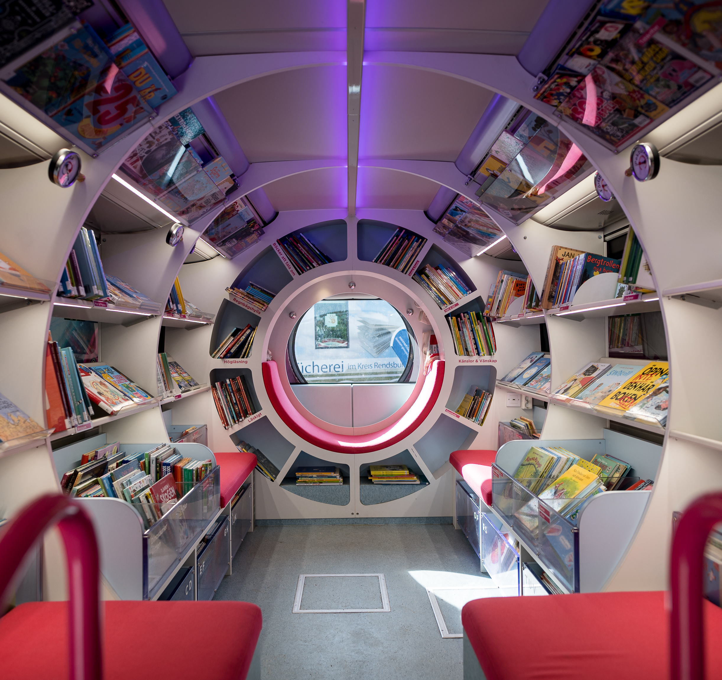
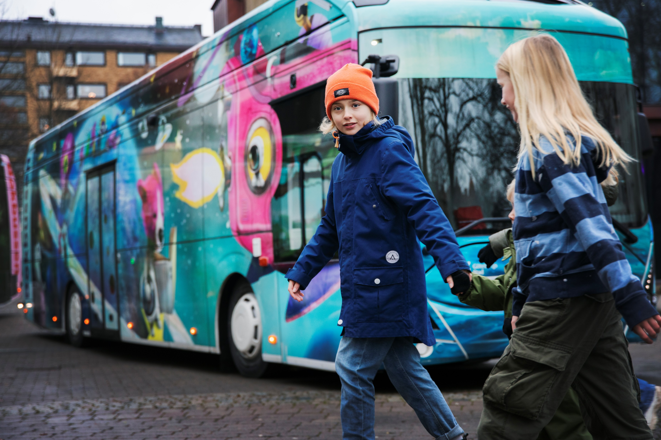
The Blue Bus
Ocean and spacecraft theme

Slide 6
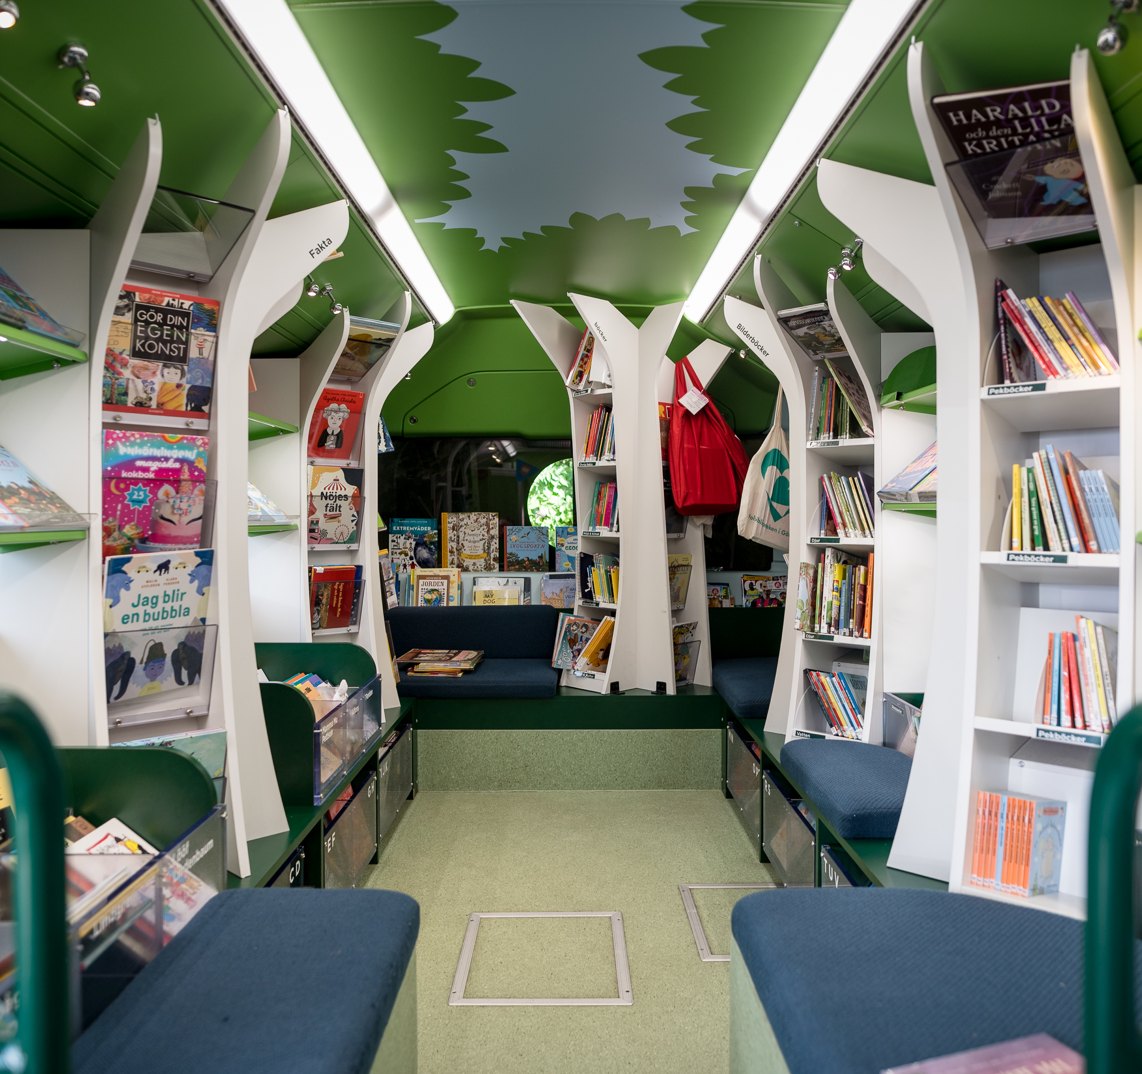
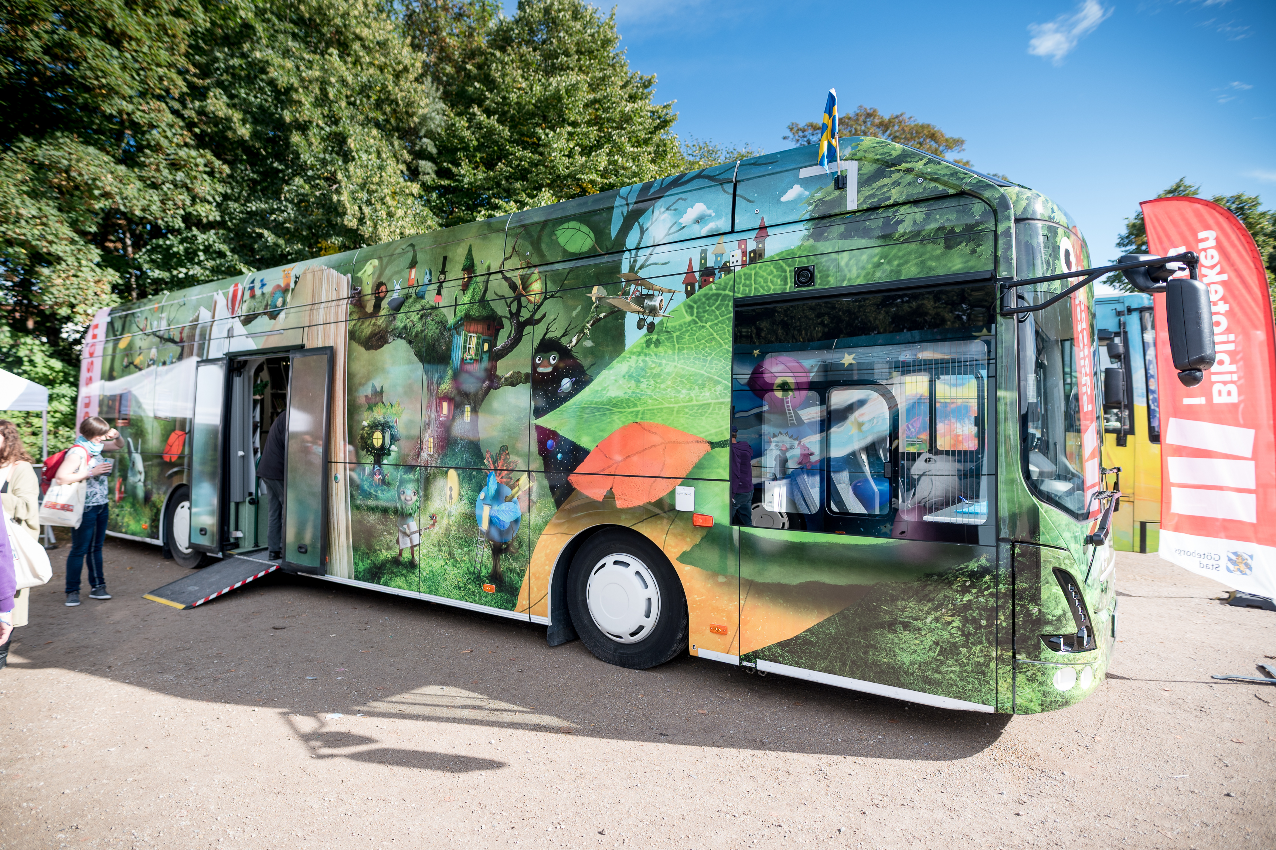
The Green Bus
Fairytale forest theme

Slide 7
User experience
The interior is focused more on the experience of the patrons, than the number of shelves and meters of books on them.

Slide 8
The operation

Slide 9
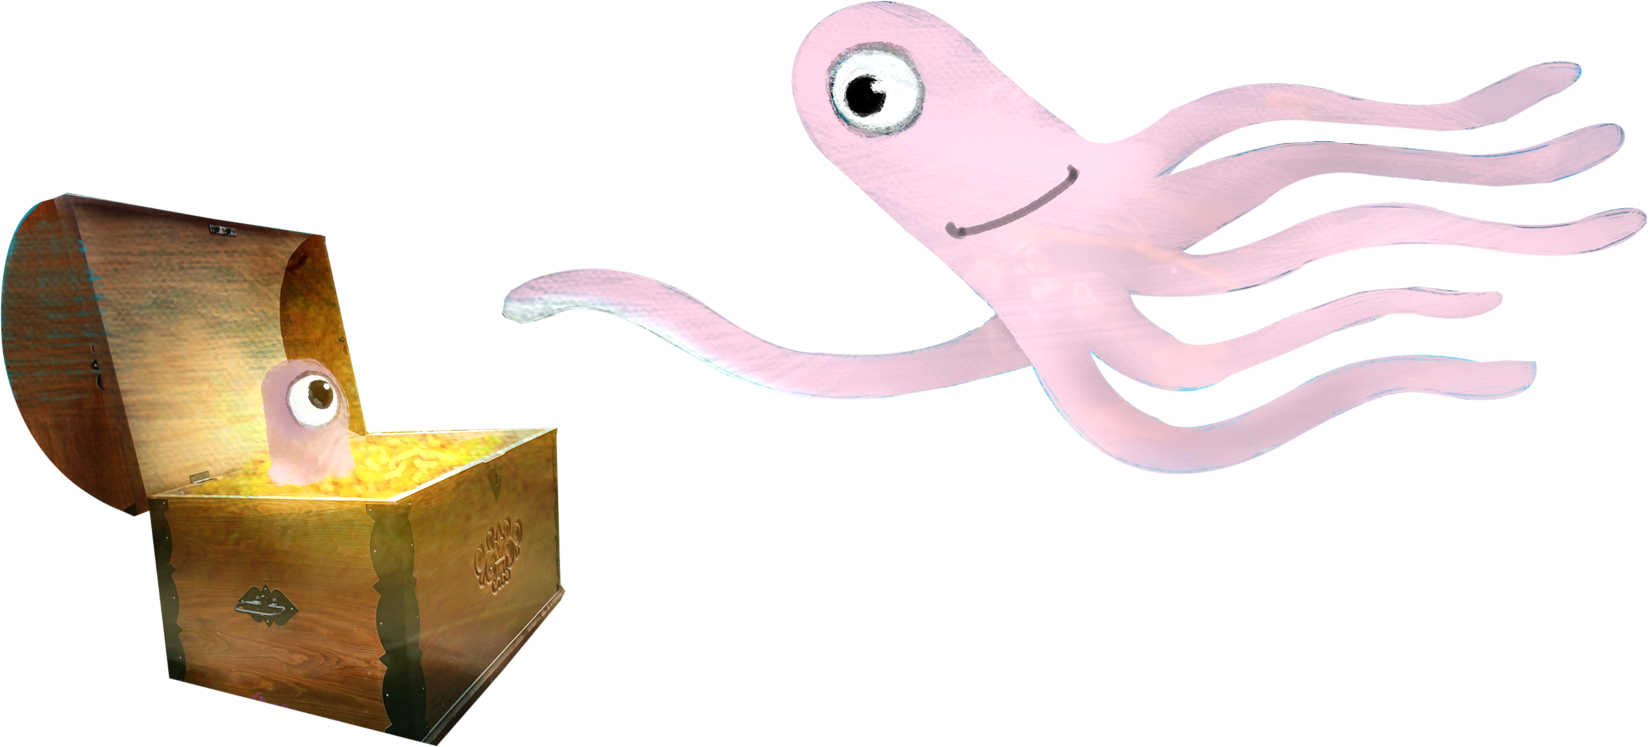
Preschools
Public stops
1) Preschools
Monday to Friday, About 400 preschool classes get a visit every month.
2) Public stops
Every day except Friday. 41 stops, every week. Which means 164 visits to 41 stops each month.
3) Popup stops
One bus every Saturday, at different locations around the city.
Popup stops

Slide 10
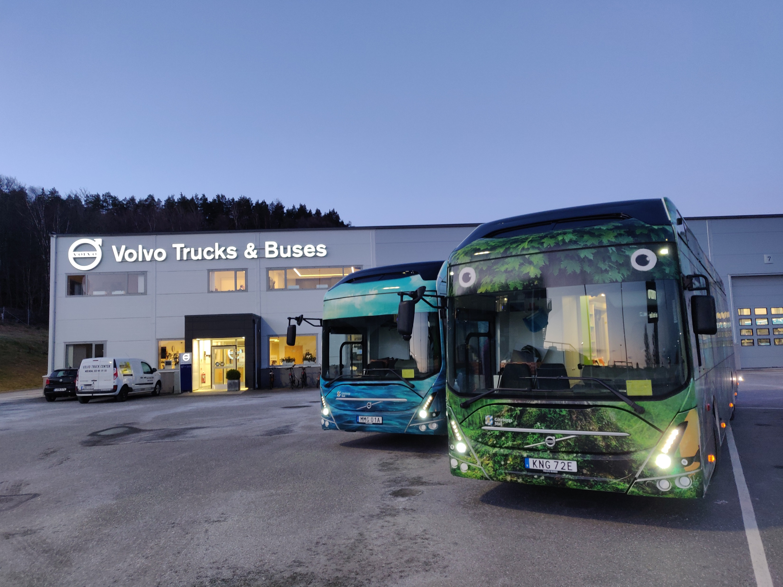
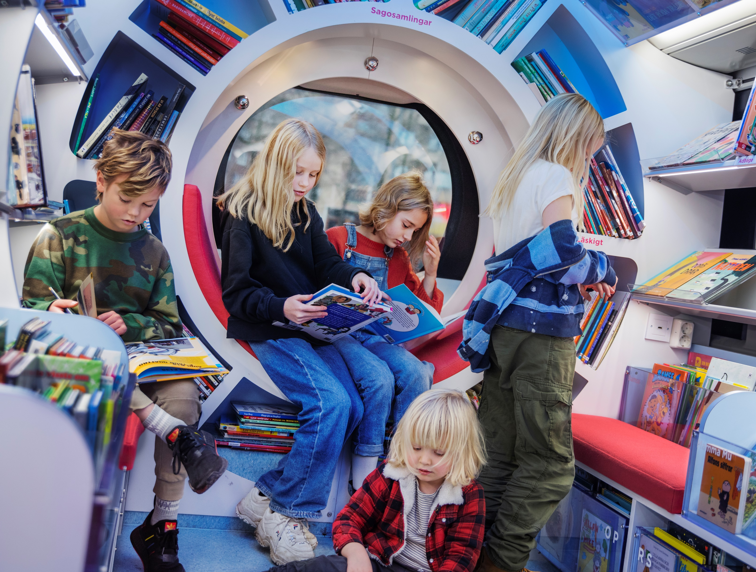
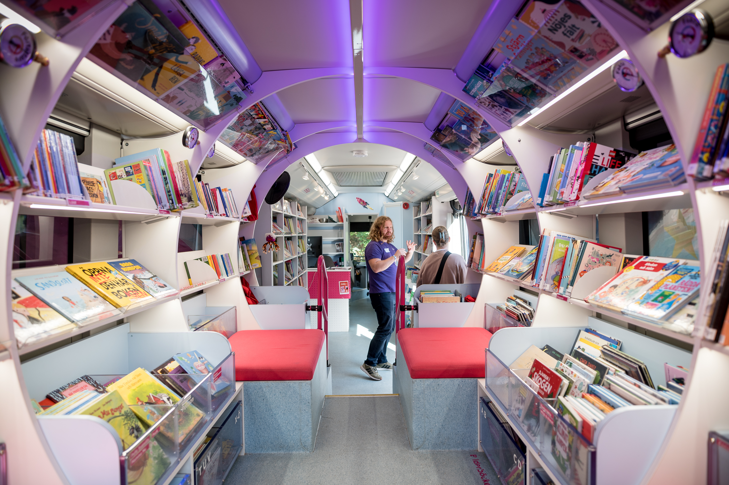
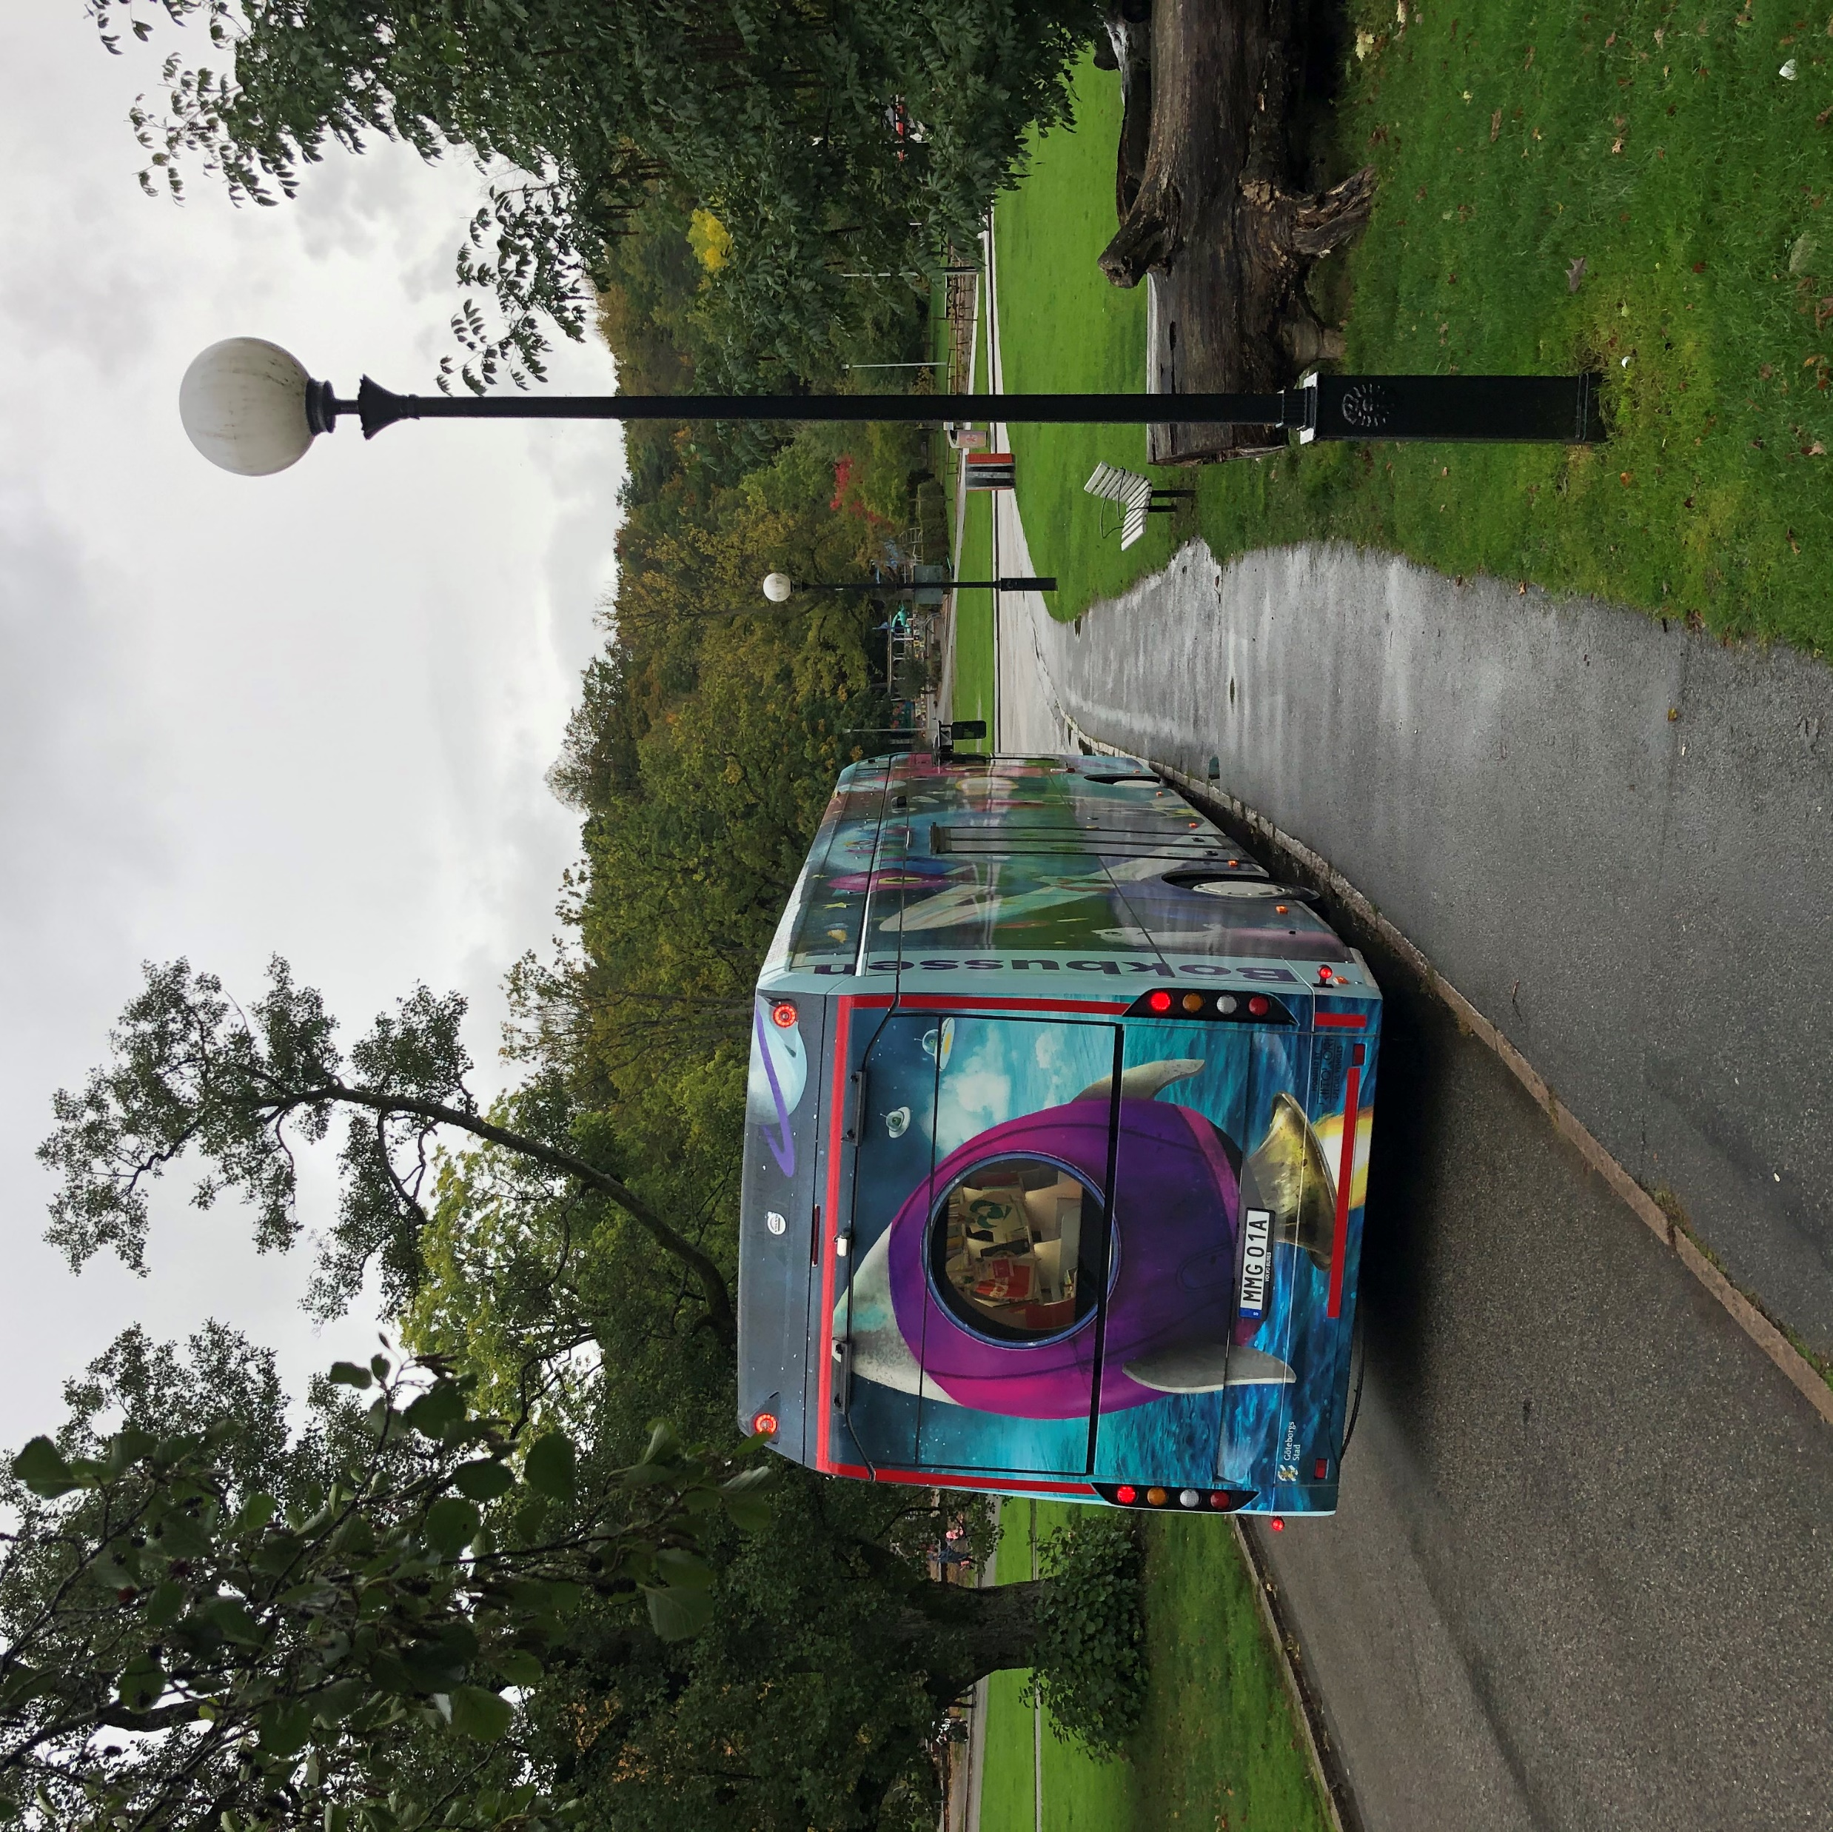
08.00
09.00-12.00
12.00-15.00
15.00-19.00
20.00
Pick up at Volvo
Preschool route
Back office service
Public stops
Return to Volvo
Return to Volvo
Beslut

Slide 11
Interacting with patrons

Slide 12
Website goteborg.se/bokbussen
Instagram @bokbussgbg
City Calendar
Library App ”Biblioteket”

Slide 13
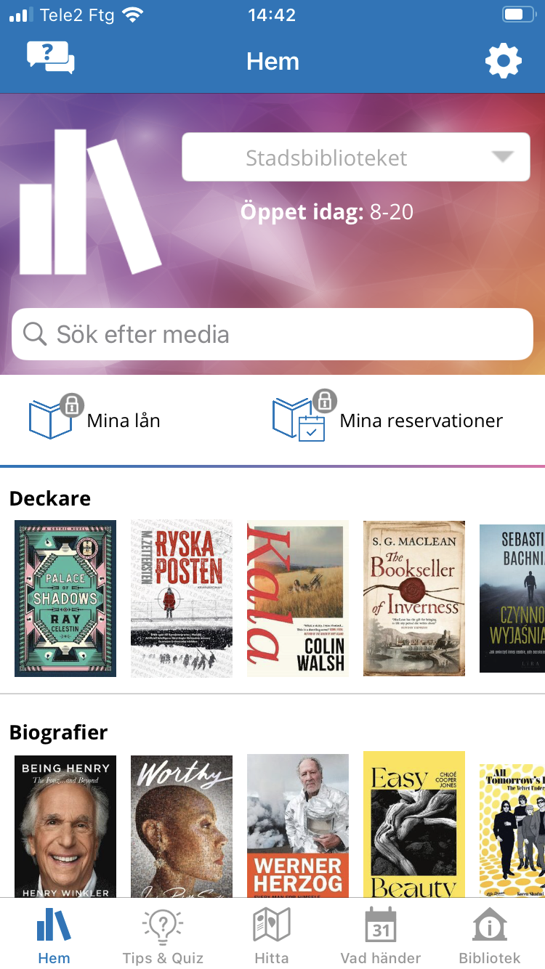
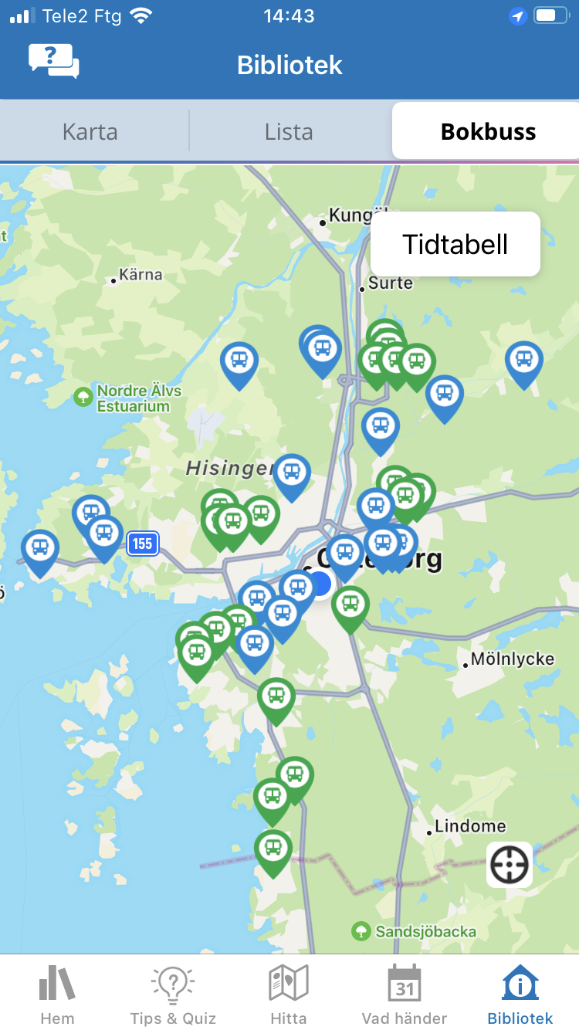
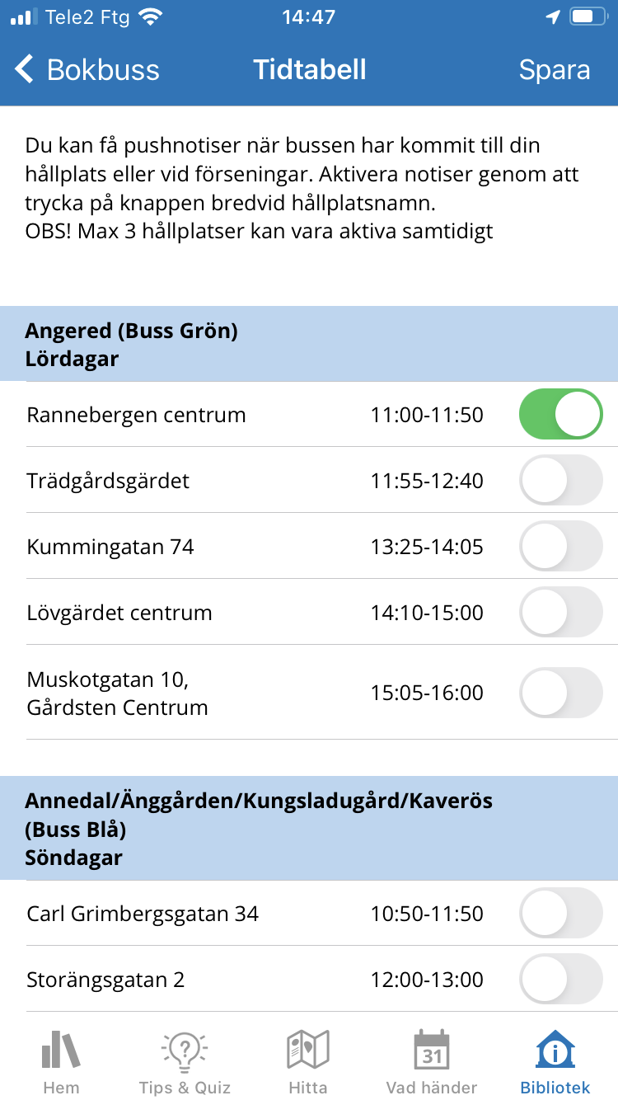
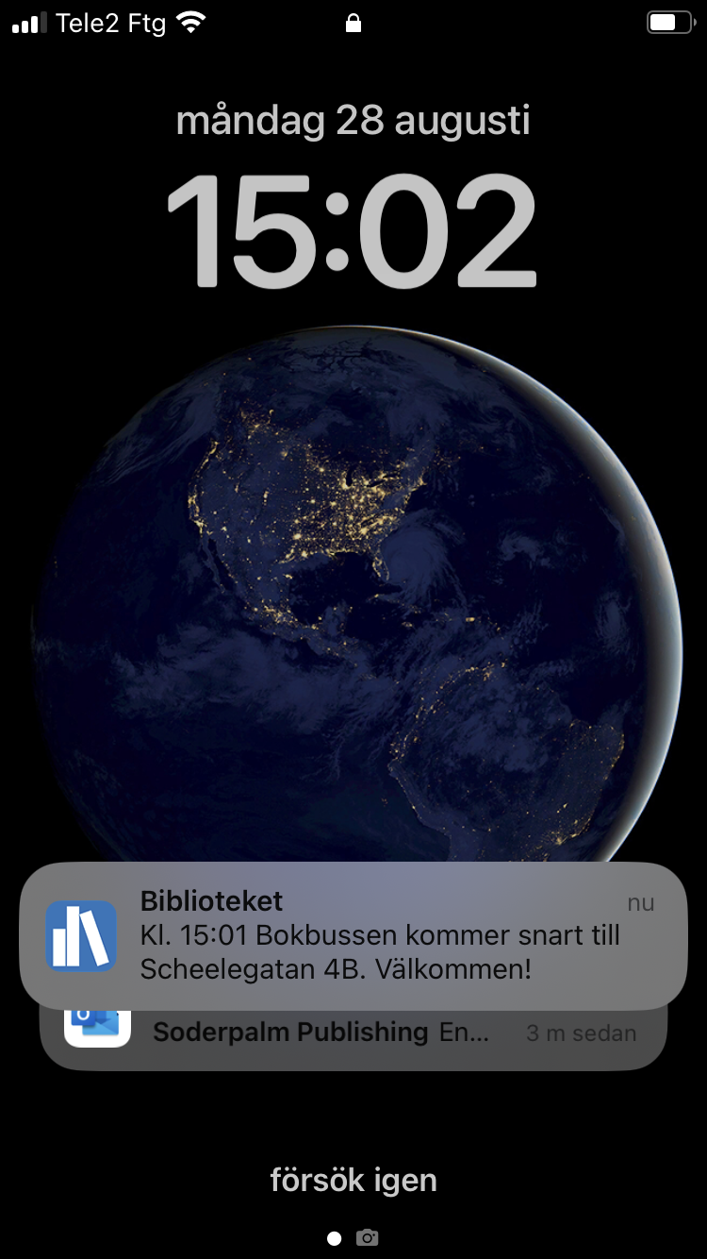
Library services
Positioning system
Push notifications

Slide 14
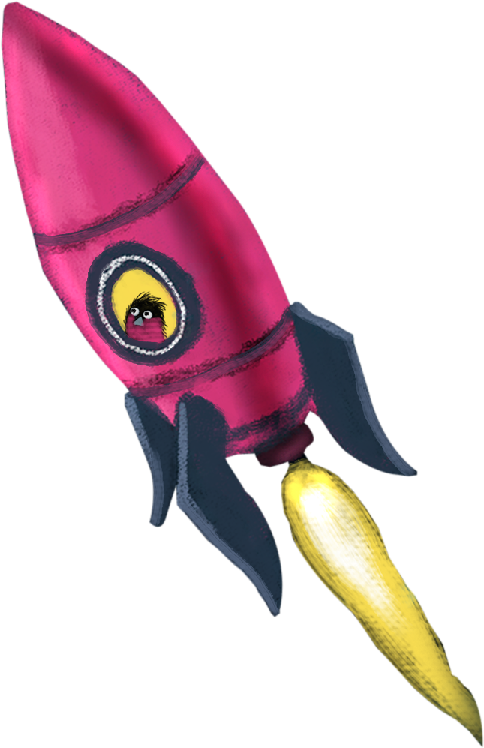
Pros
Cons
Zero emissions
Quiet
Comfortable driving
Low floor – accessibility
Able to power other equipment
- Expensive
- Limited routes
- Weight (19000 kg)
- Need of special infrastructure and maintenance

Slide 16
Contact
bokbuss@kultur.goteborg.se
goteborg.se/bokbussen
@bokbussgbg

